Slide 1

Arrival Time Picking---
wave-equation based traveltime seismic tomography
Reporter: Wang Dongdong
Department of Mathematical Science, Nanyang Technological University

Slide 2
The basic Arrival time picking methods
Manual arrival-picking
STA/LTA method
Envelop energy ratio method
Combined ray and cross-correlation method
Machine Learning……
Notes:
Manual arrival picking: time-consuming and labor intensive, but it is still a reliable/stable method; advanced method. We don’t introduce too much about the mechine learning method.

Slide 3
Manual Arrival Picking- An example for the PmP Picking
Southern California (1981-1994)
Low-pass filter the seismograms with a cutoff frequency 10 Hz.
Resample the records to a uniform sample rate of 100 Hz.
Select the P wave arrival with the largest STA/LTA for the time within 0.75s of the first arrival time (1D).
S/N:(rms): 0.5s window following the P arrival time / 0.5s window ending 1.0s before the P arrival time.
if the ratio < 3.0, then we discard it.
Normalize: / the largest value 0.2 s before and 0.5 s after the P arrival time.
Adjust the start time of seismograms to be zero at the P arrival time.
……
(Richards and Shearer, 1997)
Notes:
My following research focus on the PmP tomography for the whole California. The practical data is abundant. And the PmP phase is very emergent and difficult to pick. So, we have to set some standard to select reliable data. In this paper, they introduce several standards to pick the PmP arrival.
1:improve the signal noise ratio (SNR).2: resample. 3: Short term 4: rms (root mean square) less than // great
er than
;5:

Slide 4
Manual Arrival Picking- An example for the PmP Picking
The whole California (2000.1-2019.1)
The Magnitude: M. 3.0-5.0. A quality (< 1km horizontal and < 2km in depth).
Low-pass filter the seismograms with a cutoff frequency 10Hz and resample the records to a uniform
sample rate of 40Hz. A band-pass filter the records between 1-7Hz.
Using the 1D model to predict the first P-wave arrivals.
Discard the P-wave amplitude SNR > 10. S: 2s before and 3s after first P. N: 7s and 2s before first P.
Repick the first P-wave arrivals using the STA/LTA.
Adjust the start time of seismograms to be zero at the P arrival time and remain 2s before first P and
5s after first P. Epicentral distance (50-200km).
(From Li Tianjue’s notes)
Notes:
Time range is from 2000.1 to 2019.1.
1: error of the earthquake location is less than . greater than . 2 still resample. 3. we still use the 1D model to predict. 4. Discard. 5. STA divide LTA. 6. this can guarantee the epicenter distance from fifty to two hundard kilometer.

Slide 5
Manual Arrival Picking- An example for the PmP Picking
The whole California (2000.1-2019.1)
Predict the PmP-phase arrivals using 1D model while varying the Moho depth in it with a 1-km step
from 20 km to 36 km (hold all possible Moho depths).
Normalize: amplitudes near the predicted PmP are bigger than 0.7 and whose amplitude ratios of
the predicted PmP to first P are bigger than 2 and less than 7. The amplitude ratios of the separation
between first P and the predicted PmP to first P are required to be less than 1.
The first P-wave windows (0.1s before and 0.3s after the first P); separation window (0.05 s after first P
and 0.05s before the predicted PmP); PmP window (0.1s before and 0.3s after the predicted PmP).
(From Li Tianjue’s notes)
Notes:
7: means every time we increase 1 km as the Moho depth. 8:

Slide 6
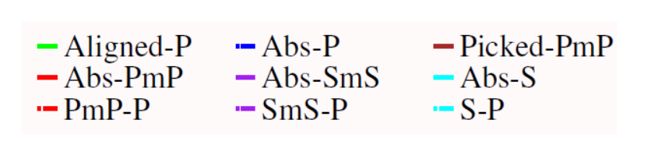
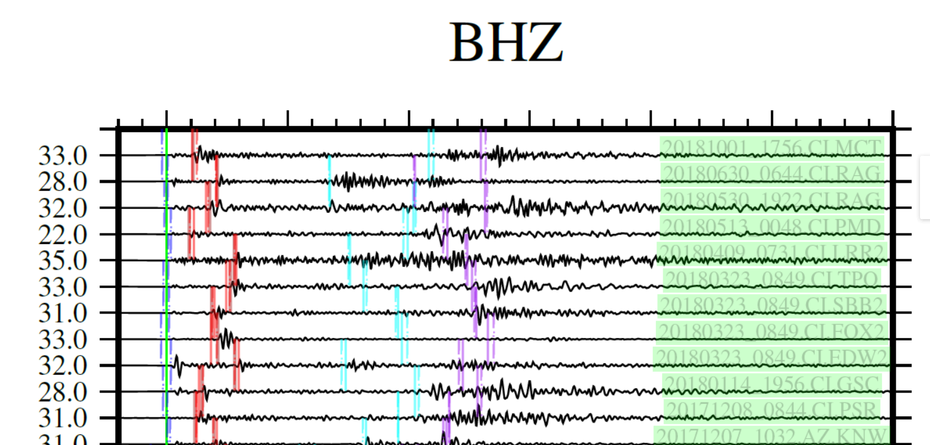
(From Li Tianjue’s notes)
Notes:
Sereval phases are picked by Li Tian Jue。 It is complex and careful work.

Slide 7
The basic Arrival time picking methods
Manual arrival-picking
STA/LTA method
Envelop energy ratio method
Combined ray and cross-correlation method
Machine Learning……

Slide 8
STA/LTA-method
Upper limit
STA:
Lower limit
Upper limit
LTA:
Lower limit
Energy Signal
Power Signal
(Munro, 2004)
(Wong et al., 2009)
Time window:
STA: > a few periods of the typically expected seismic signals.
LTA: > a few periods of the typically irregular seismic noise fluctuations.
Notes:
STA: short term average; LTA: long term average; known quantity, and unknown quantity. Onset time of the first arrive. Differential. Expression.

Slide 9
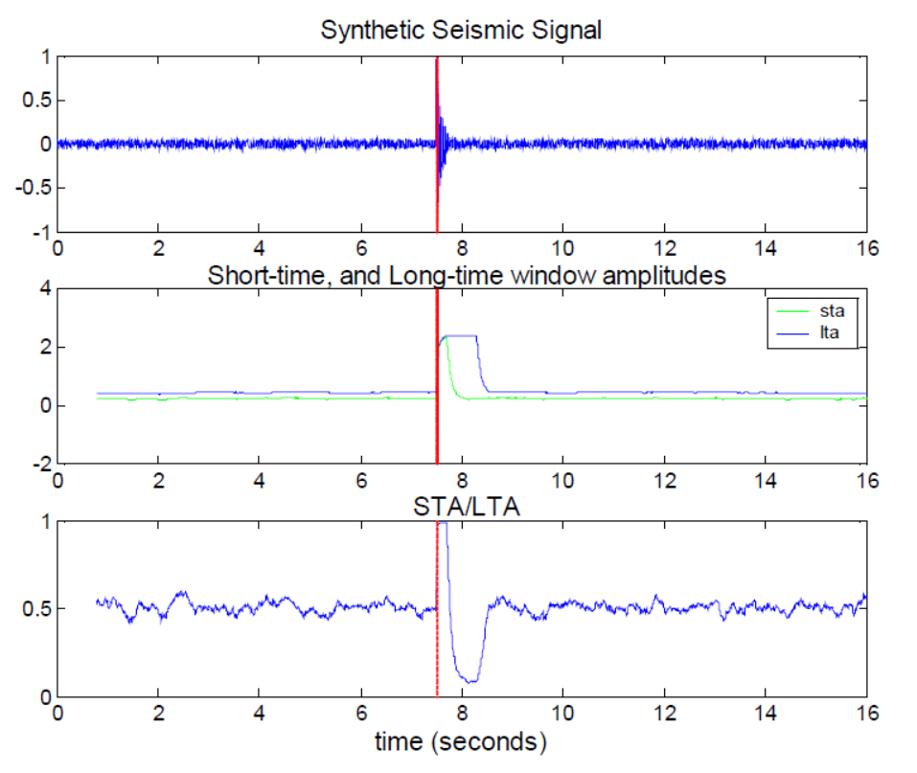
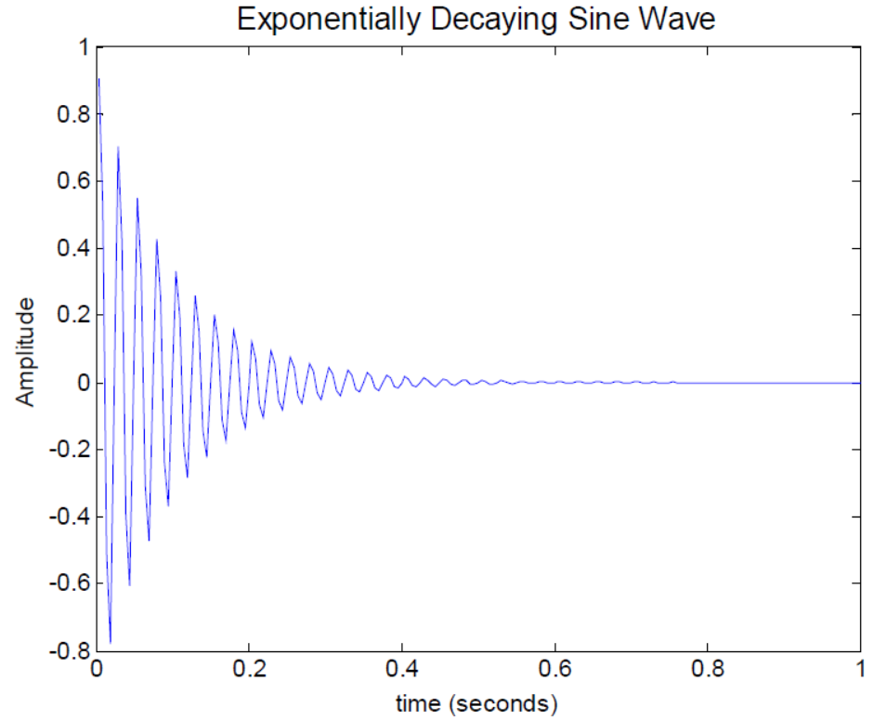
Time window---
STA: 0.3s
LTA: 0.8s
Threshold trigger value: 0.8
(Munro, 2004)
Notes:
Insert it at the time about 7.5 second. Short term average and long term average. And their ratio.. We notice that the time picked by this ratio method is very close to the actual arrival time.

Slide 10
The basic Arrival time picking methods
Manual arrival-picking
STA/LTA method
Envelop energy ratio method
Combined ray and cross-correlation method
Machine Learning……

Slide 11
Envelop energy ratio method
Window function
(Tong et al., 2014)
Notes:
Represent the Convolution . Forward or inverse

Slide 12
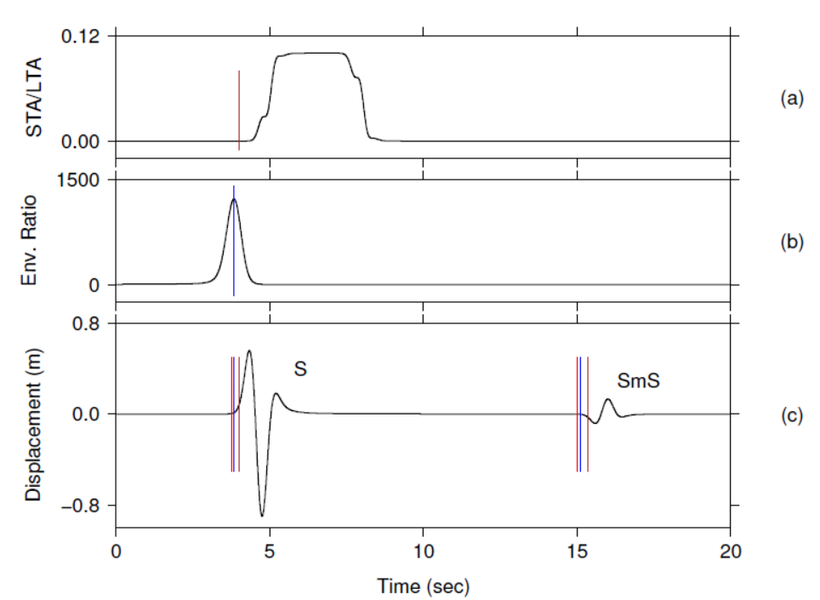
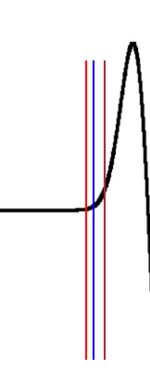
(Tong et al., 2014)
Notes:
EER method is very close to the theoretical arrival time. ENR Seems better than than STA/LTA method.

Slide 13
The basic Arrival time picking methods
Manual arrival-picking
STA/LTA method
Envelop energy ratio method
Combined ray and cross-correlation method
Machine Learning……
(Tong et al., 2014)

Slide 14
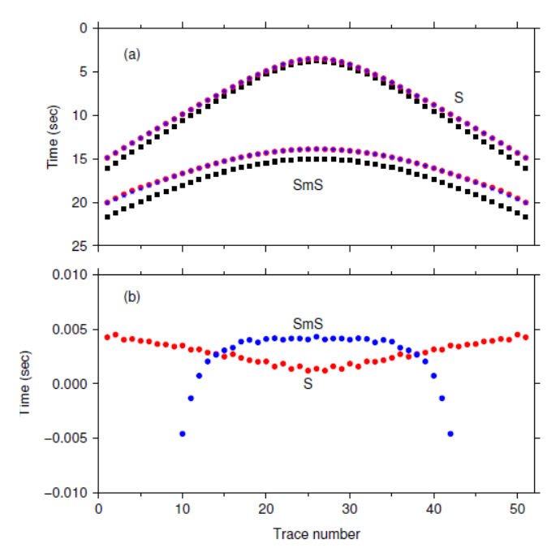
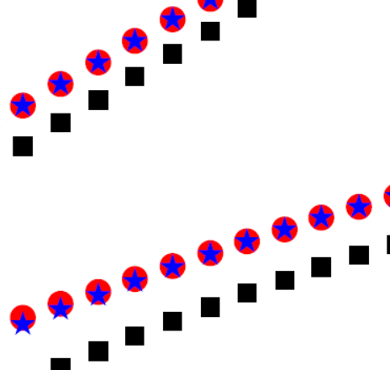
Combined ray and cross-correlation method
Ray method
Cross-correlation method
(Tong et al., 2014)
Notes:
Black square correspond to theoretical arrival time in M_0 ，the red circles--correspond to theoretical arrival time in M_1. The blue stars correspond to arrival time in Combined method.
This picture represents the errors for the Combined method. We can notice that this method can obtain acceptable results.

Slide 15
Thanks for your time and attention！
References
[1] Munro, K. . (2004). Automatic event detection and picking of p-wave arrivals. Crewes Report.
[2] Wong, J., Han, L., Bancroft, J., and Stewart, R., (2009). Automatic timepicking of first arrivals on
noisy microseismic data, CSEG.
[3] Tong, P., Zhao, D., Yang, D., Yang, X., Chen, J., & Liu, Q. (2014). Wave-equation-based travel-
time seismic tomography–Part 1: Method. Solid Earth, 5(2), 1151-1168.
[4] Richards‐Dinger, K. B., & Shearer, P. M. (1997). Estimating crustal thickness in southern
California by stacking PmP arrivals. Journal of Geophysical Research: Solid Earth, 102(B7),
15211-15224.

