Slide 1
Joint inversion of
surface wave dispersion and receiver function
Jiayuan Yao, 2020/04/17

Slide 2
Bodin, T., Sambridge, M., Tkalčić, H., Arroucau, P., Gallagher, K., & Rawlinson, N. (2012). Transdimensional inversion of receiver functions and surface wave dispersion. JGR: Solid Earth, 117(B2)
Shen, W., Ritzwoller, M. H., Schulte-Pelkum, V., & Lin, F. C. (2013). Joint inversion of surface wave dispersion and receiver functions: a Bayesian Monte-Carlo approach. GJl, 192(2), 807-836.

Slide 3
Outline
Introduction to the Bayesian inversion and Monte Carlo method
Transdimensional inversion
2.1 Model parameterization
2.2 Likelihood function
2.3 Prior distributions
2.4 Proposal distributions
2.5 Joint inversion
(not strict) Bayesian Monte Carlo inversion
3.1 Model parameterization
3.2 Likelihood function
3.3 Prior distributions
3.4 Proposal distributions
3.5 Joint inversion
Bodin et al., 2012, GJI
Shen et al., 2013, GJI

Slide 4
Probability basis
The union of two events A and B : $A∪B$
The intersection of two events A and B : $A∩B$
If A and B are two disjoint events, then $P\left(A∪B\right)=P\left(A\right)+P(B)$
If A and B are not necessarily disjoint, then $P\left(A∪B\right)=P\left(A\right)+P\left(B\right)−P(A∩B)$
$$P\left(A | B\right)=\frac{P(A∩B)}{P(B)}$$
Conditional probability :
Equivalently, $P\left(A∩B\right)=P\left(A | B\right)P(B)$
$$P\left(B | A\right)=\frac{P(B∩A)}{P(A)}$$
Equivalently, $P\left(B∩A\right)=P\left(B | A\right)P(A)$
$$P\left(B | A\right)=\frac{P\left(A | B\right)P(B)}{P\left(A\right)}$$
Bayes theorem :
A and B are said to be independent with respect to a probability distribution P( · ) if $P\left(A∩B\right)=P\left(A\right) P\left(B\right)$.
Then, $P\left(A | B\right)=P(A)$, $P\left(B | A\right)=P(B)$.
Tarantola, 2005

Slide 5
Probability basis
For any probability distribution P, there exists a positive function $f\left(x\right)$,
$P\left(A\right)=\int_{A}{f\left(x\right) dx}$
Where $f\left(x\right)$ is termed the probability density representing P (w.r.t. the given coordinate system)
If there is a change of coordinates, e.g., $x^{∗}=x^{∗}(x)$, and let ${f^{∗}(x}^{∗})$ be the probability density representing P in the new coordinates:
$$P\left(A\right)=\int_{A}{{f^{∗}(x}^{∗})dx^{∗}}$$
Jacobian rule : ${f^{∗}(x}^{∗})=f\left(x\right) \left|\frac{∂x}{∂x^{∗}}\right|$, where $\left|\frac{∂x}{∂x^{∗}}\right|$ represents the absolute value of the Jacobian of the transformation.
Tarantola, 2005

Slide 6
Bayesian inversion
Joint prior PDF
A joint PDF
$$σ\left(d,m\right)=k\frac{ρ\left(d,m\right) Θ\left(d,m\right)}{μ\left(d,m\right)}$$
PDF: probability density function
Joint posterior PDF
Normalization constant
Homogeneous joint PDF
$σ\left(d,m\right)$ contains all available information on both observable data and a priori information on
model parameters,
$ρ\left(d,m\right)$describes all a priori information in the data and model space,
$Θ\left(d,m\right)$ describes the correlations and uncertainties of a particular physical theory connecting
model parameters and predicted data,
$μ\left(d,m\right)$ is the homogeneous joint PDF.
Tarantola, 2005

Slide 7
Bayesian inversion
Joint posterior PDF
Marginal PDF in the model space
$$σ\left(d,m\right)=k\frac{ρ\left(d,m\right) Θ\left(d,m\right)}{μ\left(d,m\right)}$$
$$σ\left(m\right)= \int{σ\left(d,m\right)dd}$$
Some usual assumptions:
$$Θ\left(d,m\right)=θ\left(d \right| m) μM\left(m\right)$$
A reasonable approximation for representing the physical theory relating the model parameters to the observable data
$$ρ\left(d,m\right)=ρD\left(d\right) ρM(m)$$
Information of observable data has been obtained independently of the prior information in the model space
$$μ\left(d,m\right)=μD\left(d\right) μM\left(m\right)$$
The homogeneous PDF
$$σ\left(m\right)= \int{σ\left(d,m\right)dd}=\int{k\frac{ρ\left(d,m\right) Θ\left(d,m\right)}{μ\left(d,m\right)}dd=k\int{\frac{ρD\left(d\right) ρM\left(m\right) θ\left(d \right| m) μM\left(m\right)}{μD\left(d\right) μM\left(m\right)}dd}}$$
$$=k ρM\left(m\right)\int{\frac{ρD\left(d\right) θ\left(d \right| m) }{μD\left(d\right)}dd=k ρM\left(m\right) L\left(m\right)}$$
$$( L\left(m\right)=\int{\frac{ρD\left(d\right) θ\left(d \right| m) }{μD\left(d\right)}dd} )$$
Tarantola, 2005
Likelihood function

Slide 8
Bayesian inversion
Marginal PDF in the model space
Likelihood function
$$L\left(m\right)=\int{\frac{ρD\left(d\right) θ\left(d \right| m) }{μD\left(d\right)}dd}$$
$$σ\left(m\right)=k ρM\left(m\right) L\left(m\right)$$
$ρM\left(m\right)$is the prior PDF describing our a priori knowledge on the model parameters
$L\left(m\right)$ is so-called likelihood function, which measures how well a particular model explains the data.
Three examples:
Negligible theoretical uncertainties
Negligible observational uncertainties
Gaussian theoretical and observational uncertainties
Tarantola, 2005

Slide 9
Bayesian inversion
Negligible theoretical uncertainties
$$θ\left(d \right| m)=δ(d−g\left(m\right))$$
where $d=g\left(m\right)$ denotes the (exact) resolution of the forward problem.
$$σ\left(m\right)=k ρM\left(m\right)\int{\frac{ρD\left(d\right) θ\left(d \right| m) }{μD\left(d\right)}dd}$$
$$=k ρM\left(m\right)\int{\frac{ρD\left(d\right) δ(d−g\left(m\right))}{μD\left(d\right)}dd}$$
$$=k ρM\left(m\right)\frac{ρD\left(g\left(m\right)\right)}{μD\left(g\left(m\right)\right)}$$
$$=\frac{k}{μD\left(g\left(m\right)\right)}ρM\left(m\right)ρD\left(g\left(m\right)\right)$$
$$=\frac{1}{ν}ρM\left(m\right)L\left(m\right)$$
$$L\left(m\right)=ρD\left(g\left(m\right)\right)$$
($ν$ is a normalization constant)
Tarantola, 2005

Slide 10
Bayesian inversion
Negligible observational uncertainties
$$ρD\left(d\right)=δ(d−dobs)$$
where $d=g\left(m\right)$ denotes the (exact) resolution of the forward problem.
$$σ\left(m\right)=k ρM\left(m\right)\int{\frac{ρD\left(d\right) θ\left(d \right| m) }{μD\left(d\right)}dd}$$
$$=k ρM\left(m\right)\int{\frac{δ(d−dobs)θ\left(d \right| m)}{μD\left(d\right)}dd}$$
$$=k ρM\left(m\right)\frac{θ\left(dobs\right| m)}{μD\left(dobs\right)}$$
$$=\frac{k}{μD\left(dobs\right)}ρM\left(m\right)θ\left(dobs\right| m)$$
Tarantola, 2005

Slide 11
Bayesian inversion
Gaussian theoretical and observational uncertainties
$$θ\left(d \right| m)∝exp⁡( −\frac{1}{2}(d−g\left(m)\right)T{ C}_{t}^{−1}(d−g\left(m\right)) )$$
$$ρD\left(d\right)∝exp⁡( −\frac{1}{2}\left(d−dobs\right)T{ C}_{d}^{−1} \left(d−dobs\right) )$$
$L\left(m\right)$ $∝exp⁡( −\frac{1}{2}(g\left(m)−dobs\right)T{ C}_{D}^{−1}(g\left(m\right)−dobs) )$
${ C}_{D}^{}={ C}_{d}^{}$+ ${ C}_{t}^{}$
$σ\left(m\right)$ $=k ρM\left(m\right)L\left(m\right)$
Further assuming that a priori information on the model parameters is also Gaussian
$$ρM\left(m\right)∝exp⁡( −\frac{1}{2}\left(m−mprior\right)T{ C}_{M}^{−1} \left(m−mprior\right) )$$
Then
$$σ\left(m\right)∝exp⁡( −\frac{1}{2}( (g\left(m)−dobs\right)T{ C}_{D}^{−1}(g\left(m\right)−dobs)+\left(m−mprior\right)T{ C}_{M}^{−1} \left(m−mprior)\right) )$$
Tarantola, 2005

Slide 12
Bayesian inversion
Negligible theoretical uncertainties
$$θ\left(d \right| m)=δ(d−g\left(m\right))$$
where $d=g\left(m\right)$ denotes the (exact) resolution of the forward problem.
$$L\left(m\right)=ρD\left(g\left(m\right)\right)$$
Assuming Gaussian observational uncertainties and Gaussian prior of model parameters, then
$$ρD\left(d\right)∝exp⁡( −\frac{1}{2}\left(d−dobs\right)T{ C}_{d}^{−1} \left(d−dobs\right) )$$
$$ρM\left(m\right)∝exp⁡( −\frac{1}{2}\left(m−mprior\right)T{ C}_{M}^{−1} \left(m−mprior\right) )$$
$$L\left(m\right)∝exp⁡( −\frac{1}{2}\left(g\left(m\right)−dobs\right)T{ C}_{d}^{−1} \left(g\left(m\right)−dobs\right) )$$
$σ\left(m\right)$ $=k ρM\left(m\right) L\left(m\right)∝exp⁡( −\frac{1}{2}( (g\left(m)−dobs\right)T{ C}_{d}^{−1}(g\left(m\right)−dobs)+\left(m−mprior\right)T{ C}_{M}^{−1} \left(m−mprior)\right) )$
Tarantola, 2005

Slide 13
Bayesian inversion
Negligible theoretical uncertainties
Gaussian observational uncertainties
Uniform distribution for the prior of the model space or some other constrains
$$L\left(m\right)=ρD\left(g\left(m\right)\right)$$
$$ρD\left(d\right)=\frac{1}{\sqrt{\left(2π\right)n|{ C}_{d}^{}|}} exp⁡( −\frac{1}{2}\left(d−dobs\right)T{ C}_{d}^{−1} \left(d−dobs\right) )$$
$$ρM\left(m\right)$$
Thus,
$$σ\left(m\right)=k ρM\left(m\right) L\left(m\right)$$
$$L\left(m\right)=\frac{1}{\sqrt{\left(2π\right)n|{ C}_{d}^{}|}}exp⁡( −\frac{1}{2}S\left(m\right))$$
$$S\left(m\right)=\left(g\left(m\right)−dobs\right)T{ C}_{d}^{−1} \left(g\left(m\right)−dobs\right) )$$
Tarantola, 2005

Slide 14
Bayesian inversion
$$S\left(m\right)=\left(g\left(m\right)−dobs\right)T{ C}_{d}^{−1} \left(g\left(m\right)−dobs\right) )$$
$$L\left(m\right)=\frac{1}{\sqrt{\left(2π\right)n|{ C}_{d}^{}|}}exp⁡( −\frac{1}{2}S\left(m\right))$$
$$k= \frac{1}{\int_{M}{ρM\left(m\right) L\left(m\right)}}$$
High computation cost
$$σ\left(m\right)=k ρM\left(m\right) L\left(m\right)$$

Slide 15
Markov Chain Monte Carlo (MCMC) method
Monte Carlo (i.e., random) method means random method. E.g.,
MCMC, simulated annealing, very fast simulated annealing,
genetic algorithms, neighborhood algorithm etc.
$$S\left(m\right)=\left(g\left(m\right)−dobs\right)T{ C}_{d}^{−1} \left(g\left(m\right)−dobs\right) )$$
Markov Chain is a model chain in which the probability of each model depends only on the previous model.
Metropolis-Hastings algorithm
$$L\left(m\right)=\frac{1}{\sqrt{\left(2π\right)n|{ C}_{d}^{}|}}exp⁡( −\frac{1}{2}S\left(m\right))$$
Initialize by choosing a starting model m₀
Choose a new candidate m_{new} from a suitable proposal distribution q( . | m_{old}), that may depend on the previous model m_{old} of the chain
Accept the candidate with probability
$α\left(\text{m}\text{new} \text{|}\text{m}\text{old}\right)=\min\left(1, \frac{σ\left(\text{m}\text{new}\right) \text{q}\text{(}\text{m}\text{old} \text{|}\text{m}\text{n}\text{ew}\text{)}}{σ\left(\text{m}\text{old}\right) \text{q}\text{(}\text{m}\text{new}\text{|}\text{m}\text{old}\text{)}}\right)$
$=\min\left(1, \frac{ρM\left(\text{m}\text{new}\right) L\left(\text{m}\text{new}\right) \text{q}\text{(}\text{m}\text{old}\text{|}\text{m}\text{new}\text{)}}{ρM\left(\text{m}\text{old}\right) L\left(\text{m}\text{old}\right) \text{q}\text{(}\text{m}\text{new}\text{|}\text{m}\text{old}\text{)}}\right)$
If rejected, repeat the previous model in the chain.
Go back to step 2.
$$k= \frac{1}{\int_{M}{ρM\left(m\right) L\left(m\right)}}$$
High computation cost
$$σ\left(m\right)=k ρM\left(m\right) L\left(m\right)$$
Hastings, 1970

Slide 16
MCMC method v.s. Gradient-based method
Metropolis-Hastings algorithm
Gradient-based method
Initialize by choosing a starting model m₀
Choose a new candidate m_{new} from a suitable proposal distribution q( . | m_{old}), that may depend on the previous model m_{old} of the chain
Accept the candidate with probability
$α\left(\text{m}\text{new} \text{|}\text{m}\text{old}\right)=\min\left(1, \frac{σ\left(\text{m}\text{new}\right) \text{q}\text{(}\text{m}\text{old} \text{|}\text{m}\text{n}\text{ew}\text{)}}{σ\left(\text{m}\text{old}\right) \text{q}\text{(}\text{m}\text{new}\text{|}\text{m}\text{old}\text{)}}\right)$
$=\min\left(1, \frac{ρM\left(\text{m}\text{new}\right) L\left(\text{m}\text{new}\right) \text{q}\text{(}\text{m}\text{old}\text{|}\text{m}\text{new}\text{)}}{ρM\left(\text{m}\text{old}\right) L\left(\text{m}\text{old}\right) \text{q}\text{(}\text{m}\text{new}\text{|}\text{m}\text{old}\text{)}}\right)$
If rejected, repeat the previous model in the chain.
Go back to step 2.
Initialize by choosing a starting model m₀
Find model update direction p^{old} and step length $λold$ in the direction based on the misfit $S(\text{m}\text{old}\text{)}$and its gradient $\frac{∂S(\text{m}\text{old})}{∂\text{m}\text{old}}$
Update the model $\text{m}\text{new}=\text{m}\text{ol}\text{d}+λold \text{p}\text{old}$
If some criteria are satisfied, $\text{m}\text{new}$ is the optimal model.
Otherwise Go back to step 2.
Hastings, 1970
Tong, 2014, Solid Earth

Slide 17
MCMC method
Metropolis algorithm
Metropolis-Hastings algorithm
Initialize by choosing a starting model m₀
Choose a new candidate m_{new} from a suitable proposal distribution q( . | m_{old}), that may depend on the previous model m_{old} of the chain
Accept the candidate with probability
$α\left(\text{m}\text{new} \text{|}\text{m}\text{old}\right)=\min\left(1, \frac{σ\left(\text{m}\text{new}\right) }{σ\left(\text{m}\text{old}\right)}\right)$
$=\min\left(1, \frac{ρM\left(\text{m}\text{new}\right) L\left(\text{m}\text{new}\right) }{ρM\left(\text{m}\text{old}\right) L\left(\text{m}\text{old}\right)}\right)$
If rejected, repeat the previous model in the chain.
Go back to step 2.
Initialize by choosing a starting model m₀
Choose a new candidate m_{new} from a suitable proposal distribution q( . | m_{old}), that may depend on the previous model m_{old} of the chain
Accept the candidate with probability
$α\left(\text{m}\text{new} \text{|}\text{m}\text{old}\right)=\min\left(1, \frac{σ\left(\text{m}\text{new}\right) \text{q}\text{(}\text{m}\text{old} \text{|}\text{m}\text{n}\text{ew}\text{)}}{σ\left(\text{m}\text{old}\right) \text{q}\text{(}\text{m}\text{new}\text{|}\text{m}\text{old}\text{)}}\right)$
$=\min\left(1, \frac{ρM\left(\text{m}\text{new}\right) L\left(\text{m}\text{new}\right) \text{q}\text{(}\text{m}\text{old}\text{|}\text{m}\text{new}\text{)}}{ρM\left(\text{m}\text{old}\right) L\left(\text{m}\text{old}\right) \text{q}\text{(}\text{m}\text{new}\text{|}\text{m}\text{old}\text{)}}\right)$
If rejected, repeat the previous model in the chain.
Go back to step 2.
Symmetric proposal distribution q( . | m_{old})
General proposal distribution q( . | m_{old})
Metropolis, 1953
Hastings, 1970

Slide 18
Markov Chain
q( . | m_{old})
$$α\left(\text{m}\text{new} \text{|}\text{m}\text{old}\right)$$
m₁
m₂
m₃
m₄
m₅
m_{N-3}
m_{N-2}
m_{N-1}
m_{N}
A
R
A
A
R
…….
A
R
A
A
m₀
m₁
m₁
m₃
m₄
m₄
m_{N-3}
m_{N-3}
m_{N-1}
m_{N}
A: accept R: reject

Slide 19
Outline
Introduction to the Bayesian inversion and Monte Carlo method
Transdimensional inversion
2.1 Model parameterization
2.2 Likelihood function
2.3 Prior distributions
2.4 Proposal distributions
2.5 Joint inversion
(not strict) Bayesian Monte Carlo inversion
3.1 Model parameterization
3.2 Likelihood function
3.3 Prior distributions
3.4 Proposal distributions
3.5 Joint inversion
Bodin et al., 2012, GJI
Shen et al., 2013, GJI

Slide 20
MCMC method
Accept probability in Metropolis-Hastings algorithm
$$α\left(\text{m}\text{new} \text{|}\text{m}\text{old}\right)=\min\left(1, \frac{σ\left(\text{m}\text{new}\right) \text{q}\text{(}\text{m}\text{old} \text{|}\text{m}\text{n}\text{ew}\text{)}}{σ\left(\text{m}\text{old}\right) \text{q}\text{(}\text{m}\text{new}\text{|}\text{m}\text{old}\text{)}}\right)$$
$=\min\left(1, \frac{ρM\left(\text{m}\text{new}\right) L\left(\text{m}\text{new}\right) \text{q}\text{(}\text{m}\text{old}\text{|}\text{m}\text{new}\text{)}}{ρM\left(\text{m}\text{old}\right) L\left(\text{m}\text{old}\right) \text{q}\text{(}\text{m}\text{new}\text{|}\text{m}\text{old}\text{)}}\right)$
$$ρM\left(\text{m}\right)$$
$$L\left(\text{m}\right)$$
$$\text{q}\text{(} \text{.} \text{|}\text{m}\text{)}$$
$$L\left(m\right)=\frac{1}{\sqrt{\left(2π\right)n|{ C}_{d}^{}|}}exp⁡( −\frac{1}{2}S\left(m\right))$$
$$S\left(m\right)=\left(g\left(m\right)−dobs\right)T{ C}_{d}^{−1} \left(g\left(m\right)−dobs\right) )$$

Slide 21
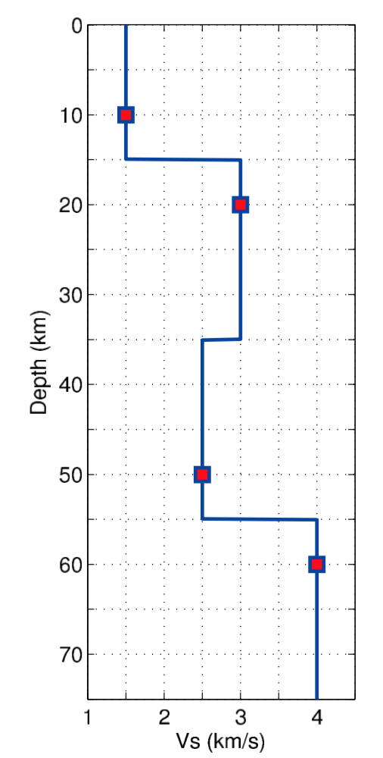
Model parameterization
v₁
Voronoi nuclei
c₁
v₂
c₂
A variable number (e.g., k) of Voronoi nuclei
The layer boundaries are defined as equidistant between adjacent nuclei
Each layer i (1..k) is determined by the depth c_{i} of its nucleus and by a shear wave velocity value v_{i}.
c₃
c₄
v₃
k=4
v₄
Bodin, 2012

Slide 22
Model parameterization
v₁
v_{new}
A variable number (e.g., k) of Voronoi nuclei
The layer boundaries are defined as equidistant between adjacent nuclei
Each layer i (1..k) is determined by the depth c_{i} of its nucleus and by a shear wave velocity value v_{i}.
Voronoi nuclei
c₁
v₂
c₂
c_{new}
c₃
c₄
v₃
Add a new layer with the depth of its nucleus to be 30 km (c_{new}) and by a shear wave velocity value 3.5 km/s (v_{new}).
k=4
v₄
Bodin, 2012

Slide 23
Model parameterization
v₁
A variable number (e.g., k) of Voronoi nuclei
The layer boundaries are defined as equidistant between adjacent nuclei
Each layer i (1..k) is determined by the depth c_{i} of its nucleus and by a shear wave velocity value v_{i}.
Voronoi nuclei
c₁
v₂
c₂
c₃
Remove layer 3
c₄
v₃
k=4
v₄
Bodin, 2012

Slide 24
Transdimensional inversion
The number of layers, i.e., the dimension of the model space is also a variable. Hence, the posterior becomes a transdimensional function.
It can be sampled with a generalization of the Metropolis-Hastings algorithm, termed as the reversible-jump MCMC (rj-MCMC).
The Accept probability in rj-MCMC is also a generalization of that in Metropolis-Hastings algorithm.
Bodin, 2012

Slide 25
Accept probability in rj-MCMC
Metropolis-Hastings algorithm
$$α\left(\text{m}\text{new} \text{|}\text{m}\text{old}\right)=\min\left(1, \frac{ρM\left(\text{m}\text{new}\right) L\left(\text{m}\text{new}\right) \text{q}\text{(}\text{m}\text{old}\text{|}\text{m}\text{new}\text{)}}{ρM\left(\text{m}\text{old}\right) L\left(\text{m}\text{old}\right) \text{q}\text{(}\text{m}\text{new}\text{|}\text{m}\text{old}\text{)}}\right)$$
rj-MCMC
$$α\left(\text{m}\text{new} \text{|}\text{m}\text{old}\right)=\min\left(1, \frac{ρM\left(\text{m}\text{new}\right) L\left(\text{m}\text{new}\right) \text{q}\text{(}\text{m}\text{old}\text{|}\text{m}\text{new}\text{)}}{ρM\left(\text{m}\text{old}\right) L\left(\text{m}\text{old}\right) \text{q}\text{(}\text{m}\text{new}\text{|}\text{m}\text{old}\text{)}}| J |\right)$$
Matrix J is the Jacobian of the transformation from $\text{m}\text{ol}\text{d}$ to $\text{m}\text{new}$ and is needed to account for the scale changes involved when the transformation involves a jump between dimensions
Bodin, 2012

Slide 26
rj-MCMC method
Accept probability
$$α\left(\text{m}\text{new} \text{|}\text{m}\text{old}\right)=\min\left(1, \frac{ρM\left(\text{m}\text{new}\right) L\left(\text{m}\text{new}\right) \text{q}\text{(}\text{m}\text{old}\text{|}\text{m}\text{new}\text{)}}{ρM\left(\text{m}\text{old}\right) L\left(\text{m}\text{old}\right) \text{q}\text{(}\text{m}\text{new}\text{|}\text{m}\text{old}\text{)}}| J |\right)$$
$$ρM\left(\text{m}\right)$$
$$L\left(\text{m}\right)$$
$$\text{q}\text{(} \text{.} \text{|}\text{m}\text{)}$$
Jacobian
$$L\left(m\right)=\frac{1}{\sqrt{\left(2π\right)n|{ C}_{d}^{}|}}exp⁡( −\frac{1}{2}S\left(m\right))$$
$$S\left(m\right)=\left(g\left(m\right)−dobs\right)T{ C}_{d}^{−1} \left(g\left(m\right)−dobs\right) )$$
Bodin, 2012

Slide 27
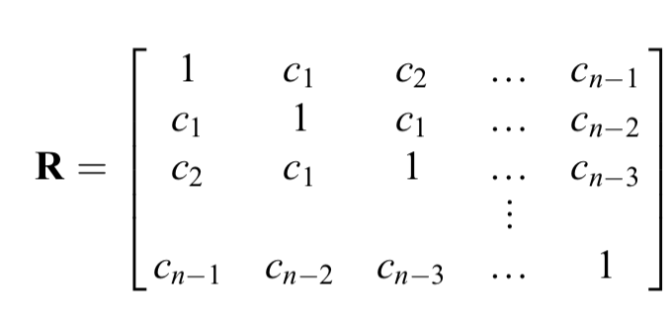
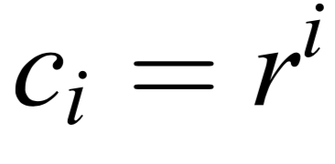
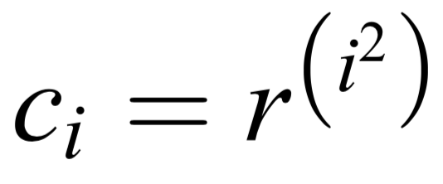
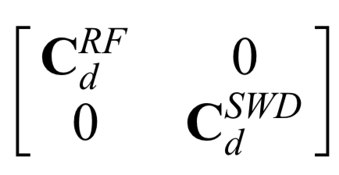
Likelihood function
$$L\left(m\right)=\frac{1}{\sqrt{\left(2π\right)n|{ C}_{d}^{}|}}exp⁡( −\frac{1}{2}S\left(m\right))$$
$$S\left(m\right)=\left(g\left(m\right)−dobs\right)T{ C}_{d}^{−1} \left(g\left(m\right)−dobs\right) )$$
One dataset
First Type of Noise
$${ C}_{d}^{}=σ2R$$
Second Type of Noise
Two datasets
$${ C}_{d}^{RF}=σ_{RF}^{2}RRF$$
($σ_{RF}^{}\text{,} \text{r}RF$)
$${ C}_{d}^{}=$$
$${ C}_{d}^{SWD}=σ_{SWD}^{2}RSWD$$
($σ_{SWD}^{}$, $\text{r}SWD$)
Bodin, 2012

Slide 28
Inversion parameters
v₁
Voronoi nuclei
c₁
Depth c_{i} of each nucleus
Shear wave velocity v_{i} of each layer
Voronoi nuclei number (layer number) k
Hyper-parameters h = ($σ_{RF}^{}\text{,} \text{r}RF$, $σ_{SWD}^{}$, $\text{r}SWD$)
v₂
c₂
c₃
c₄
v₃
Hierarchical Bayes
k=4
v₄
Bodin, 2012

Slide 29
rj-MCMC method
Accept probability
$$α\left(\text{m}\text{new} \text{|}\text{m}\text{old}\right)=\min\left(1, \frac{ρM\left(\text{m}\text{new}\right) L\left(\text{m}\text{new}\right) \text{q}\text{(}\text{m}\text{old}\text{|}\text{m}\text{new}\text{)}}{ρM\left(\text{m}\text{old}\right) L\left(\text{m}\text{old}\right) \text{q}\text{(}\text{m}\text{new}\text{|}\text{m}\text{old}\text{)}}| J |\right)$$
$$ρM\left(\text{m}\right)$$
$$L\left(\text{m}\right)$$
$$\text{q}\text{(} \text{.} \text{|}\text{m}\text{)}$$
Jacobian
$$L\left(m\right)=\frac{1}{\sqrt{\left(2π\right)n|{ C}_{d}^{}|}}exp⁡( −\frac{1}{2}S\left(m\right))$$
$$S\left(m\right)=\left(g\left(m\right)−dobs\right)T{ C}_{d}^{−1} \left(g\left(m\right)−dobs\right) )$$
Bodin, 2012

Slide 30
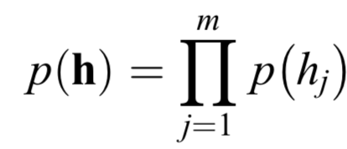
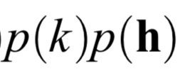
Prior distribution : uniform distribution
Voronoi nuclei number (layer number) k
Shear wave velocity v
Nucleus depth c
N : number of possible depths
Hyper-parameters h = ($σ_{RF}^{}\text{,} \text{r}RF$, $σ_{SWD}^{}$, $\text{r}SWD$)
Bodin, 2012

Slide 31
rj-MCMC method
Accept probability
$$α\left(\text{m}\text{new} \text{|}\text{m}\text{old}\right)=\min\left(1, \frac{ρM\left(\text{m}\text{new}\right) L\left(\text{m}\text{new}\right) \text{q}\text{(}\text{m}\text{old}\text{|}\text{m}\text{new}\text{)}}{ρM\left(\text{m}\text{old}\right) L\left(\text{m}\text{old}\right) \text{q}\text{(}\text{m}\text{new}\text{|}\text{m}\text{old}\text{)}}| J |\right)$$
$$ρM\left(\text{m}\right)$$
$$L\left(\text{m}\right)$$
$$\text{q}\text{(} \text{.} \text{|}\text{m}\text{)}$$
Jacobian
$$L\left(m\right)=\frac{1}{\sqrt{\left(2π\right)n|{ C}_{d}^{}|}}exp⁡( −\frac{1}{2}S\left(m\right))$$
$$S\left(m\right)=\left(g\left(m\right)−dobs\right)T{ C}_{d}^{−1} \left(g\left(m\right)−dobs\right) )$$
Bodin, 2012

Slide 32
Proposal distributions
After randomly initializing the model parameters by drawing values from the prior distribution of each parameter, the algorithm proceeds iteratively.
At each iteration of the reversible jump algorithm, we propose a new model by drawing from a proposal probability distribution $\text{q}\text{(}\text{m}’\text{|}\text{m}\text{)}$ such that the new proposed model $\text{m}’$ is conditional only on the current model $\text{m}$ (i.e., Markov chain).
At each iteration, one move is uniformly randomly selected from the five possibilities.
This is similar to component-wise Metropolis-Hastings sampling.
Bodin, 2012

Slide 33
Proposal distributions
Change the velocity in one layer.
Uniformly randomly select a layer i over [1, k] and randomly propose a new velocity v′_{i} using a Gaussian probability distribution centered at the current velocity v_{i} :
Birth: create a new layer.
Add a new Voronoi nucleus with position c’_{k+1} found by choosing uniformly randomly a point that is not occupied. A new velocity value v′_{k+1} needs to be assigned to the new layer using a Gaussian probability distribution centered at the current velocity v_{i} at the depth c’_{k+1} :
Death: delete a new layer.
Uniformly randomly remove one layer over the range [1, k].
Bodin, 2012

Slide 34
Proposal distributions
Move : change the nucleus position of one layer
Uniformly randomly pick one layer over [1, k] and randomly propose a new position c′_{i} of its nucleus using a Gaussian probability distribution centered at the current nucleus position c_{i} :
Change the estimated data noise.
Uniformly randomly select a hyper-parameter j over the range [1, m], then propose a new h′_{j} using a Gaussian probability distribution centered at the current h_{j} :
The standard deviations ($θ$₁, $θ$₂, $θ$₃, $θ$_{hj}) of the Gaussian proposal functions are parameters to be fixed by the user. the magnitude of perturbations does not affect the solution but rather the sampling efficiency of the algorithm.
Bodin, 2012

Slide 35
rj-MCMC method
Accept probability
$$α\left(\text{m}\text{new} \text{|}\text{m}\text{old}\right)=\min\left(1, \frac{ρM\left(\text{m}\text{new}\right) L\left(\text{m}\text{new}\right) \text{q}\text{(}\text{m}\text{old}\text{|}\text{m}\text{new}\text{)}}{ρM\left(\text{m}\text{old}\right) L\left(\text{m}\text{old}\right) \text{q}\text{(}\text{m}\text{new}\text{|}\text{m}\text{old}\text{)}}| J |\right)$$
$$ρM\left(\text{m}\right)$$
$$L\left(\text{m}\right)$$
$$\text{q}\text{(} \text{.} \text{|}\text{m}\text{)}$$
Jacobian
$$L\left(m\right)=\frac{1}{\sqrt{\left(2π\right)n|{ C}_{d}^{}|}}exp⁡( −\frac{1}{2}S\left(m\right))$$
$$S\left(m\right)=\left(g\left(m\right)−dobs\right)T{ C}_{d}^{−1} \left(g\left(m\right)−dobs\right) )$$
Bodin, 2012

Slide 36
Jacobian
$| J$|=1

Slide 37
rj-MCMC method
Accept probability
$$α\left(\text{m}\text{new} \text{|}\text{m}\text{old}\right)=\min\left(1, \frac{ρM\left(\text{m}\text{new}\right) L\left(\text{m}\text{new}\right) \text{q}\text{(}\text{m}\text{old}\text{|}\text{m}\text{new}\text{)}}{ρM\left(\text{m}\text{old}\right) L\left(\text{m}\text{old}\right) \text{q}\text{(}\text{m}\text{new}\text{|}\text{m}\text{old}\text{)}}| J |\right)$$
$$ρM\left(\text{m}\right)$$
$$L\left(\text{m}\right)$$
$$\text{q}\text{(} \text{.} \text{|}\text{m}\text{)}$$
Jacobian
$| J$|=1
$$L\left(m\right)=\frac{1}{\sqrt{\left(2π\right)n|{ C}_{d}^{}|}}exp⁡( −\frac{1}{2}S\left(m\right))$$
$$S\left(m\right)=\left(g\left(m\right)−dobs\right)T{ C}_{d}^{−1} \left(g\left(m\right)−dobs\right) )$$
Bodin, 2012

Slide 38
$$S\left(m\right)=\left(g\left(m\right)−dobs\right)T{ C}_{d}^{−1} \left(g\left(m\right)−dobs\right) )$$
rj-MCMC method
$$L\left(m\right)=\frac{1}{\sqrt{\left(2π\right)n|{ C}_{d}^{}|}}exp⁡( −\frac{1}{2}S\left(m\right))$$
Initialize by choosing a starting model m₀
Choose a new candidate m_{new} from a suitable proposal distribution q( . | m_{old}), that may depend on the previous model m_{old} of the chain
Accept the candidate with probability
$α\left(\text{m}\text{new} \text{|}\text{m}\text{old}\right)=\min\left(1, \frac{σ\left(\text{m}\text{new}\right) \text{q}\text{(}\text{m}\text{old} \text{|}\text{m}\text{n}\text{ew}\text{)}}{σ\left(\text{m}\text{old}\right) \text{q}\text{(}\text{m}\text{new}\text{|}\text{m}\text{old}\text{)}}| J \text{|}\right)$
$=\min\left(1, \frac{ρM\left(\text{m}\text{new}\right) L\left(\text{m}\text{new}\right) \text{q}\text{(}\text{m}\text{old}\text{|}\text{m}\text{new}\text{)}}{ρM\left(\text{m}\text{old}\right) L\left(\text{m}\text{old}\right) \text{q}\text{(}\text{m}\text{new}\text{|}\text{m}\text{old}\text{)}}| J \text{|}\right)$
If rejected, repeat the previous model in the chain.
Go back to step 2.
$$σ\left(m\right)=k ρM\left(m\right) L\left(m\right)$$
$C_{d}^{}$ is also inverted.
So this is a Hierarchical Bayes.
The layer number is also a variable.
So this is a transdimensional inversion.
The accept probability has the same form as traditional Metropolis-Hastings algorithm, but each ratio term needs to be treated carefully.
Bodin, 2012

Slide 39
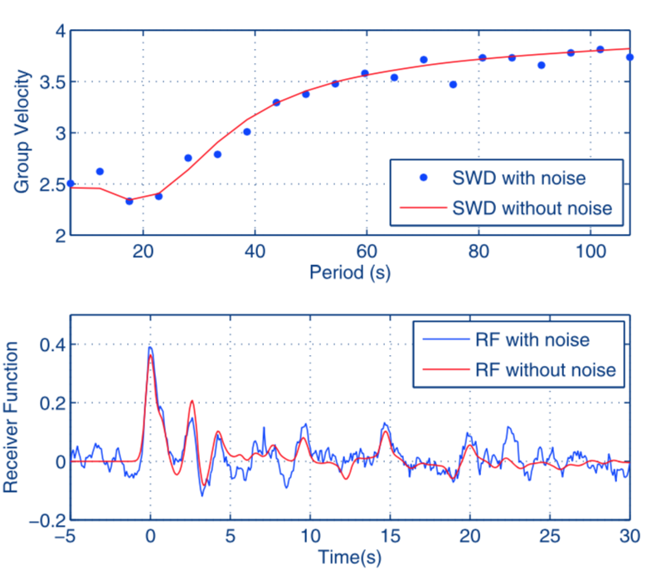
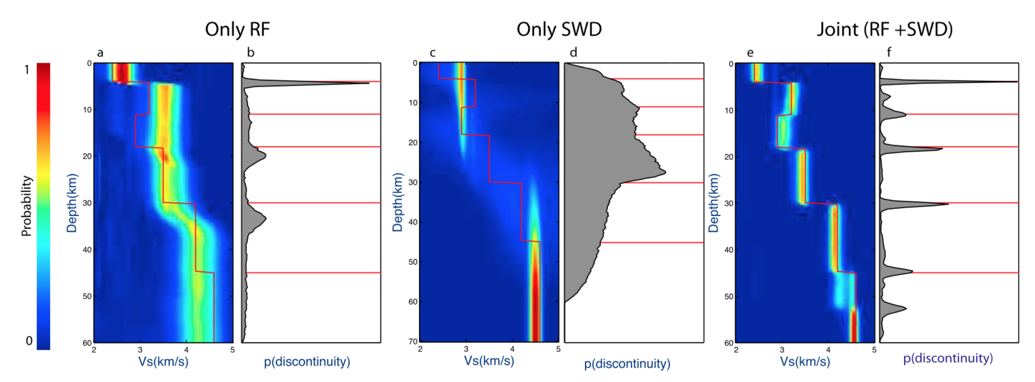
Joint inversion : synthetic test
$σ_{SWD}^{}=0.1$ $\text{r}SWD=0$
$σ_{RF}^{}=0.04$ $\text{r}RF=0.85$
Bodin, 2012

Slide 40
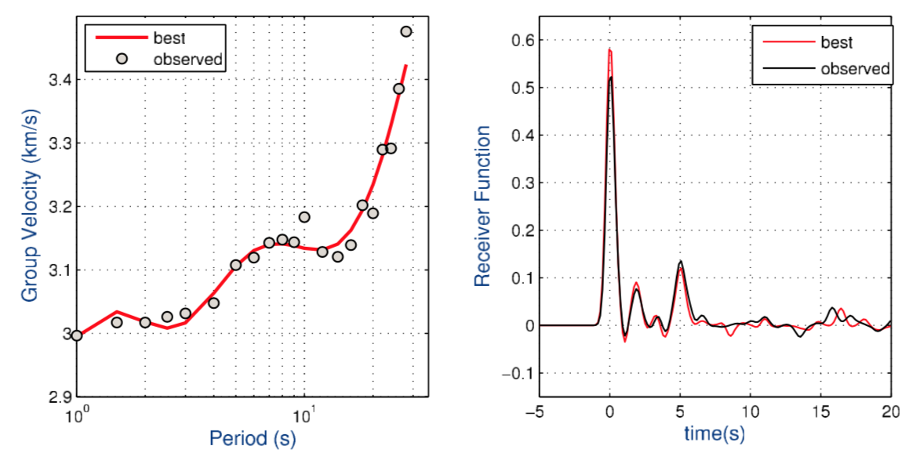
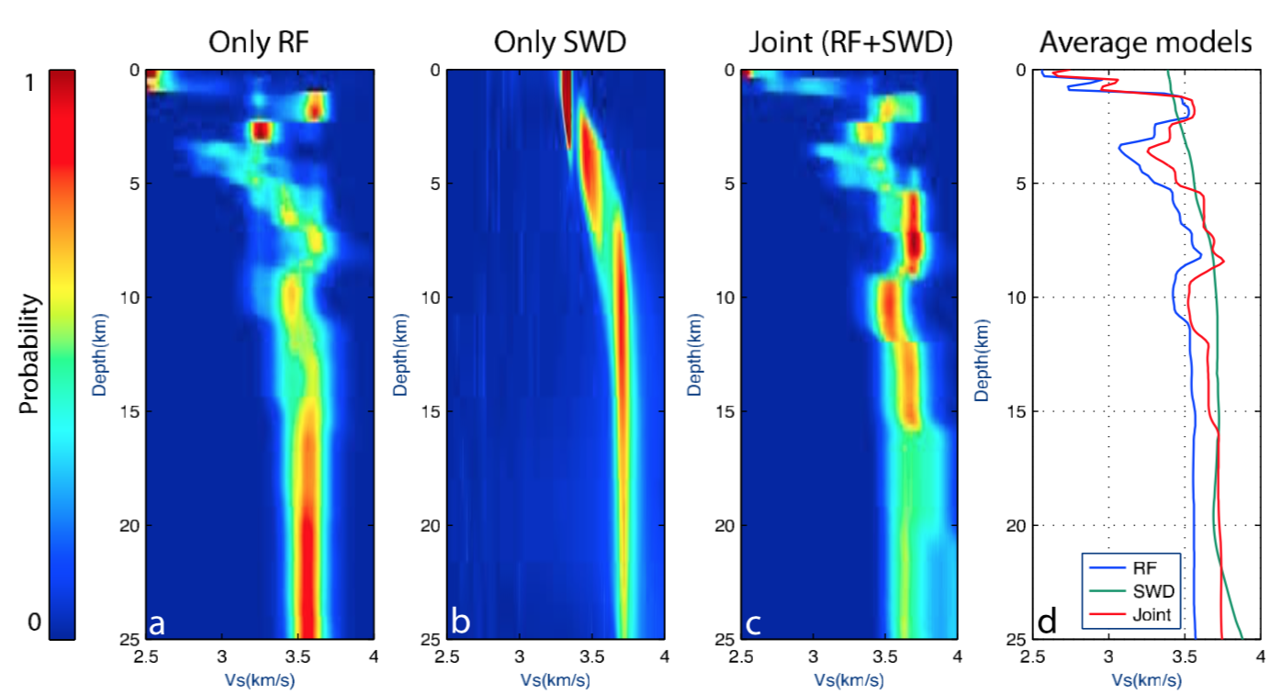
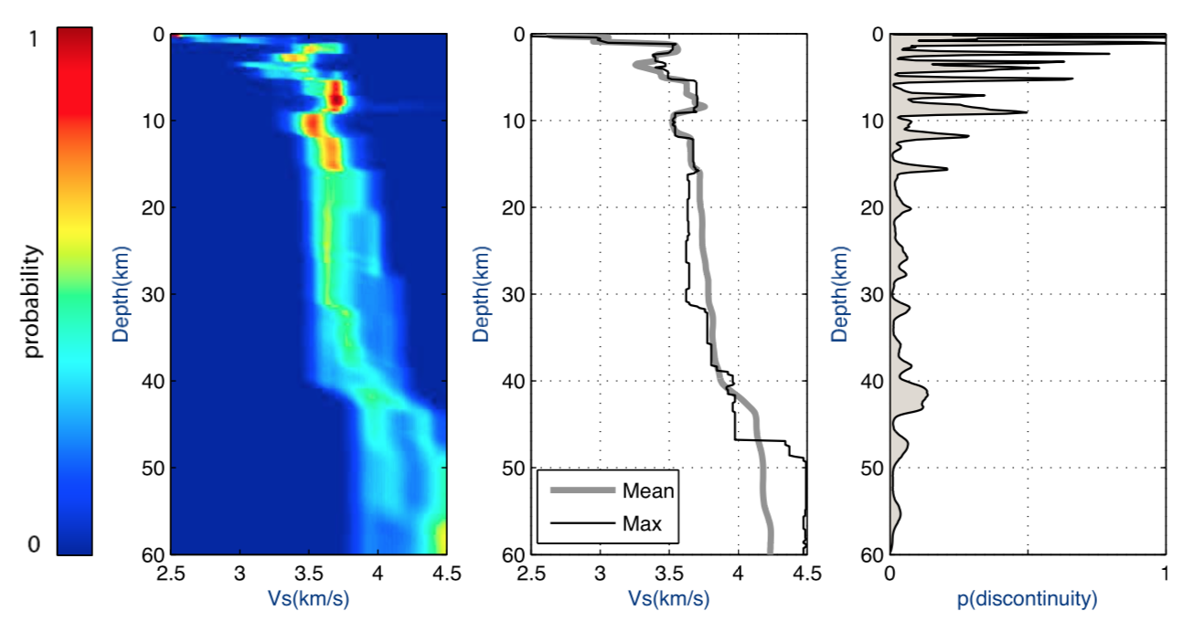
Joint inversion : data
Inverted: $σ_{RF}^{}$ $σ_{SWD}^{}$
Fixed: $\text{r}RF$ $\text{r}SWD=0$
0-60km
0-25km
Bodin, 2012

Slide 41
Outline
Introduction to the Bayesian inversion and Monte Carlo method
Transdimensional inversion
2.1 Model parameterization
2.2 Likelihood function
2.3 Prior distributions
2.4 Proposal distributions
2.5 Joint inversion
(not strict) Bayesian Monte Carlo inversion
3.1 Model parameterization
3.2 Likelihood function
3.3 Prior distributions
3.4 Proposal distributions
3.5 Joint inversion
Bodin et al., 2012, GJI
Shen et al., 2013, GJI

Slide 42
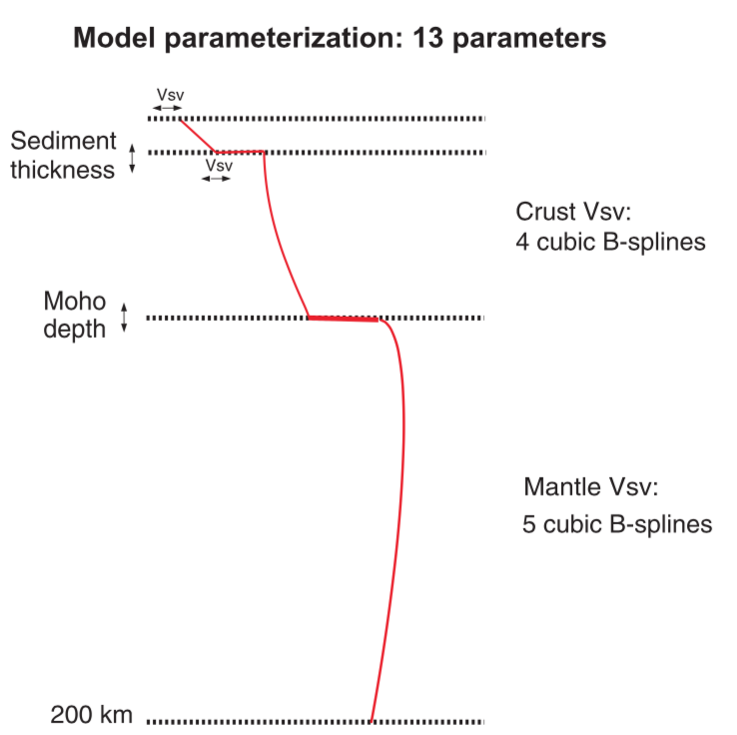
Model parameterization
Fixed layer number
Vs is smooth in the crust and mantle.
Velocity jump only exists at the sediment-crust boundary and Moho discontinuity
Shen et al., 2013, GJI

Slide 43
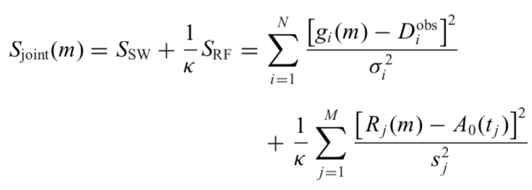
Likelihood function
$$L\left(m\right)=\frac{1}{\sqrt{\left(2π\right)n|{ C}_{d}^{}|}}exp⁡( −\frac{1}{2}S\left(m\right))$$
Strict Bayes
Not strict Bayes
$$S\left(m\right)=\left(g\left(m\right)−dobs\right)T{ C}_{d}^{−1} \left(g\left(m\right)−dobs\right) )$$
Off-diagonal element of ${ C}_{d}^{}$is 0
A weighting factor between SW and RF
Shen et al., 2013, GJI

Slide 44
Accept probability
Metropolis algorithm
$$α\left(\text{m}\text{new} \text{|}\text{m}\text{old}\right)=\min\left(1, \frac{ρM\left(\text{m}\text{new}\right) L\left(\text{m}\text{new}\right) }{ρM\left(\text{m}\text{old}\right) L\left(\text{m}\text{old}\right)}\right)$$
$$L\left(m\right)=\frac{1}{\sqrt{\left(2π\right)n|{ C}_{d}^{}|}}exp⁡( −\frac{1}{2}S\left(m\right))$$
The prior distribution ratio does not need to computed, since it is already included in the iteration.
${ C}_{d}^{}$is given so the Likelihood ratio only contain the exp part.
$$α\left(\text{m}\text{new} \text{|}\text{m}\text{old}\right)=\min\left(1, \frac{ exp⁡(−\frac{1}{2}S\left(\text{m}\text{new}\right) }{exp⁡(−\frac{1}{2}S\left(\text{m}\text{old}\right)}\right)$$
Shen et al., 2013, GJI

Slide 45
An additional model acceptance criterion
root mean square misfit $χ=\sqrt{S(m)/N}$
Shen et al., 2013, GJI

Slide 46
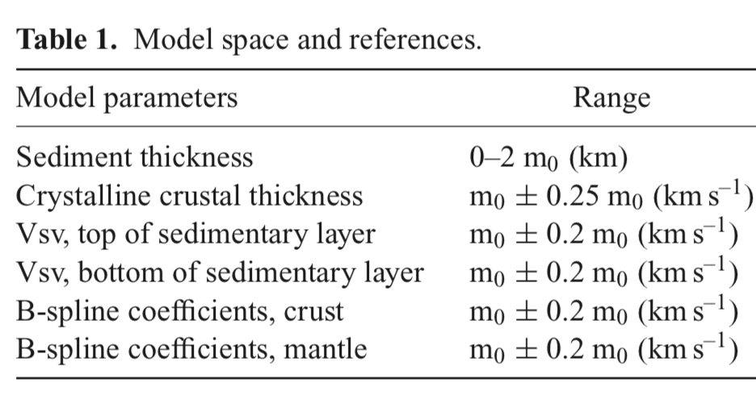
Prior distribution : some constrains
Models exist in the model space M, which is defined as the reference model subject to allowed perturbations (Table 1).
The model is continuous between Vs discontinuities at the base of the sediments and Moho and is continuous in the mantle.
Velocity in the sedimentary layer increases with depth.
Velocity in the crystalline crust increases with depth.
Velocity contrasts across the sedimentary basement and
across the Moho discontinuity are positive.
Vs < 4.9 km/s throughout the model.
When surface wave data are used alone we apply the assumption of a positive velocity gradient in the uppermost mantle.
Shen et al., 2013, GJI

Slide 47
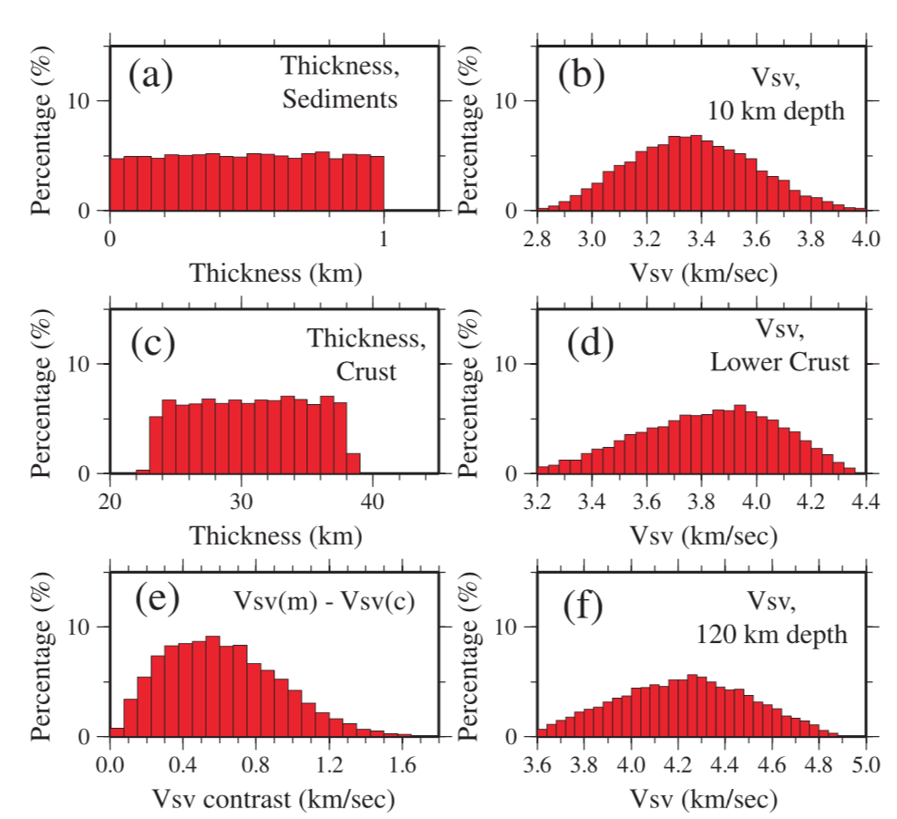
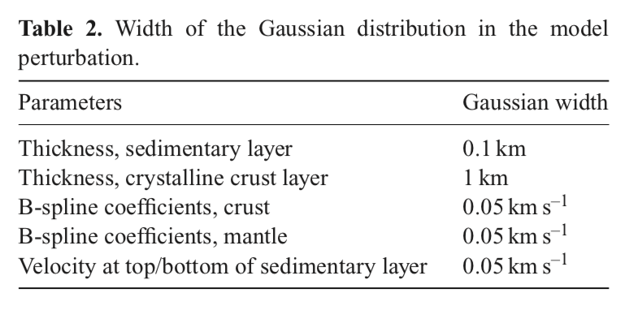
Prior distribution : some constrains
We perform a random walk in model space to determine the prior distribution.
Shen et al., 2013, GJI

Slide 48
Proposal distributions
Since a Gaussian proposal distribution is used, it is symmetric and the sampling method is then Metropolis algorithm, which is special case of Metropolis-Hastings algorithm.
Shen et al., 2013, GJI

Slide 49
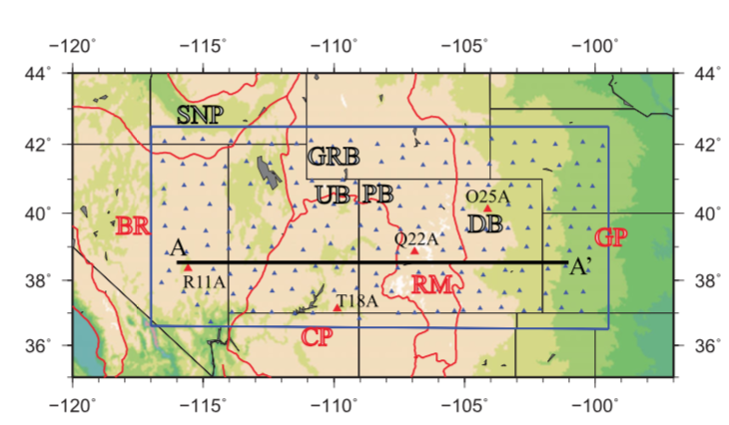
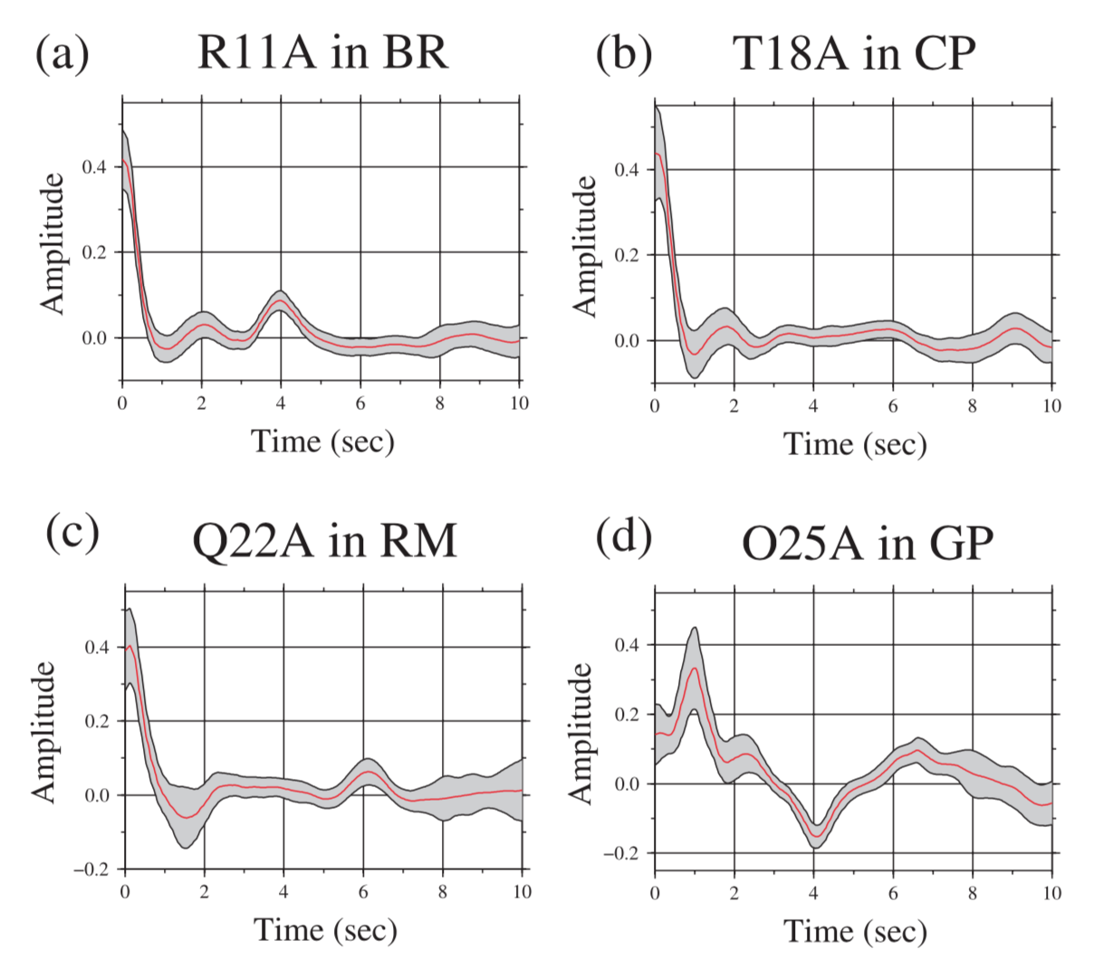
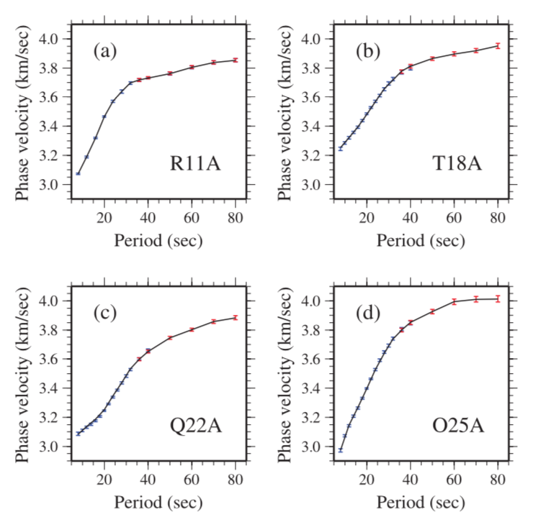
Joint inversion : data at four stations
RF
SW
Shen et al., 2013, GJI

Slide 50
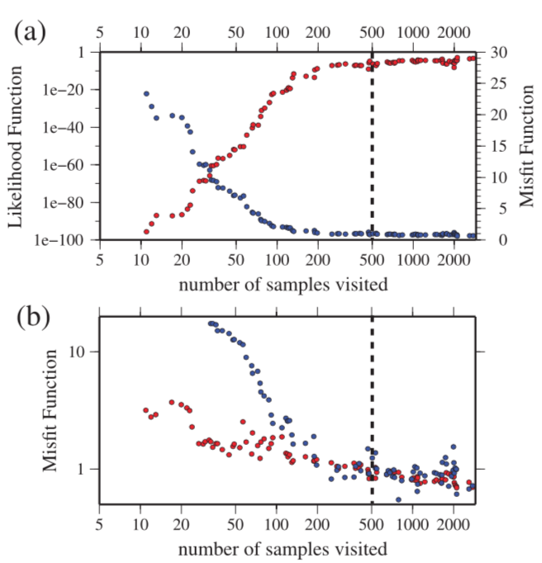
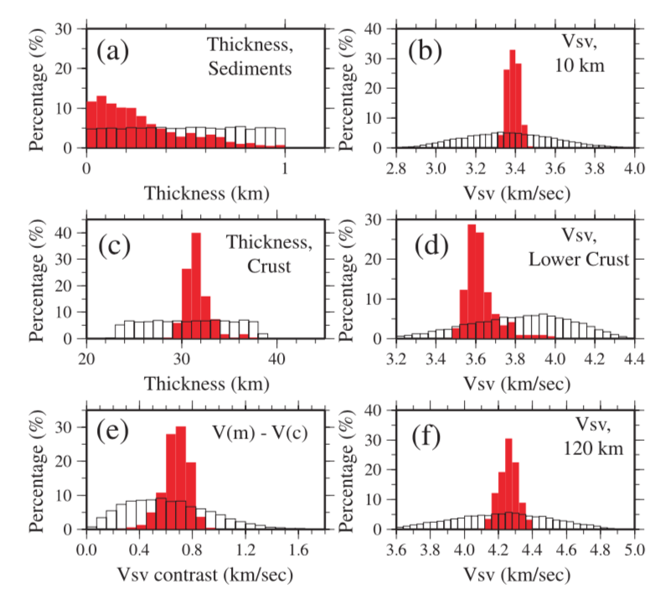
Joint inversion
R11A
Shen et al., 2013, GJI

Slide 51
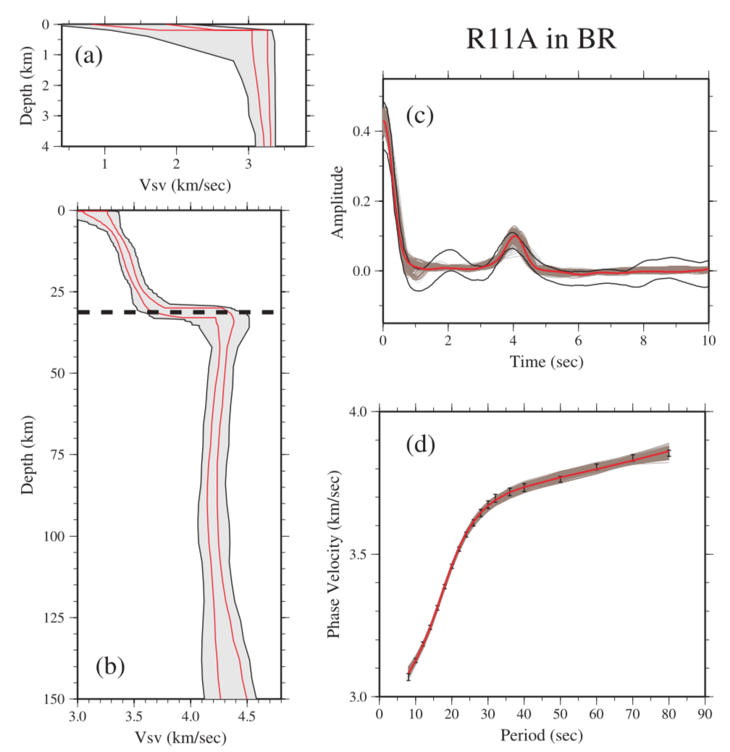
Joint inversion
Shen et al., 2013, GJI

Slide 52
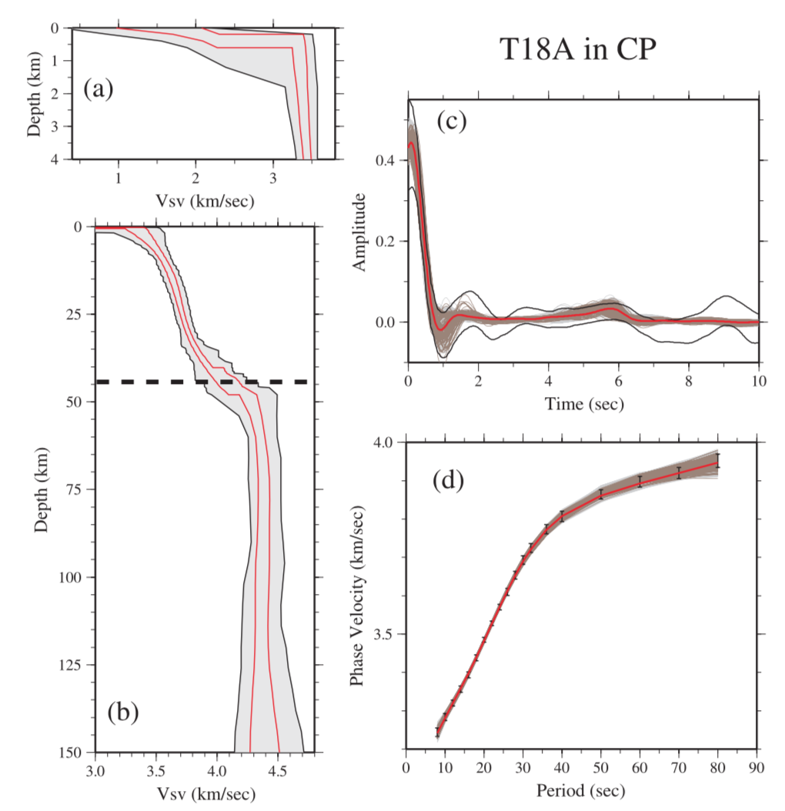
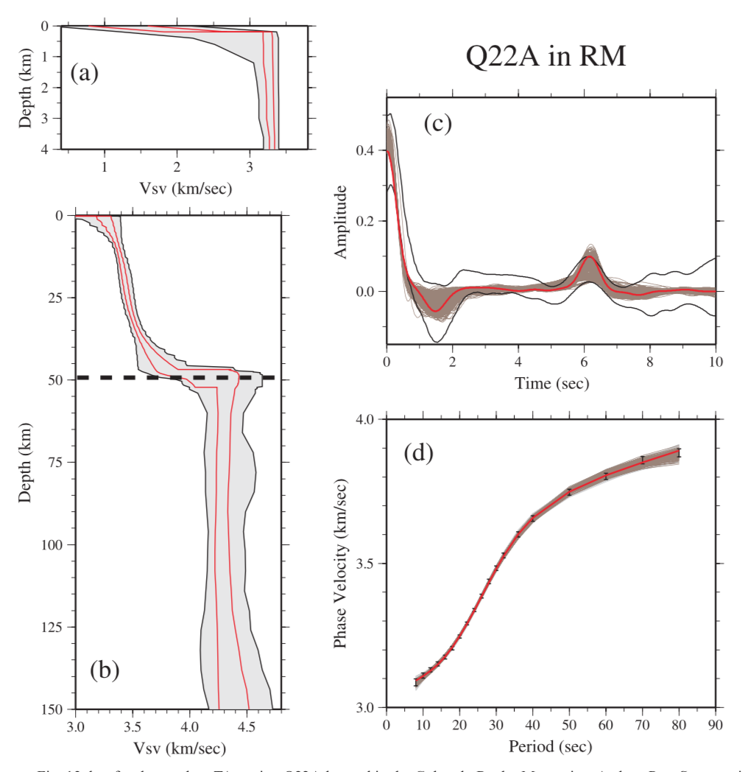
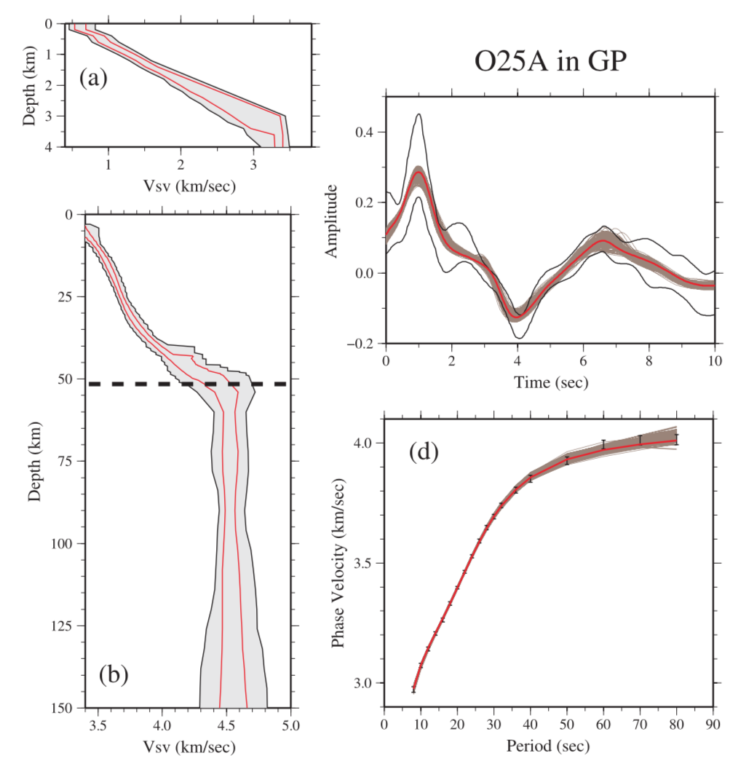
Joint inversion
Shen et al., 2013, GJI

Slide 53
Conclusions
A non-linear Bayesian Monte-Carlo method is presented to estimate a Vs model beneath stations by jointly interpreting Rayleigh wave dispersion and receiver functions and associated uncertainties.
Bodin et al. (2012) use the transdimensional Bayesian formulation to treats the number of model parameters as an unknown in the problem. They use an extended Hierarchical Bayesian formulation to treat variance and covariance of data noise as unknowns in the inversion.
Instead, Shen et al. (2013) choose to fix the number of model parameters and estimate the data noise. A weighting is also considered to balance RF and Rayleigh-wave data.

