Slide 1
Insight of Coso-Ridgecrest Area
Dongdong Wang, 2020/04/24

Slide 2
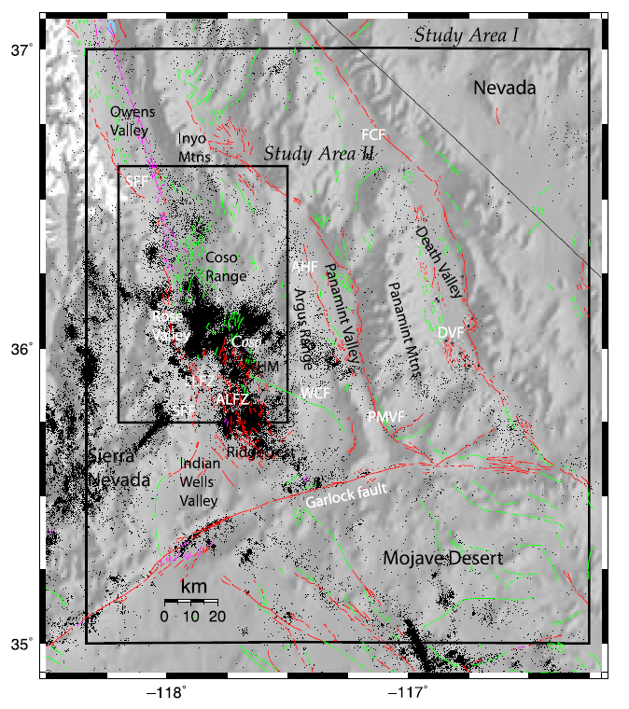
(Hauksson and Unruh 2007, JGR)
Notes:
Relocated seismicity in southern California determined using three-dimensional velocity models [Hauksson, 2000].

Slide 3
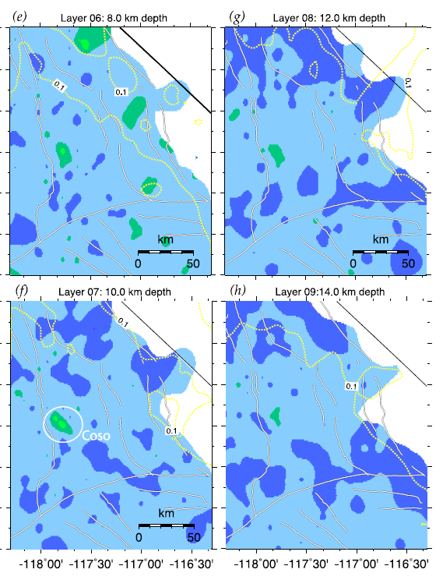
Indian Wells Valley
(Hauksson and Unruh 2007, JGR)
Notes:
1: There is a prominent low-Vp anomaly associated with Indian Wells Valley, which is best expressed in the upper 2 km and, in some areas, is imaged to 4-km depth. 2: The high amplitude, low-Vp anomaly that coincides with the Coso geothermal field extends across several depth layers for Vp, from depths of 8 to 12 km.

Slide 4
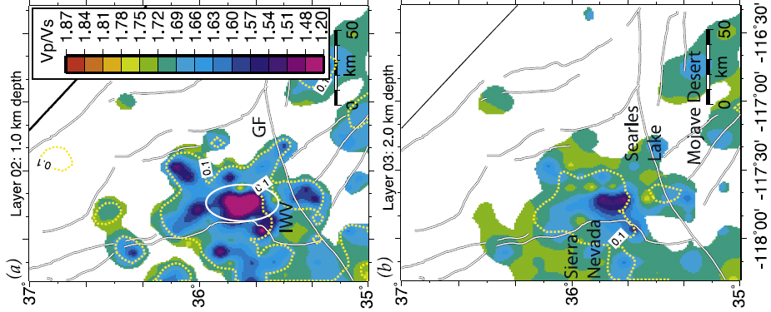
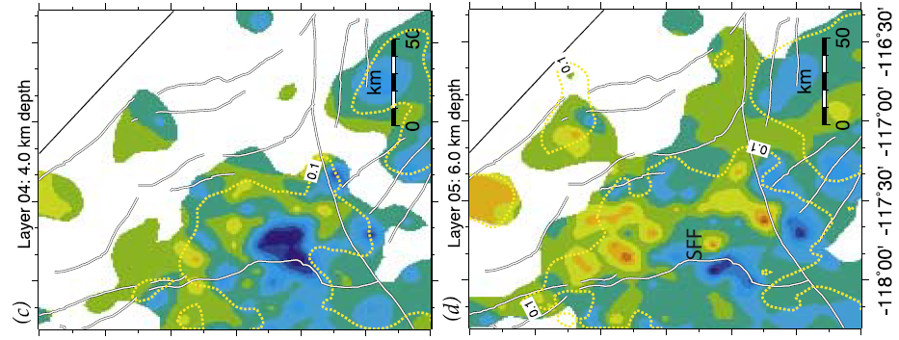
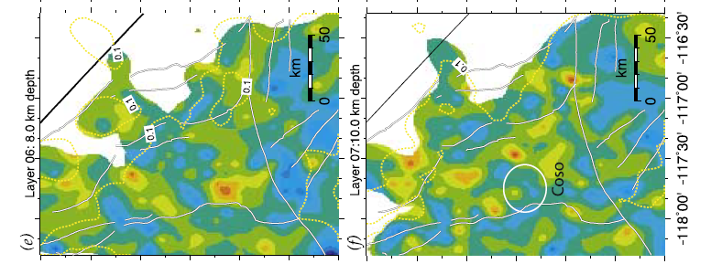
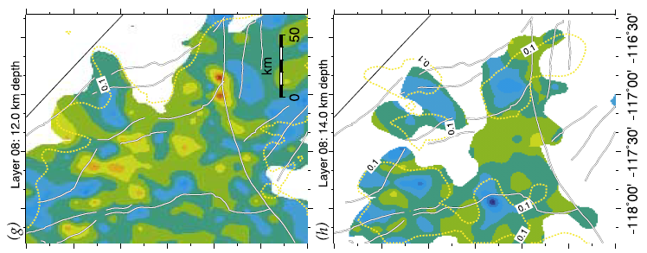
Such
Such low Vp and low Vp /Vs values for sediments are rare.
(Hauksson and Unruh 2007, JGR)
Notes:
The most prominent Vp /Vs low coincides with Indian Wells Valley, extending to depths of 3 km. Such low Vp and low Vp /Vs values for sediments are rare [Brocher, 2005] and suggest unusual geological conditions.

Slide 5
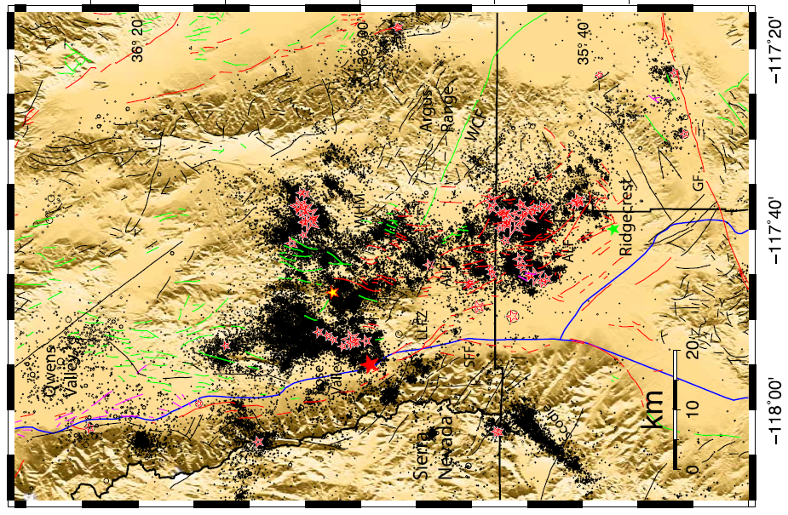
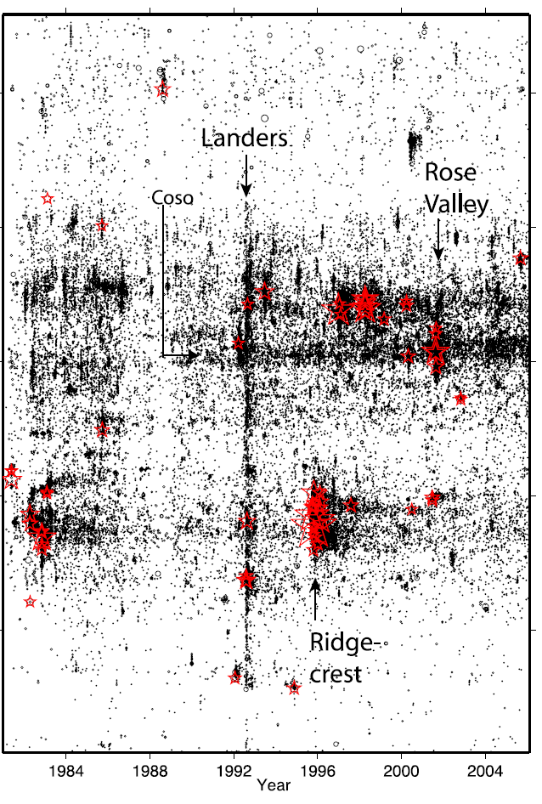
Transition to aseismic region.
(Hauksson and Unruh 2007, JGR)
Notes:
One of the most prominent features in the spatial distribution of seismicity is the abrupt transition north of Coso from a very seismically active region to an aseismic region.

Slide 6
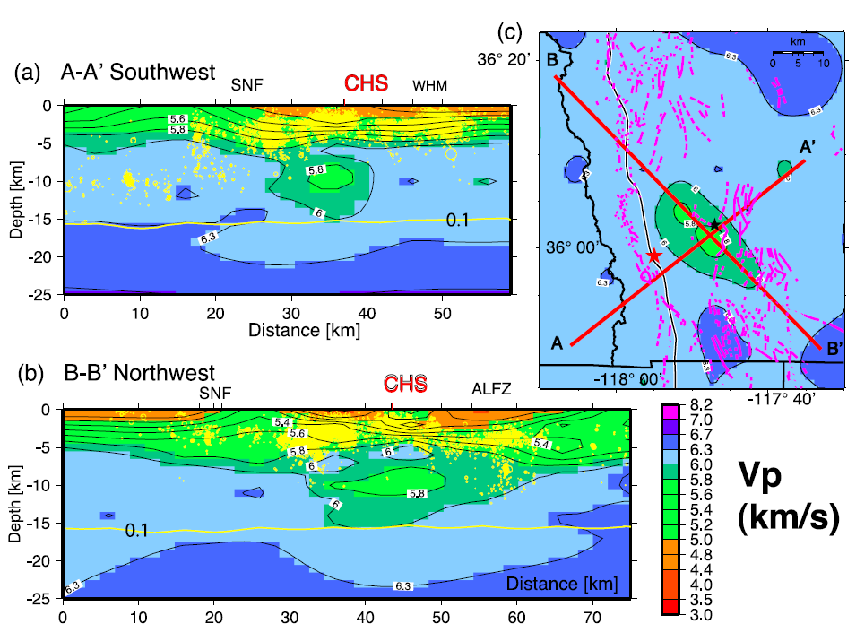
CHS- Coso hot spring
Brittle-ductile transition depth.
(Hauksson and Unruh 2007, JGR)
Notes:
Below 6-km depth, the Vp gradually decreases, forming a prominent low-Vp anomaly (5.8 km/s) in the depth range of 8 to 12 km.

Slide 7
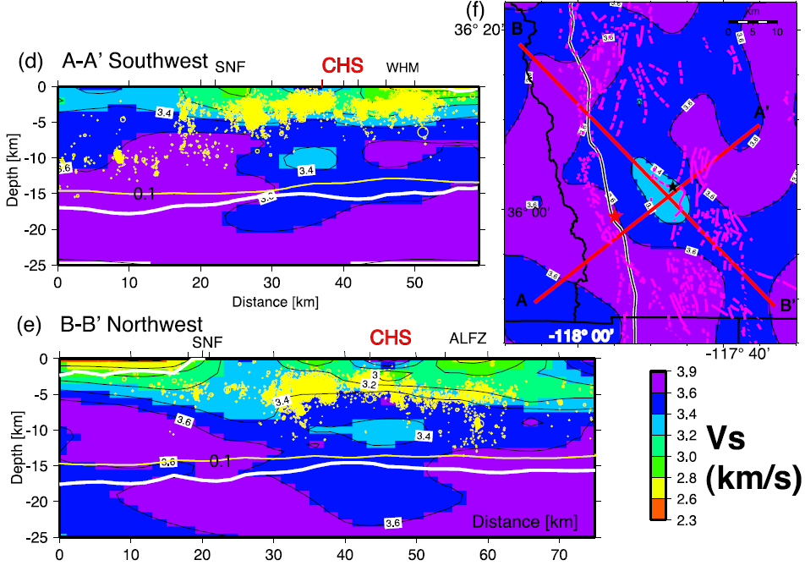
Coso
(Hauksson and Unruh 2007, JGR)
Notes:
1: We interpret the low-Vp and low-Vs regions to indicate the presence of rock containing about 4–6% geothermal brines.
2: aseismically, with the brittle-ductile transition zone locally elevated to shallow depths above the low-velocity zone.

Slide 8
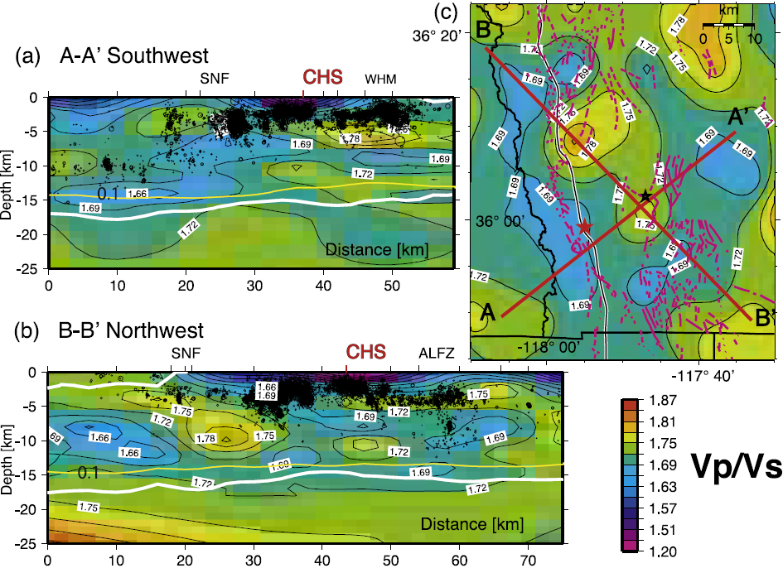
(Hauksson and Unruh 2007, JGR)
Notes:
At 10-km depth in both cross sections, there is a small body (about 1 km wide) of moderately elevated Vp /Vs beneath the Coso geothermal field.

Slide 9
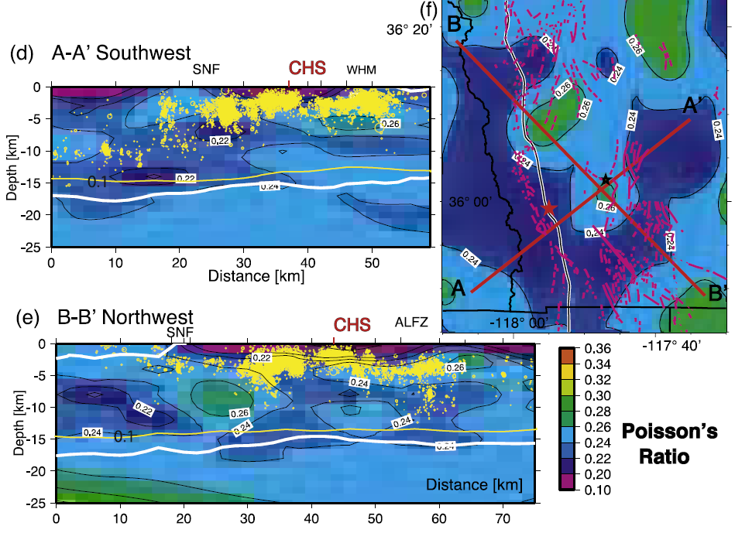
Magma
(Hauksson and Unruh 2007, JGR)
Notes:
1: We interpret the anomalous zone at 10-km depth that may contain magma to be only about 1 km long and 1 km thick or possibly smaller or much smaller than advocated by Wilson et al. [2003] and Monastero et al. [2005].
2: Rose Valley as being caused by crustal compositional changes, with less quartz or silicate minerals and more mafic rocks.

Slide 10
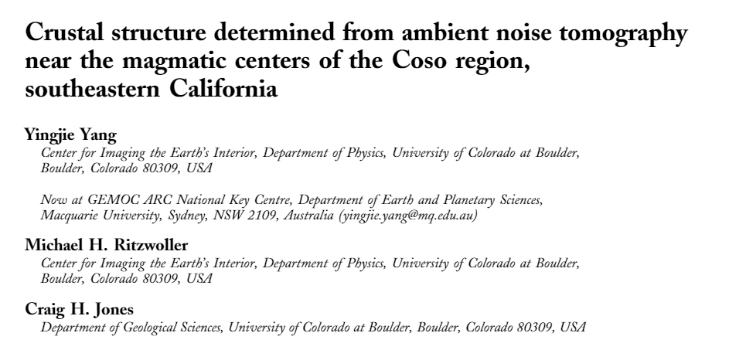
The object of this research: constrain the depth of any magma chambers underlying the area using ambient noise dispersion measurements.

Slide 11
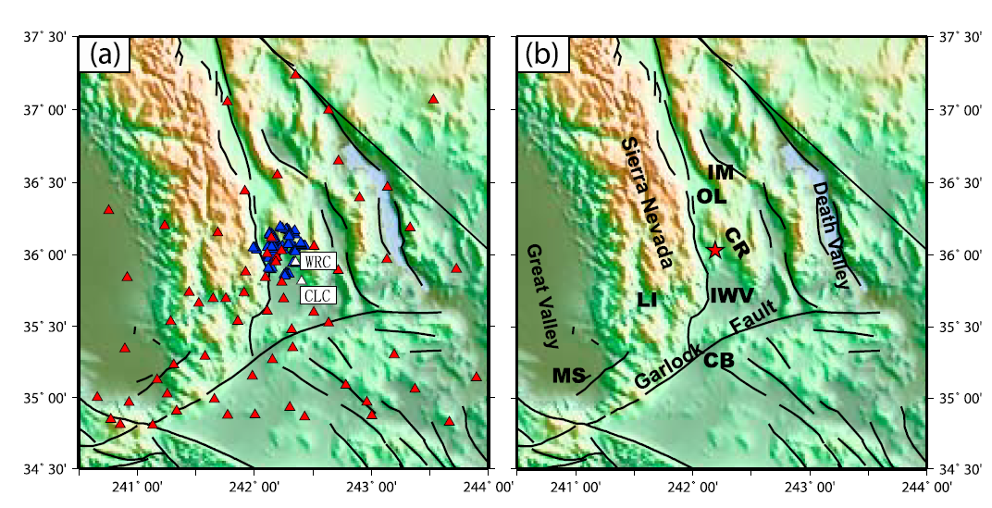
-119° -118° -117° -116° -119° -118° -117° -116°
More than 3°× 3.
(Yang et al, 2011, GGG)
Notes:
You can see, it’s a large area. More than 3° times 3°.
Place names mentioned in text: CB, Cantil Basin; CR, Coso Range; IM, Inyo Mountains; IWV, Indian Wells Valley; LI, Lake Isabella; MS, Maricopa Subbasin; OL,
Owens Lake.

Slide 12
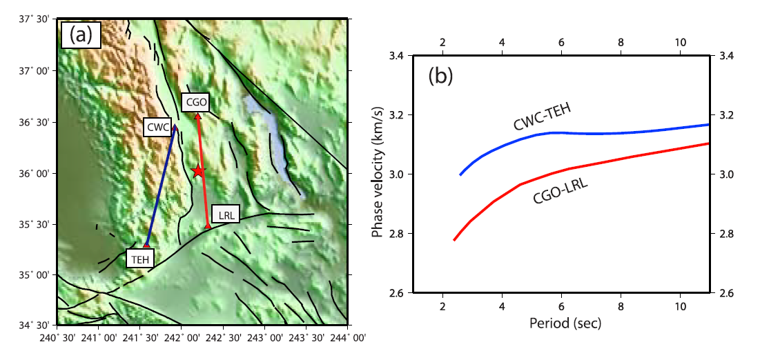
Phase velocity dispersion curves:
Station pair
Phase velocity dispersion measurements of Rayleigh waves are obtained from the symmetric components of interstation cross correlations by automatic frequency‐time analysis (FTAN) (Bensen et al.,2007).

Slide 13
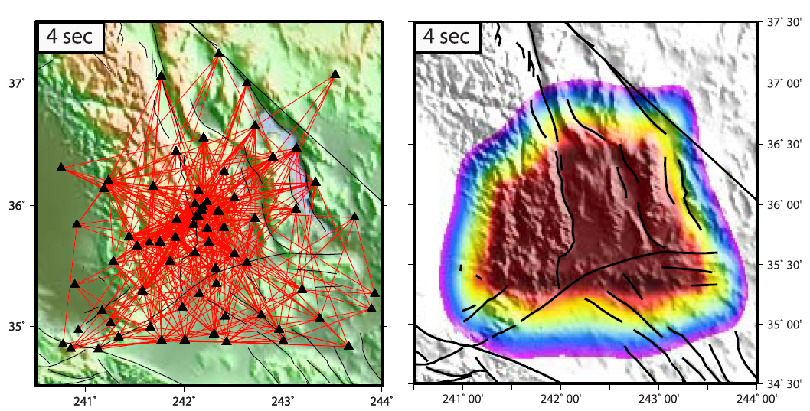
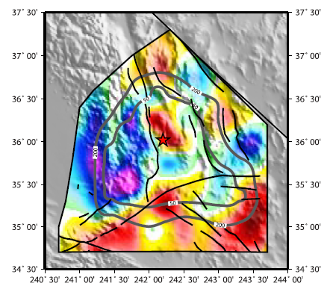
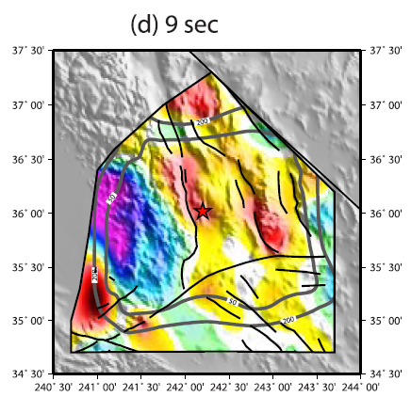
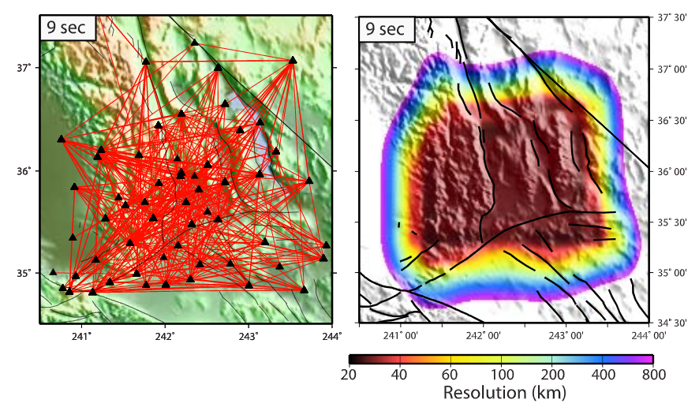
Ray-based Theory
(Barmin et al., 2001)
(Yang et al, 2011, GGG)

Slide 14
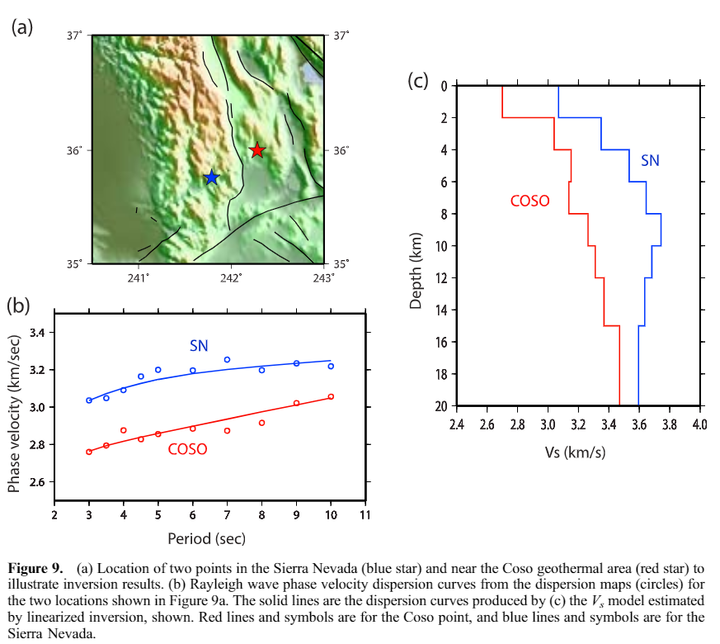
Linearized inversion of each Rayleigh wave phase speed curve for best fitting Vs model below each grid.
Grid: 0.25°×0.25°
(Yang et al, 2011, GGG)

Slide 15
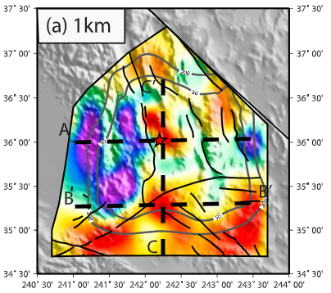
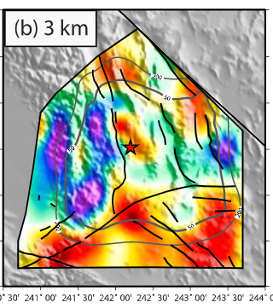
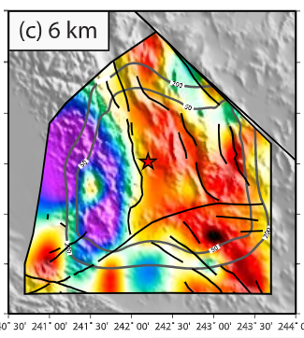
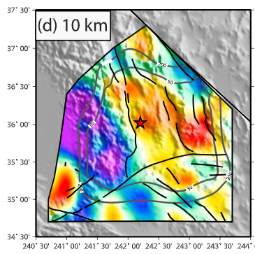
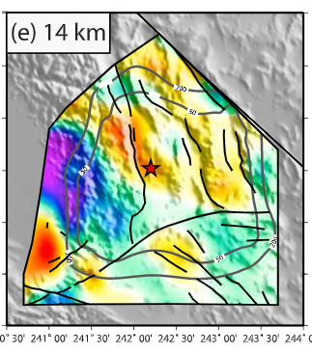
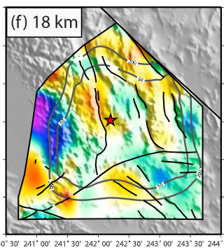
Sierra Nevada
Coso
In the upper crust (<10 km), prominent low velocities are imaged beneath the Coso geothermal area, which are probably related to high temperatures and perhaps the presence of partial melt.
(Yang et al, 2011, GGG)
Notes:
1: The most pronounced high velocity is observed beneath the Sierra Nevada, which is composed primarily of Mesozoic granitic plutons and is probably colder and less faulted than other regions in this study area. 2: pronounced shallow low velocity is also imaged near 242° 15′ just south of the Garlock Fault.3: Within the southern Sierra Nevada, low velocities are imaged in the top 3 km of the crust near Lake Isabella, which may be due to the presence of sediments or deformation associated with the proto–Kern Canyon or Kern Canyon fault zones. 4: magmatic origin

Slide 16
Vertical cross sections:
Geothermal field
Resolution tests show that
our data and methods are able to resolve a low velocity
body situated in the top 5 km.
?
Conclusions:
1: no significant anomaly below about 14 km depth, and a weakly resolved low‐velocity
anomaly between 6 and 12 km depth.
2: No magmatic body is imaged beneath 14 km depth, but
the shear velocity anomaly between 6 and 12 km
may be due to partial melt associated with a magma
Body.
?
Notes:
Deeper anomalies are harder to resolve, but the absence of prominent low velocities beneath about 14 km depth in our estimated model (Figures 11 and 13) beneath the Coso geothermal area is inconsistent with a deep seated magmatic source below this depth.

Slide 17
The object of this research: to image the high-resolution subsurface velocity structure underneath the Coso geothermal field and outline the location, geometry, and depth of magma body.
(Zhang and Lin, 2014, JGR)

Slide 18
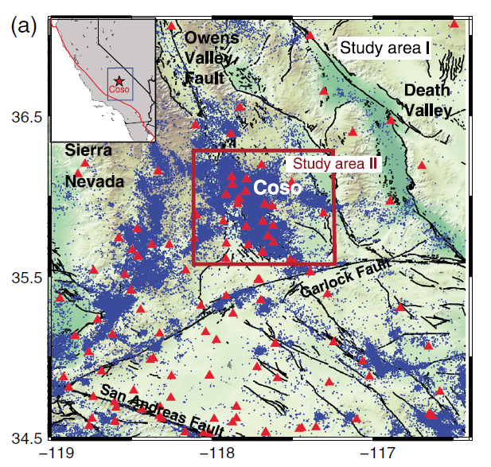
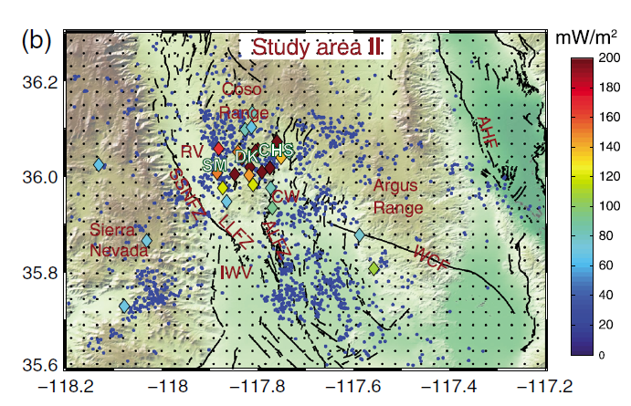
Select events:
5 km×5 km×2 km
2 km×2 km×1 km
Inversion grids:
6 km×6 km× ?
3 km×3 km× ?
-5, 0, 3, 6, 9, 12, 15, 20, 25.
(Zhang and Lin, 2014, JGR)

Slide 19
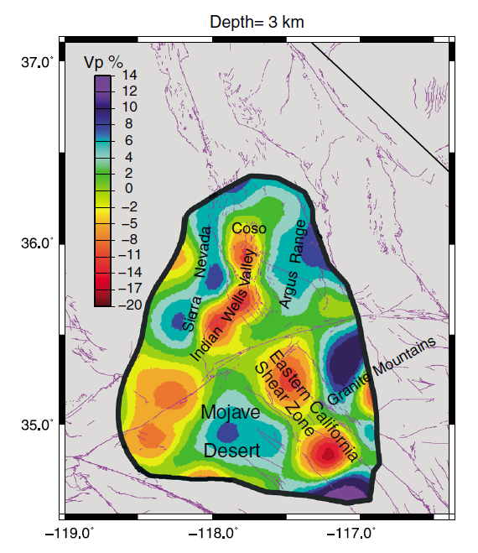
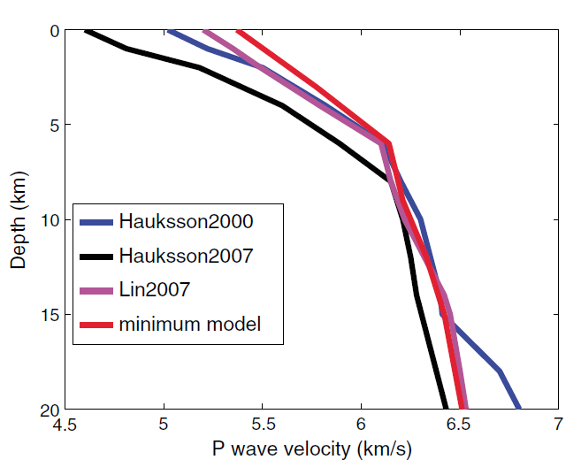
Vp (Region I):
1D model:
(Zhang and Lin, 2014, JGR)
Notes:
The Indian Wells Valley and the Eastern California Shear Zone mainly exhibit low Vp. The mountain
areas, such as the Sierra Nevada, the Argus Range, and the Granite Mountain with the Mesozoic granitic
rocks, and the stable Mojave Desert show high Vp anomalies.

Slide 20
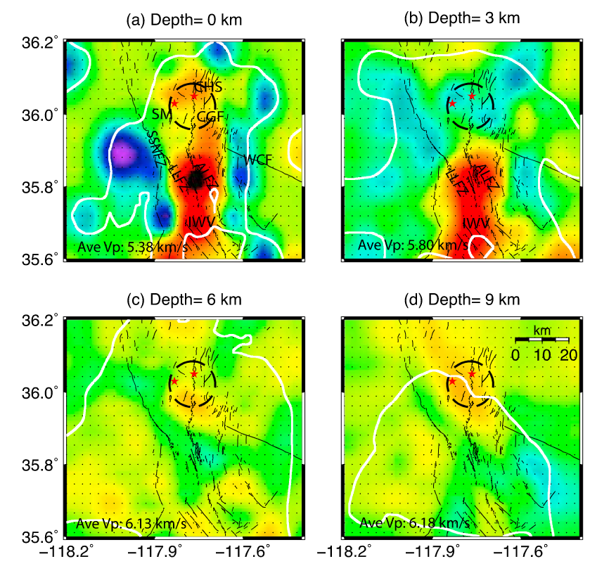
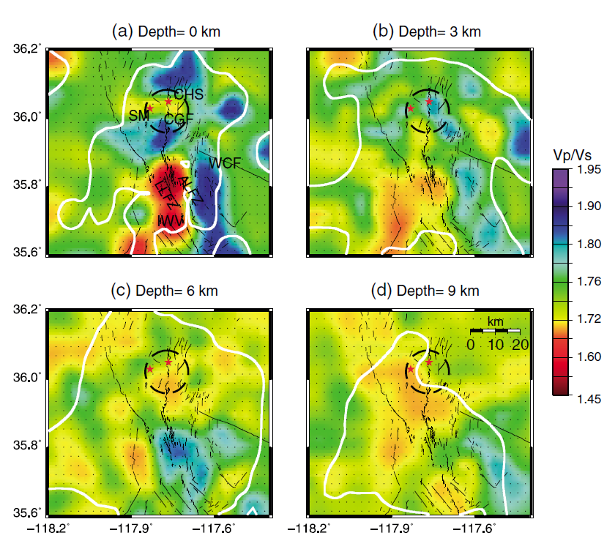
Vp (Region II):
CGF(Coso geothermal field)
Vp/Vs (Region II):
LLFZ:
AR
?
(Zhang and Lin, 2014, JGR)
Notes:
Only above 9 km for the ray density.
1: Left: low velocity-CGF(Coso geothermal field), Little Lake Fault Zone (LLFZ), the Airport Lake Fault Zone(ALFZ), and the Indian Wells Valley (IWV). High velocity-Southern Sierra Nevada Frontal Fault (SSNFZ) and the Argus Range(AR). 2: Spatial correlation between the Vp and Vp/Vs anomalies is observed for most parts of our study area II. 3: The northern part of the geothermal field shows low Vp/Vs, whereas the other areas within and in proximity to the CGF show high Vp/Vs.

Slide 21
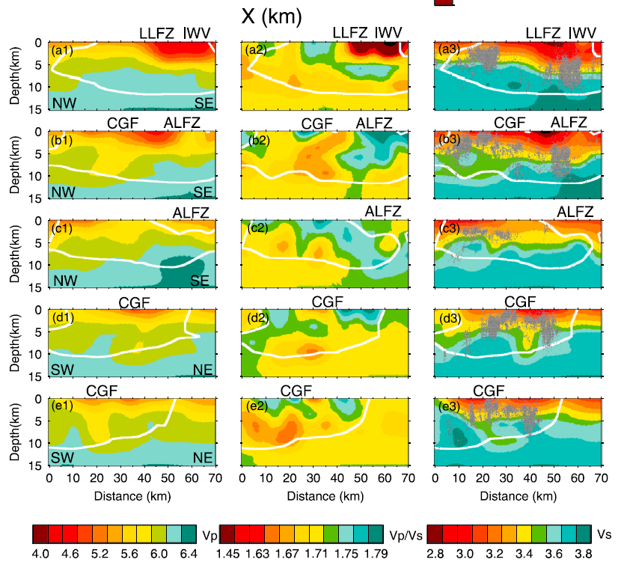
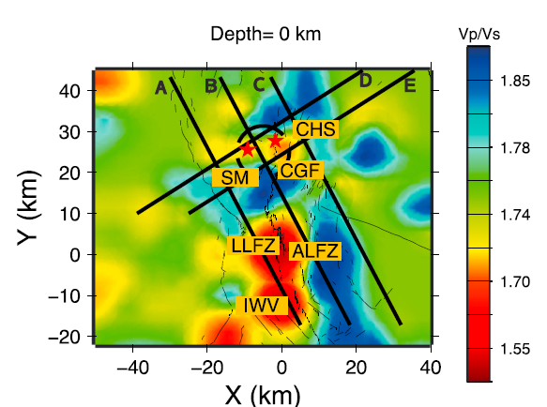
Brittle-ductile transition depth.
(Zhang and Lin, 2014, JGR)
Notes:
Beneath profiles B, D, and E, which pass through the CGF, an extensive velocity anomaly of low Vp, low Vs, and low Vp/Vs from 6 to 12 km.
The size of this anomaly is about 10 km in lateral and 6 km in depth.
The anomalous zone of low-velocity anomalies between 6 and 12 km is aseismic. CGF(Coso geothermal field),

Slide 22
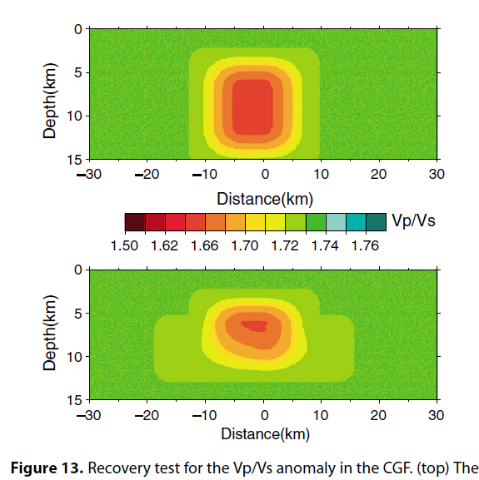
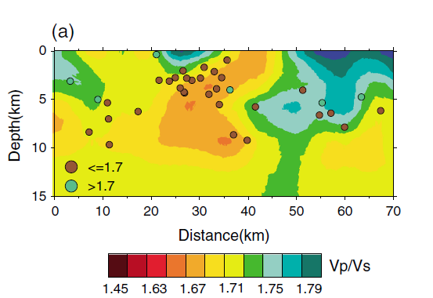
Recovery test for Vp/Vs anomaly in CGF.
In Situ Vp/Vs ratios for clusters around CGF. (Profile B)
(Lin and Shearer, 2007, JGR)
Support our results.
(Zhang and Lin, 2014, JGR)
Notes:
The velocity of seismic waves can be affected when they propagate through different materials due to changes in lithology, mineral
composition, presence of fracture, temperature, pore pressure, and fluid saturation.

Slide 23
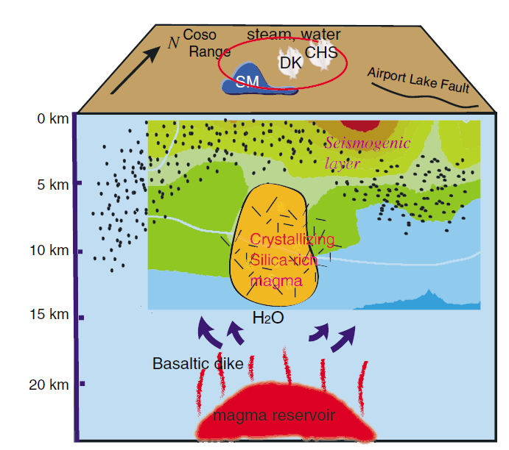
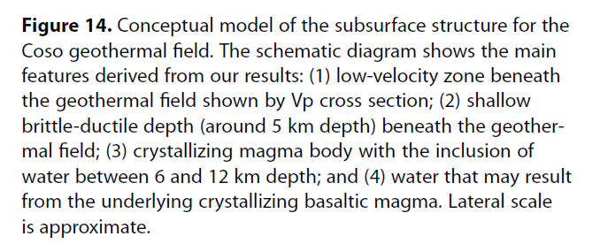
Conclusions:
1: The low-velocity zone with ductile behavior is the typical
feature associated with magma, but the low Vp/Vs ratios
suggest a lack of pervasive partial melt. Thus,it refutes the
possibility of a magma chamber with a large amount of partial
melt.
2: Increasing Silica contents could decrease the Vp/Vs ratio
(Christensen, 1996).
3: 2% of water with aspect ratio of 0.1 can reduce Vp from
the original 6.31 km/s to 6.1 km/s and Vp/Vs as low as 1.67
compared to the reference value of 1.71 (Nakajima et al. 2001).
4: low Vp, low Vs, and low Vp/Vs body lacking of seismicity may
indicate that the molten material is felsic, rich in gas, or with the
inclusion of water.
?
(Zhang and Lin, 2014, JGR)

Slide 24
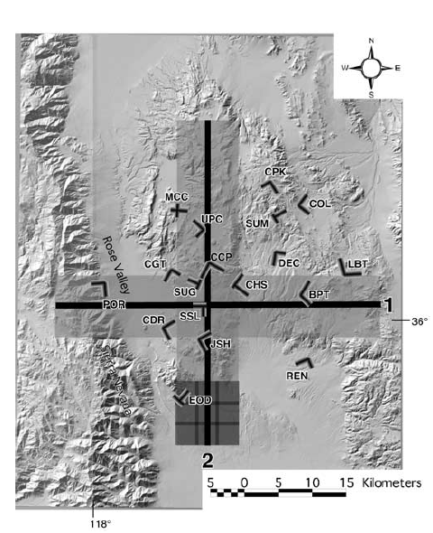
Receiver function + CCP stacking
Common Conversion Point
(Wilson et al, 2003, JGR)

Slide 25
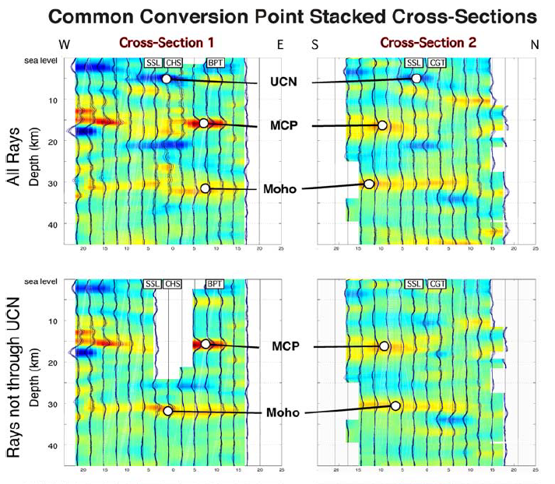
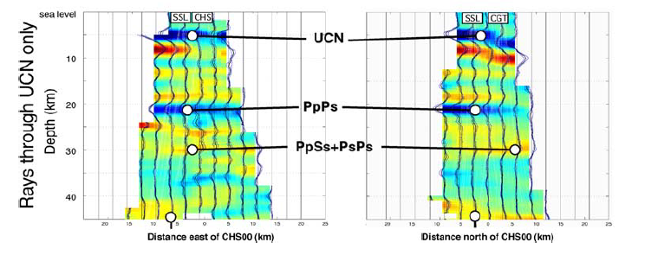
Cross-Section 1
Cross-Section 2
Conclusion: geothermal system lies over a single shallow magma reservoir (5 km below the surface) that also plays a crucial role in the local change in deformation style from areas to the north and west.
UCN: upper crustal negative discontinuity.
MCP: middlecrustal positive discontinuity.
(Wilson et al, 2003, JGR)

Slide 26
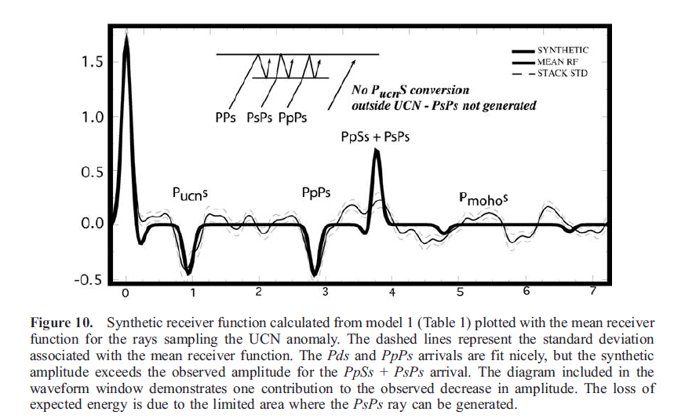
(Wilson et al, 2003, JGR)

Slide 27
Thank you !

