Slide 1
Imaging the underground discontinuity using P-wave reflectivity through seismic interferometry
The reflection response of a horizontally layered acoustic medium can be retrieved from the autocorrelation of a plane-wave transmission response -- (Claerbout, 1968).
The widespread application of these methodologies has also led to data-driven (or observational) advances prior to theoretical understanding. -- (Delph et al., 2019).
Tianjue Li
2020.05

Slide 2
Outlines
Background thesis to reconstruct P-wave reflectivity (1D case);
Candidate phases used to reconstruct P-wave reflectivity:
  Teleseismic phase
  Global phase
Procedure applied to reconstruct P-wave reflectivity;
Extract crustal structure from P-wave reflectivity;
Comparison between P-reflectivity imaged discontinuity with other probes’.

Slide 3
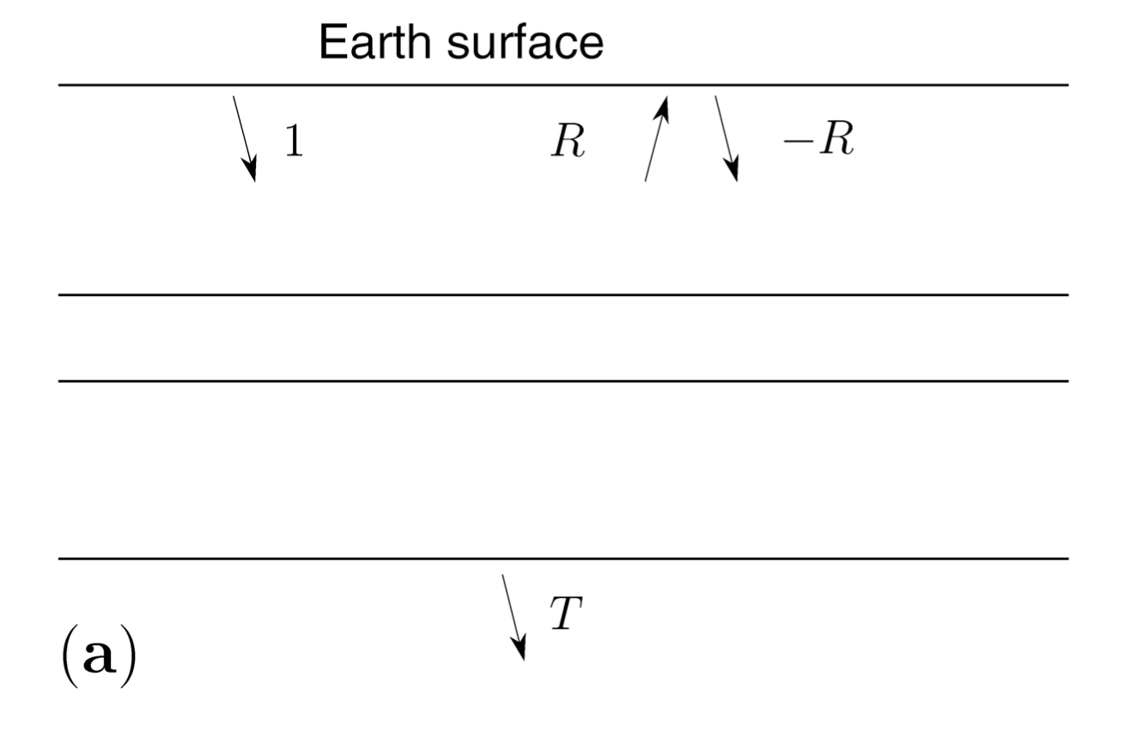



Background thesis to reconstruct P-wave reflectivity (1D case)
R -- total upcoming reflected wavefield;
-R -- downgoing reflected wavefield;
T -- downgoing transmitted wavefield.
layered
Total downgoing wavefield: $D=1−R$
Total upgoing wavefield: U $=R$
homogeneous
Net downgoing power flux: D*D – U*U = (1-R*)(1-R) – R*R = 1-R*-R
Net downgoing power flux in homogeneous half-space:
D*D – U*U = D*D = T*T
Energy conserved
1-R*-R = T*T
Wapenaar, 2003, Geophysics.

Slide 4

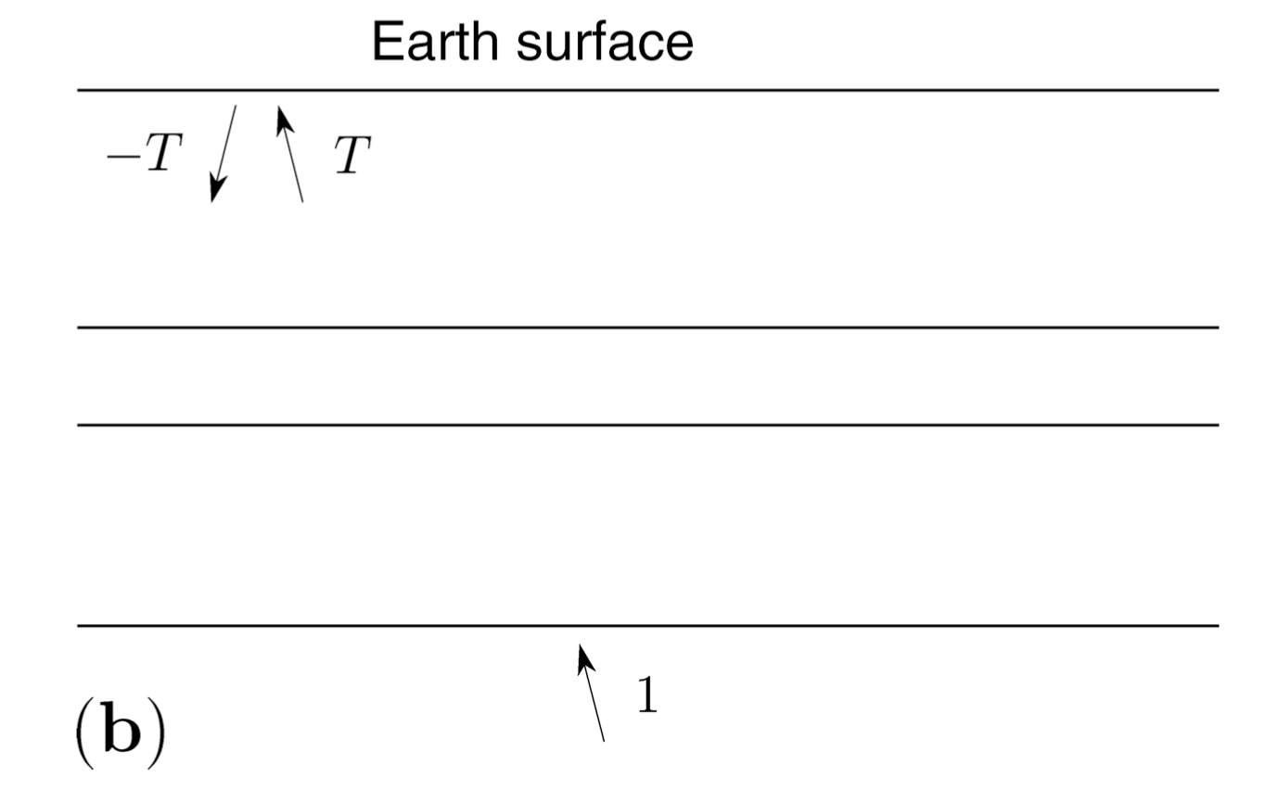
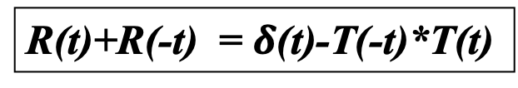
Background thesis to reconstruct P-wave reflectivity (1D case)
Using reciprocity: same seismogram should be recorded if the locations of the source and geophone are exchanged.
layered
layered
homogeneous
homogeneous
1-R*-R = T*T
R(t)+R(-t) = $δ$(t)-T(-t)*T(t)
Wapenaar, 2003, Geophysics.

Slide 5
Background thesis to reconstruct P-wave reflectivity (1D case)
Main Points:
Impulsive source;
Transmission from half-space;
Free surface observation.
layered
homogeneous
Wapenaar, 2003, Geophysics.
Our goal is to highlight pulse-like signal resulted from discontinuity, for the reflection/transmission is simply scaled version of the input wavelet.
Delph et al., 2019, JGR.

Slide 6
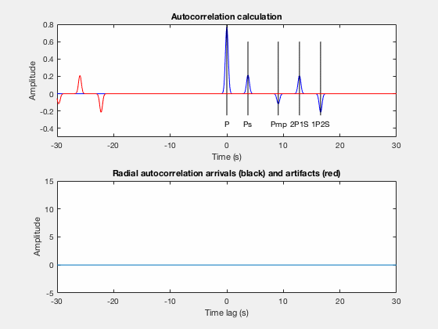
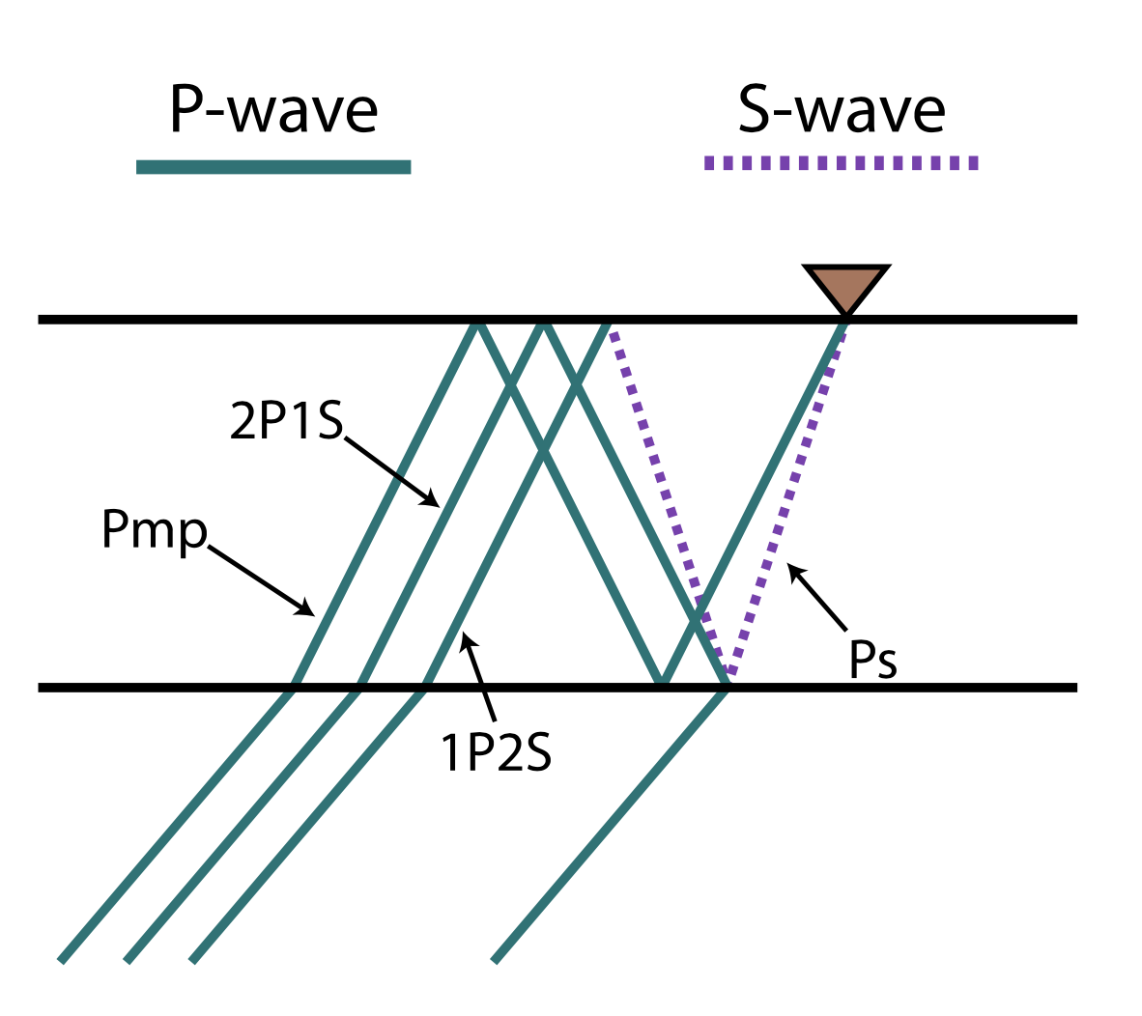
Background thesis to reconstruct P-wave reflectivity (1D case)
Delph et al., 2019, JGR.

Slide 7
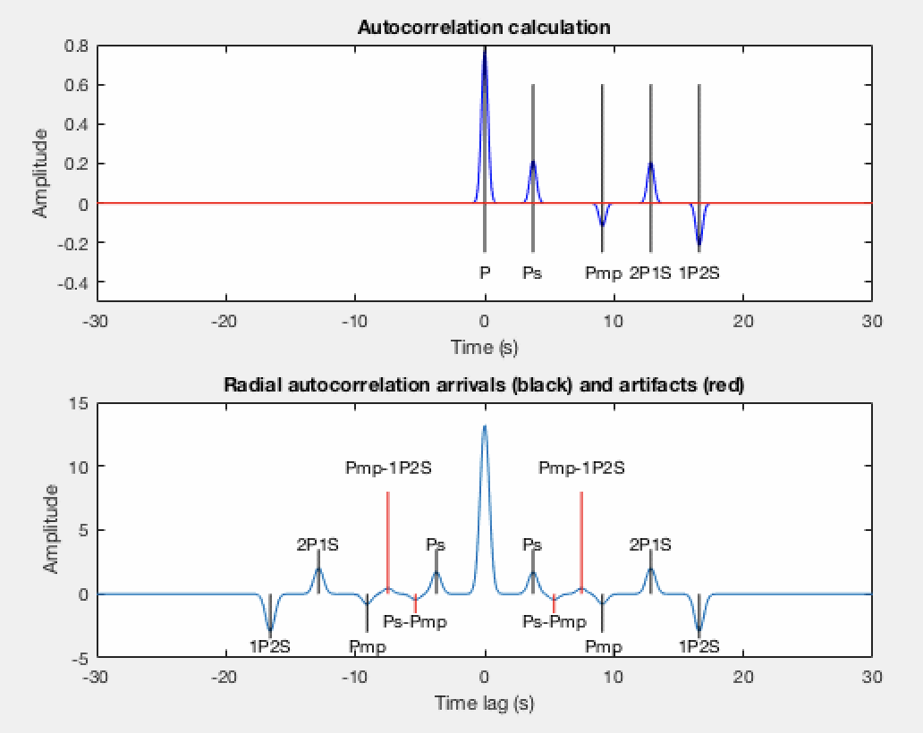
Background thesis to reconstruct P-wave reflectivity (1D case)
Delph et al., 2019, JGR.

Slide 8
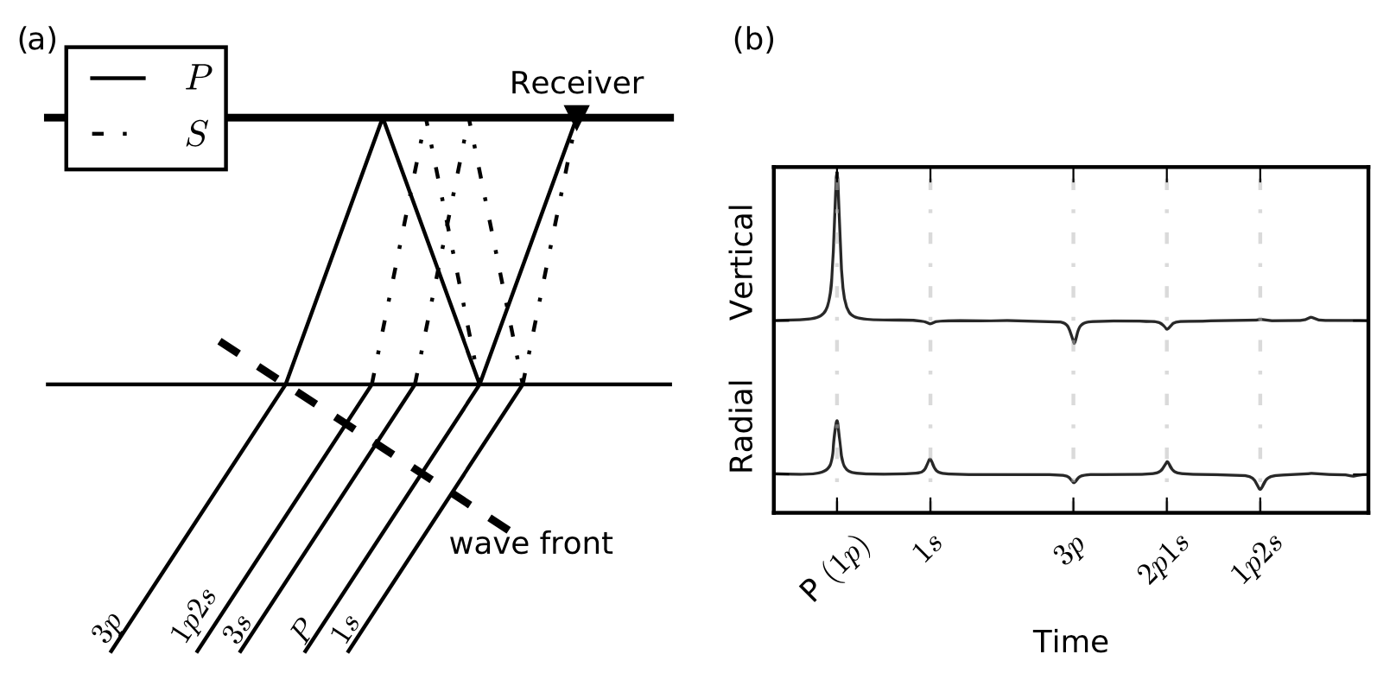
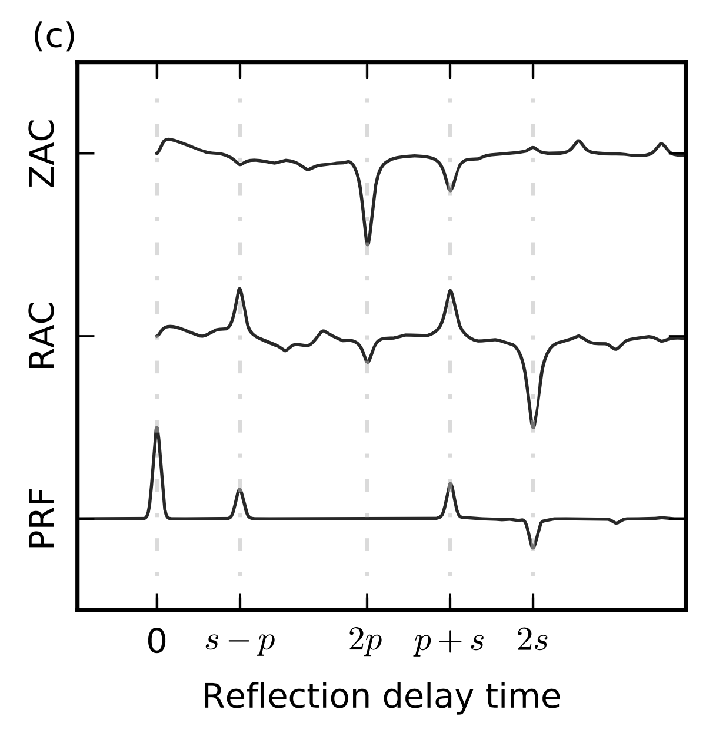
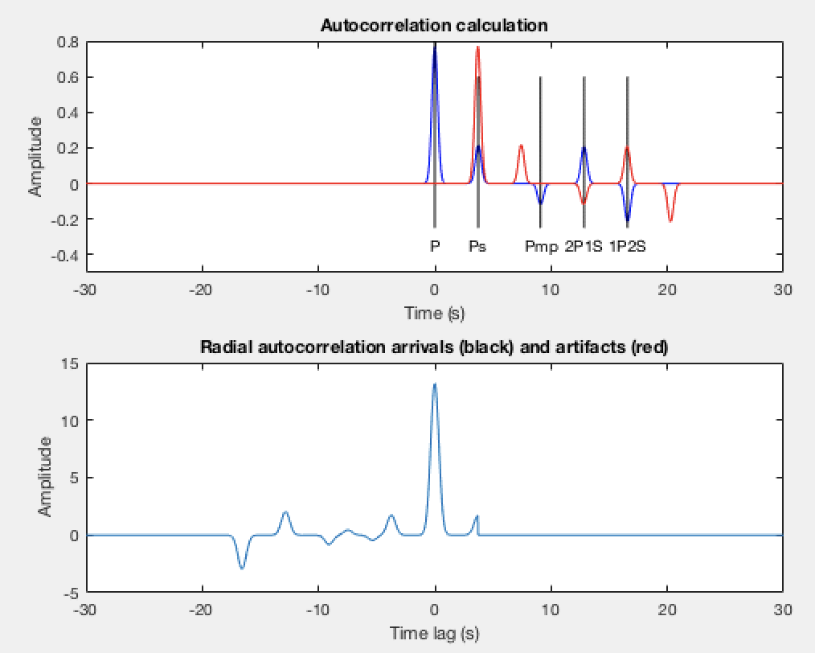
Background thesis to reconstruct P-wave reflectivity (1D case)
Delph et al., 2019, JGR.
Pms
(1p-1s + 3p-2p1s + 2p1s-1p2s)
Phạm & Tkalčić, 2017, JGR.

Slide 9
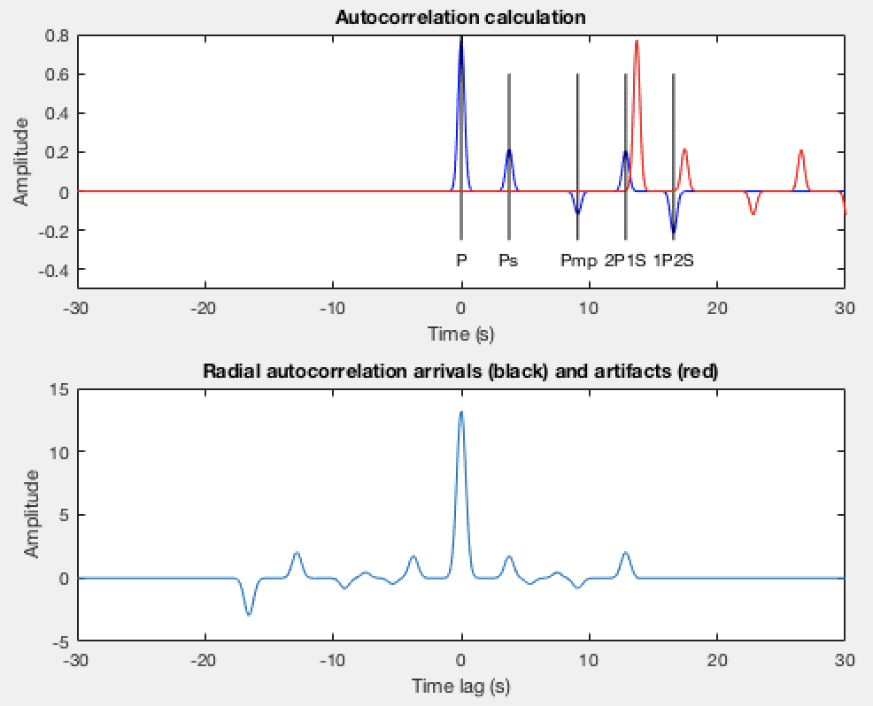
Background thesis to reconstruct P-wave reflectivity (1D case)
Delph et al., 2019, JGR.
PpPms
(1p-2p1s + 1s-1p2s )
Phạm & Tkalčić, 2017, JGR.

Slide 10
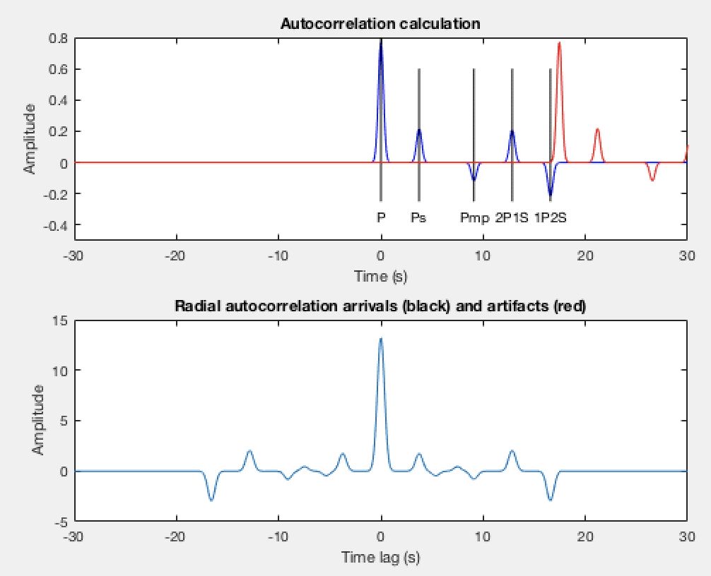
Background thesis to reconstruct P-wave reflectivity (1D case)
Delph et al., 2019, JGR.
PsSmp
(1p-1p2s)
Phạm & Tkalčić, 2017, JGR.

Slide 11
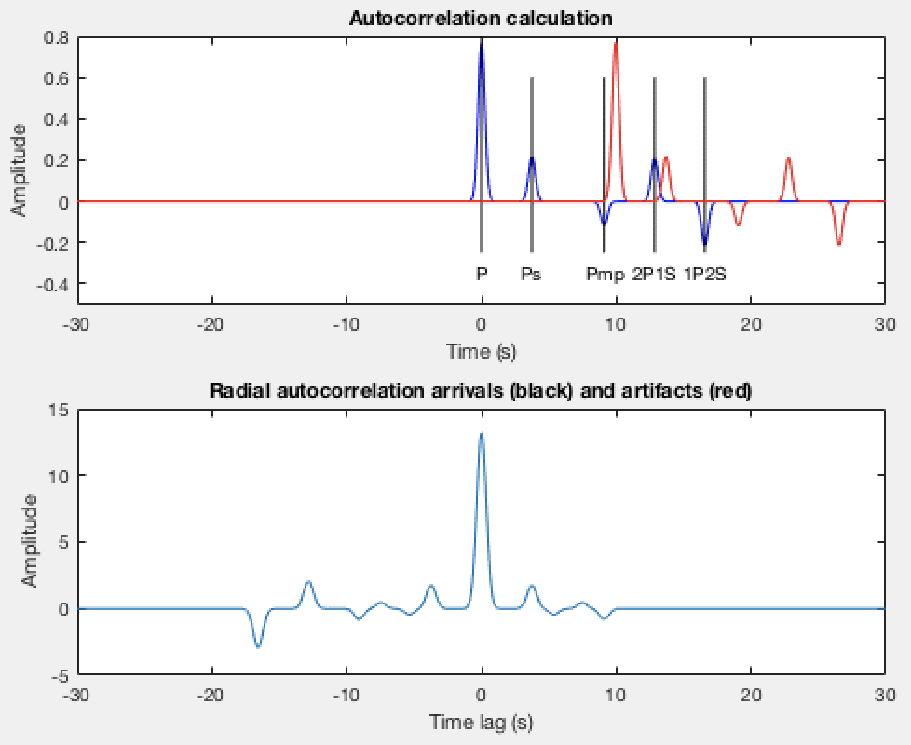
Background thesis to reconstruct P-wave reflectivity (1D case)
Delph et al., 2019, JGR.
PmP
Z_{PmP}/R_{PmP}=Z_{P}/R_{P}
(1p-3p + 1s-2p1s)
Phạm & Tkalčić, 2017, JGR.

Slide 12
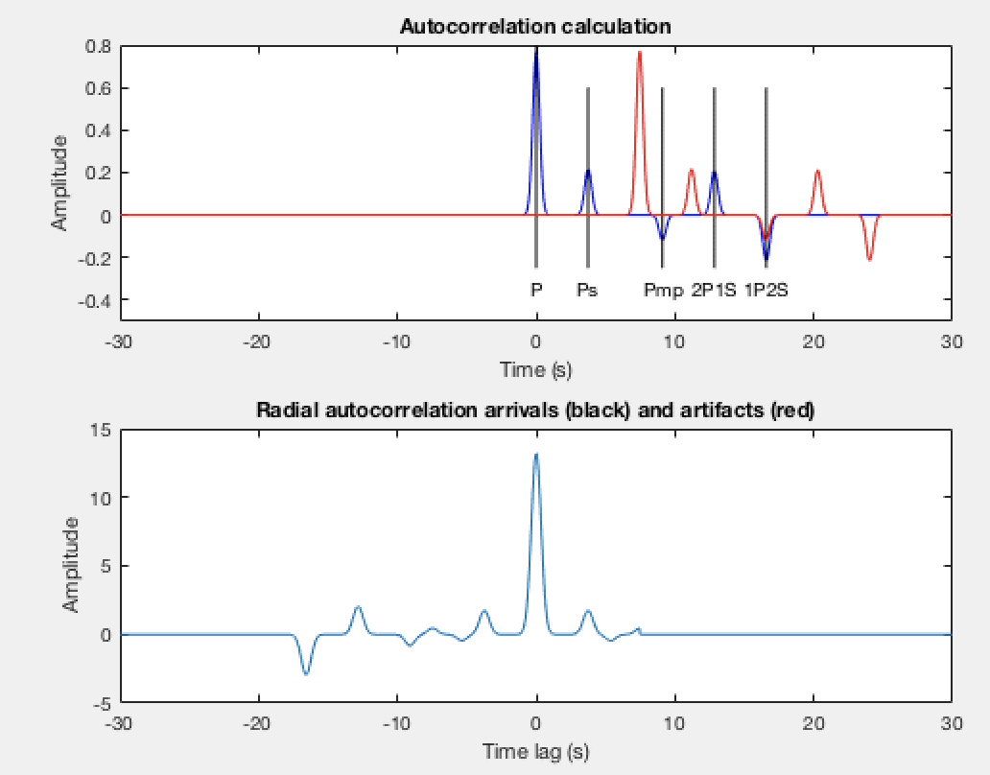
Background thesis to reconstruct P-wave reflectivity (1D case)
Spurious phase – correlation wavefield
Predicted by 𝑡_{1P2S} − 𝑡_{PmP}
Delph et al., 2019, JGR.

Slide 13
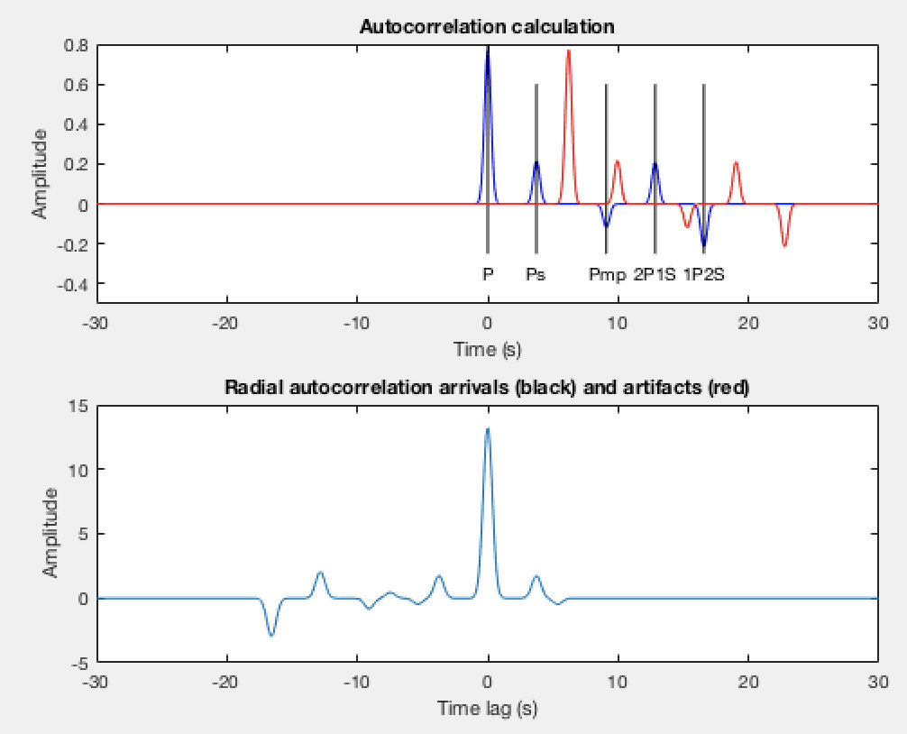
Background thesis to reconstruct P-wave reflectivity (1D case)
Spurious phase – correlation wavefield
Predicted by 𝑡_{PmP} − 𝑡_{Ps}
Delph et al., 2019, JGR.

Slide 14
Background thesis to reconstruct P-wave reflectivity (1D case)
Phạm & Tkalčić, 2017, JGR.
Pmp phase in receiver functions largely cancels due to its similarity on both the vertical and radial component seismograms (and converted phases are highlighted, crosscorrelation);
The autocorrelation of the individual components highlights waves that are similar in character.
Delph et al., 2019, JGR.

Slide 15


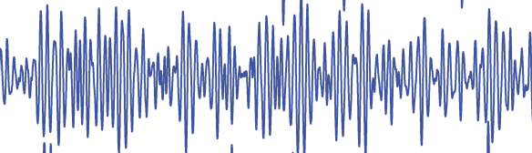
Candidate phases used to reconstruct P-wave reflectivity
P-wave Coda
Ambient Noise
Single station

Slide 16
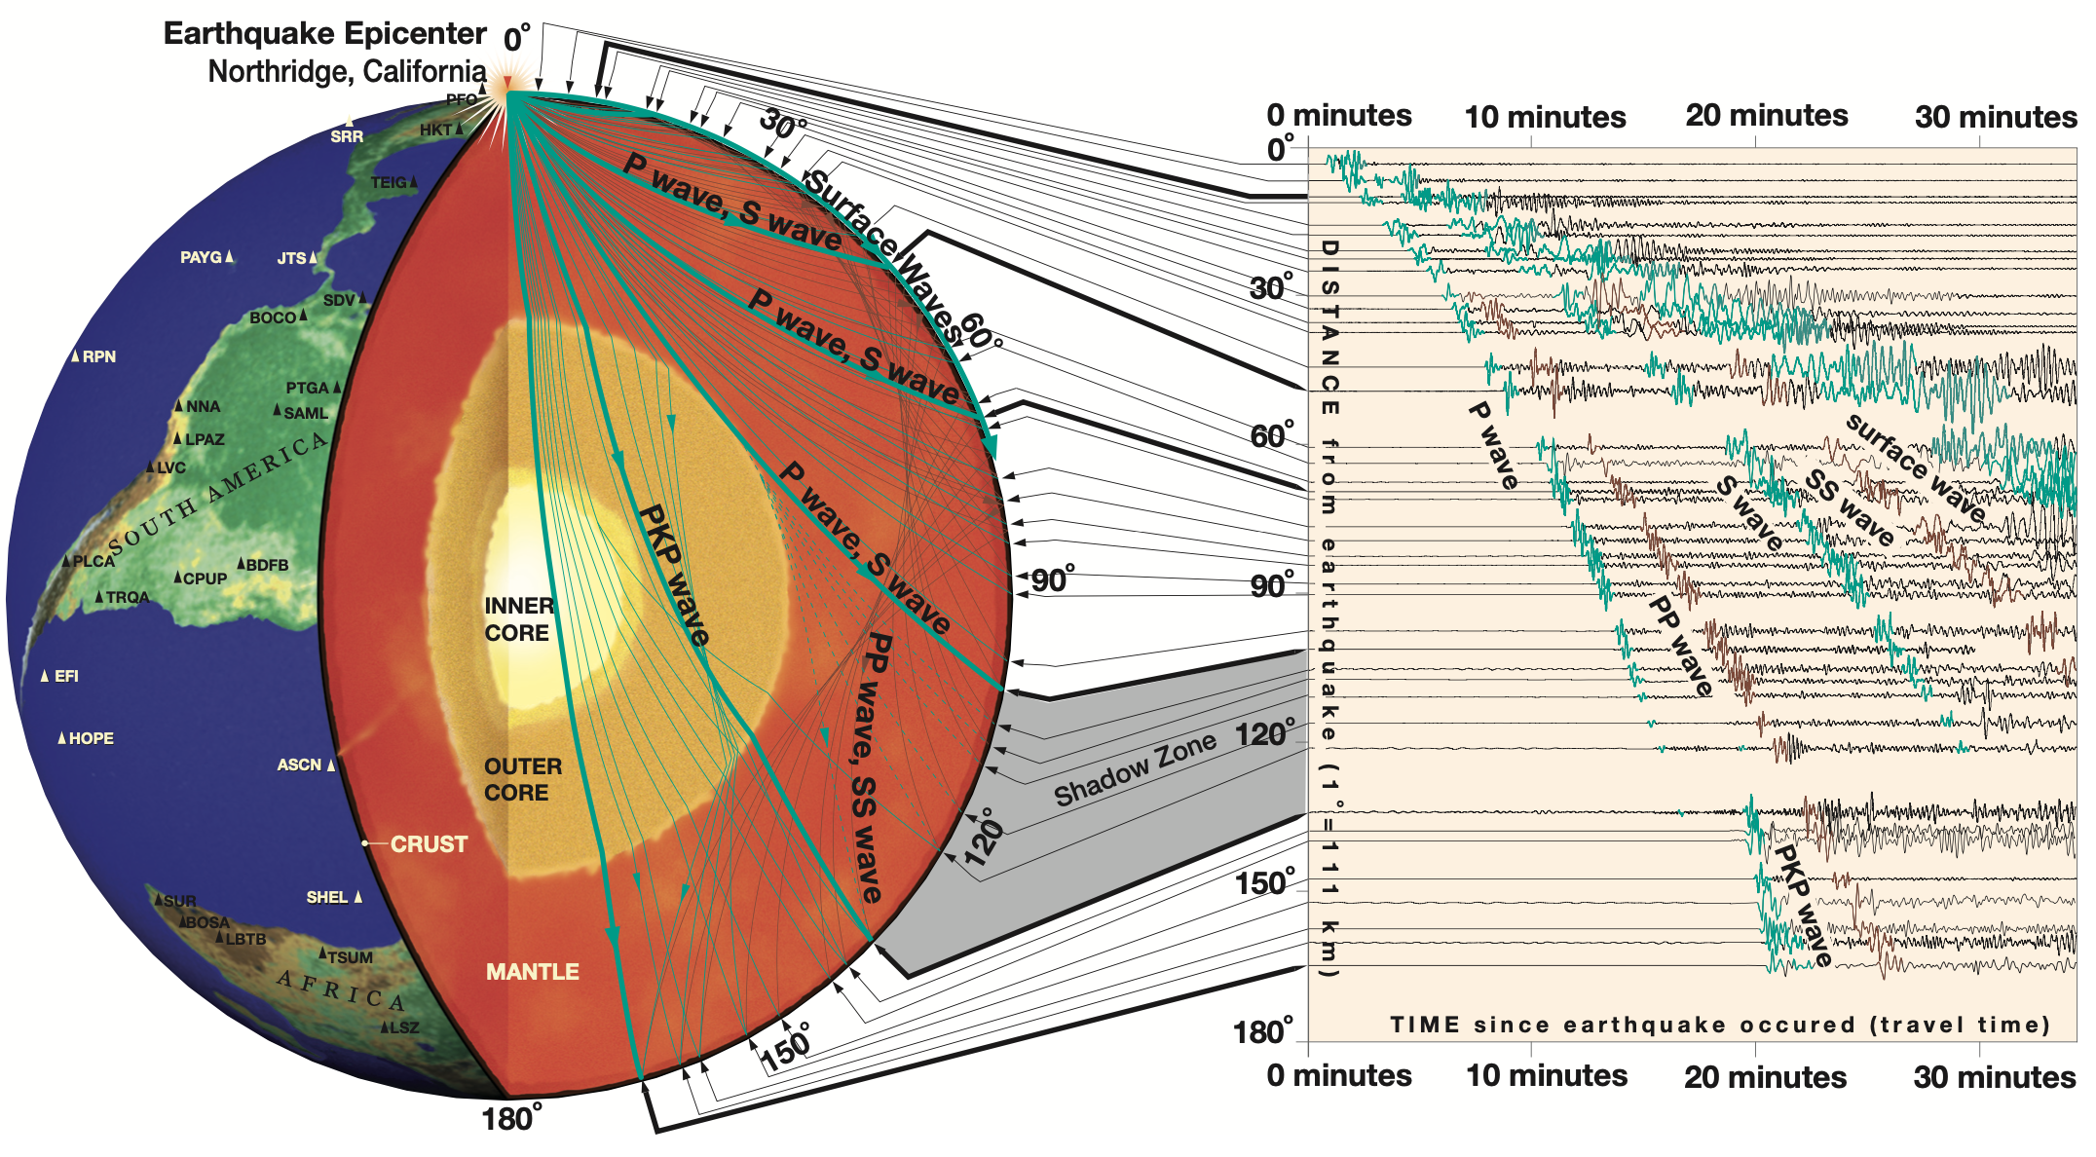
Candidate phases used to reconstruct P-wave reflectivity
Teleseismic
(0.04～0.08 s/km)
Global
0~0.04 s/km
IRIS
Select the time window containing a single dominant phase and its reverberations between free surface and discontinuities.
Notes:
Incident at Moho, 0.04 – 18.9; 0.08 – 40.4; with mantle P-wave 8.1 km/s.

Slide 17
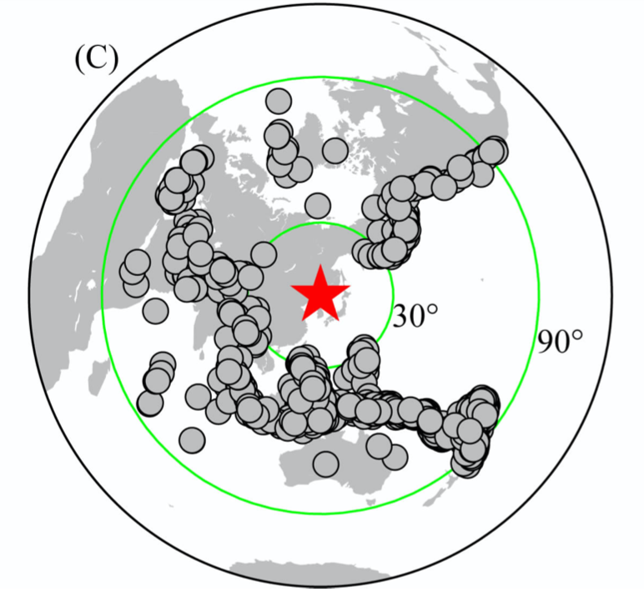
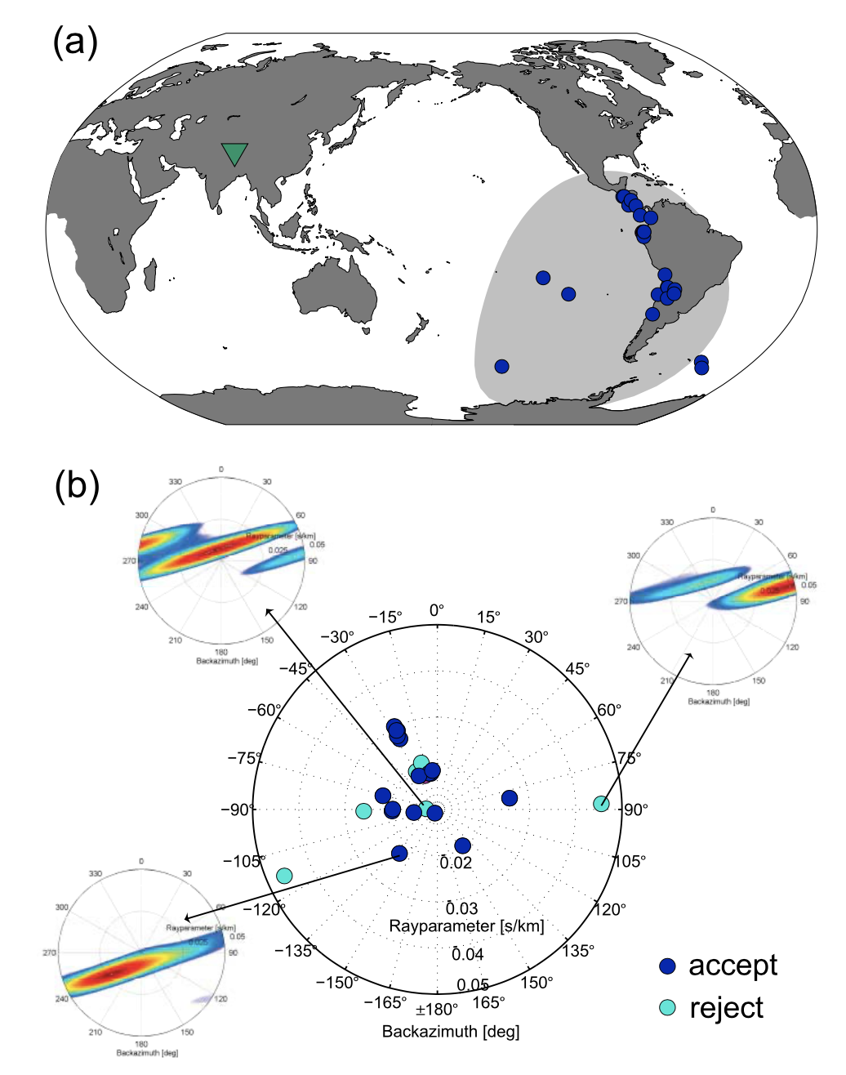
Candidate phases used to reconstruct P-wave reflectivity
30 ~ 90∘ , M>5.5
Teleseismic Phase
Gobal Phase
>120∘ , M>6, p < 0.04 s/km, single p
Ruigrok & Wapenaar, 2012, GRL.

Slide 18
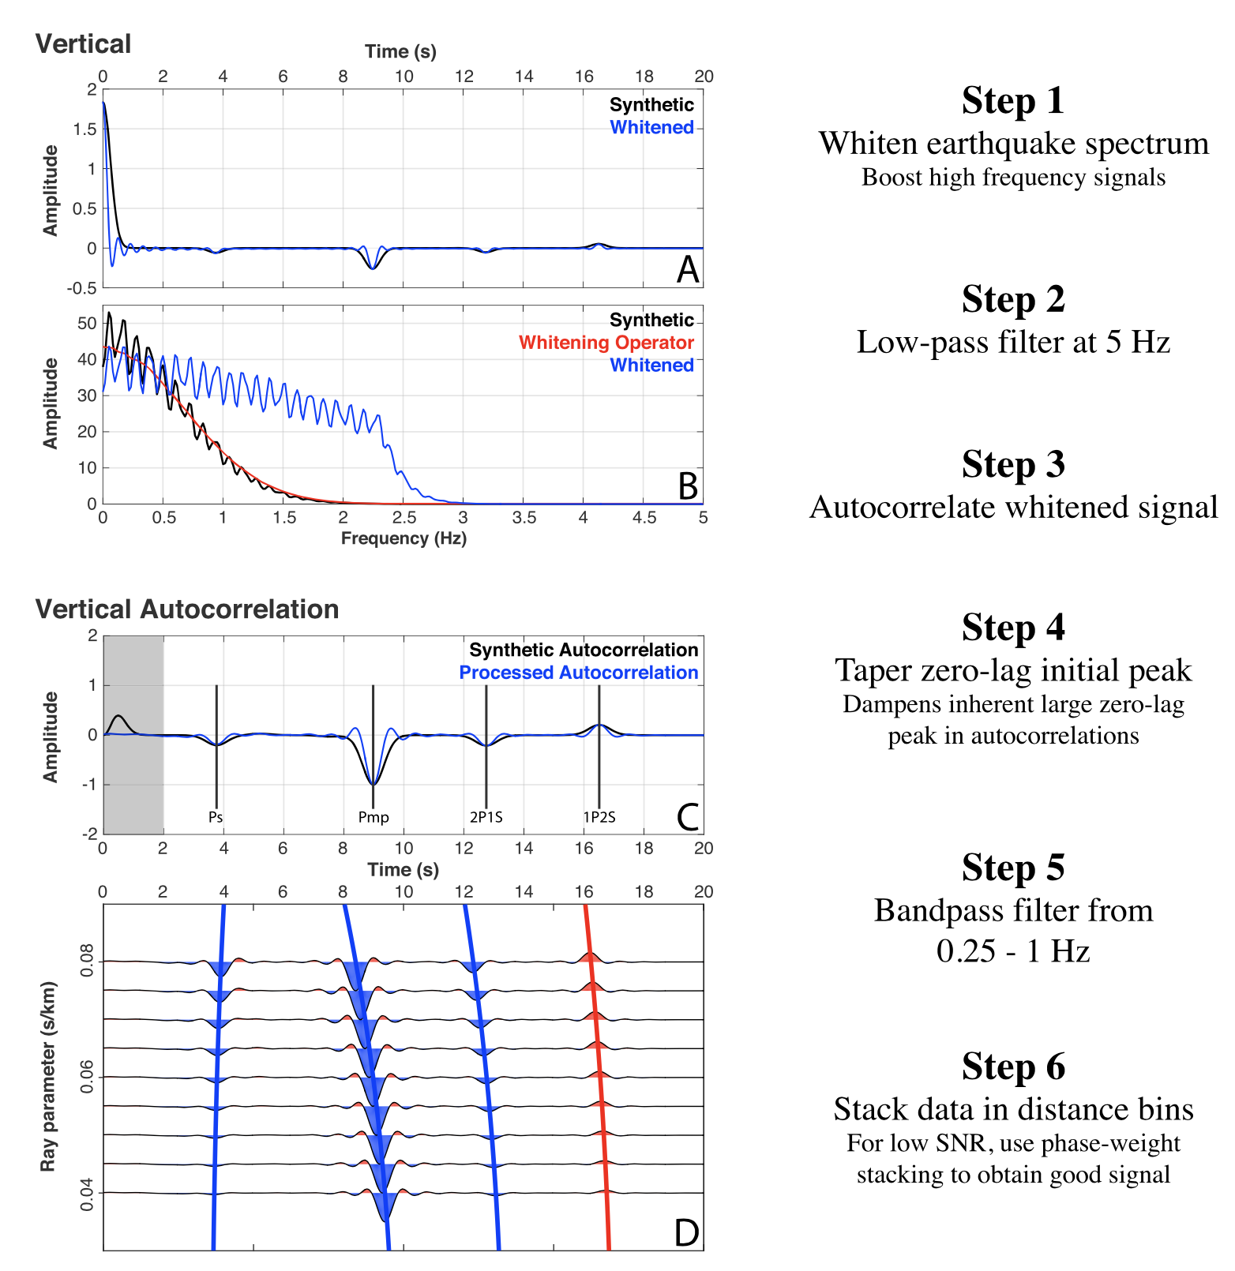
Procedure applied to reconstruct P-wave reflectivity
Synthetic
Delph et al., 2019, JGR.

Slide 19
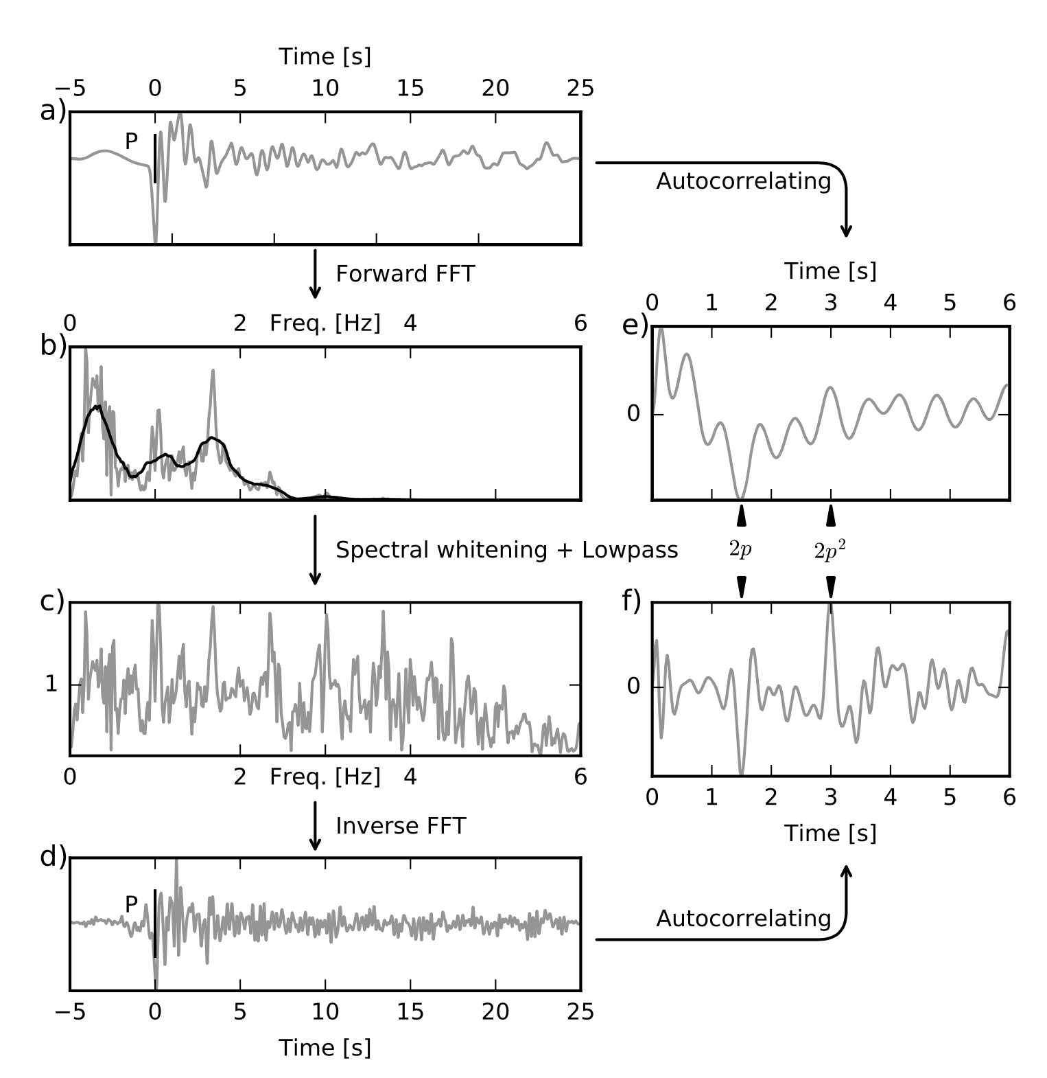
Procedure applied to reconstruct P-wave reflectivity
Observation:
Whiten Signal
Phạm & Tkalčić, 2017, JGR.

Slide 20
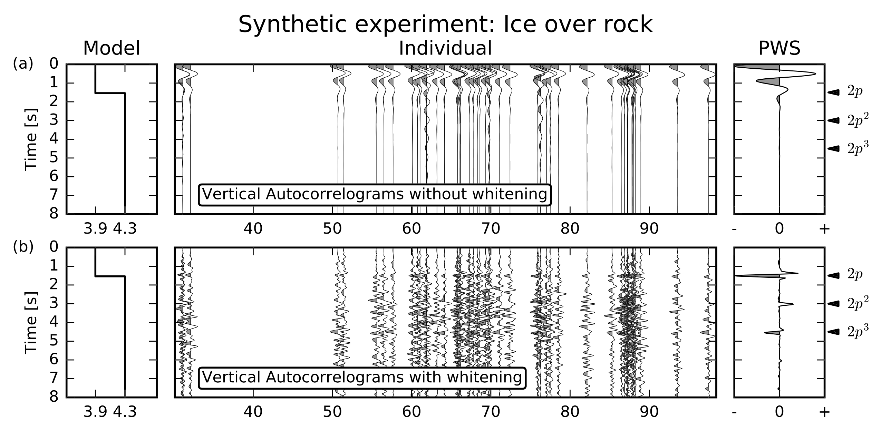
Procedure applied to reconstruct P-wave reflectivity
Observation:
Whiten Signal
Phạm & Tkalčić, 2017, JGR.

Slide 21
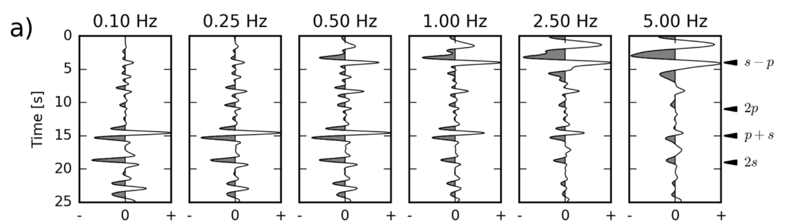
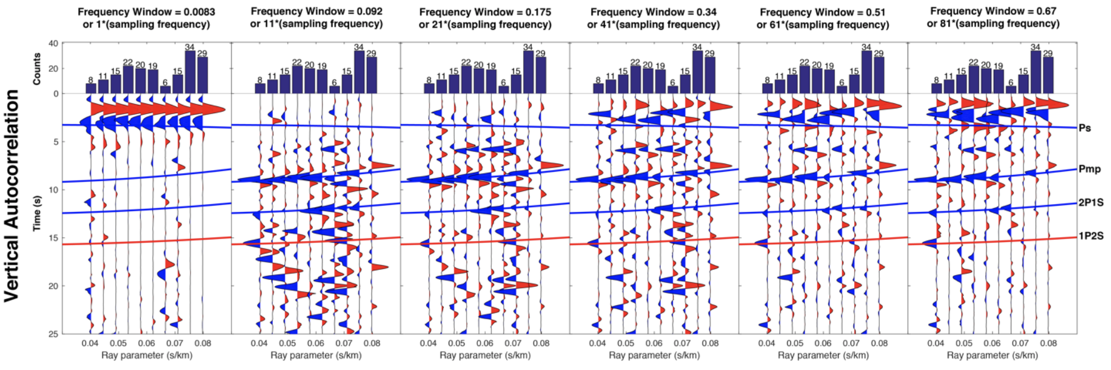
Procedure applied to reconstruct P-wave reflectivity
Observation:
Whiten Signal
whitening–window widths
ΔW=2NΔω (in Hz)
Phạm & Tkalčić, 2017, JGR.
Delph et al., 2019, JGR.

Slide 22
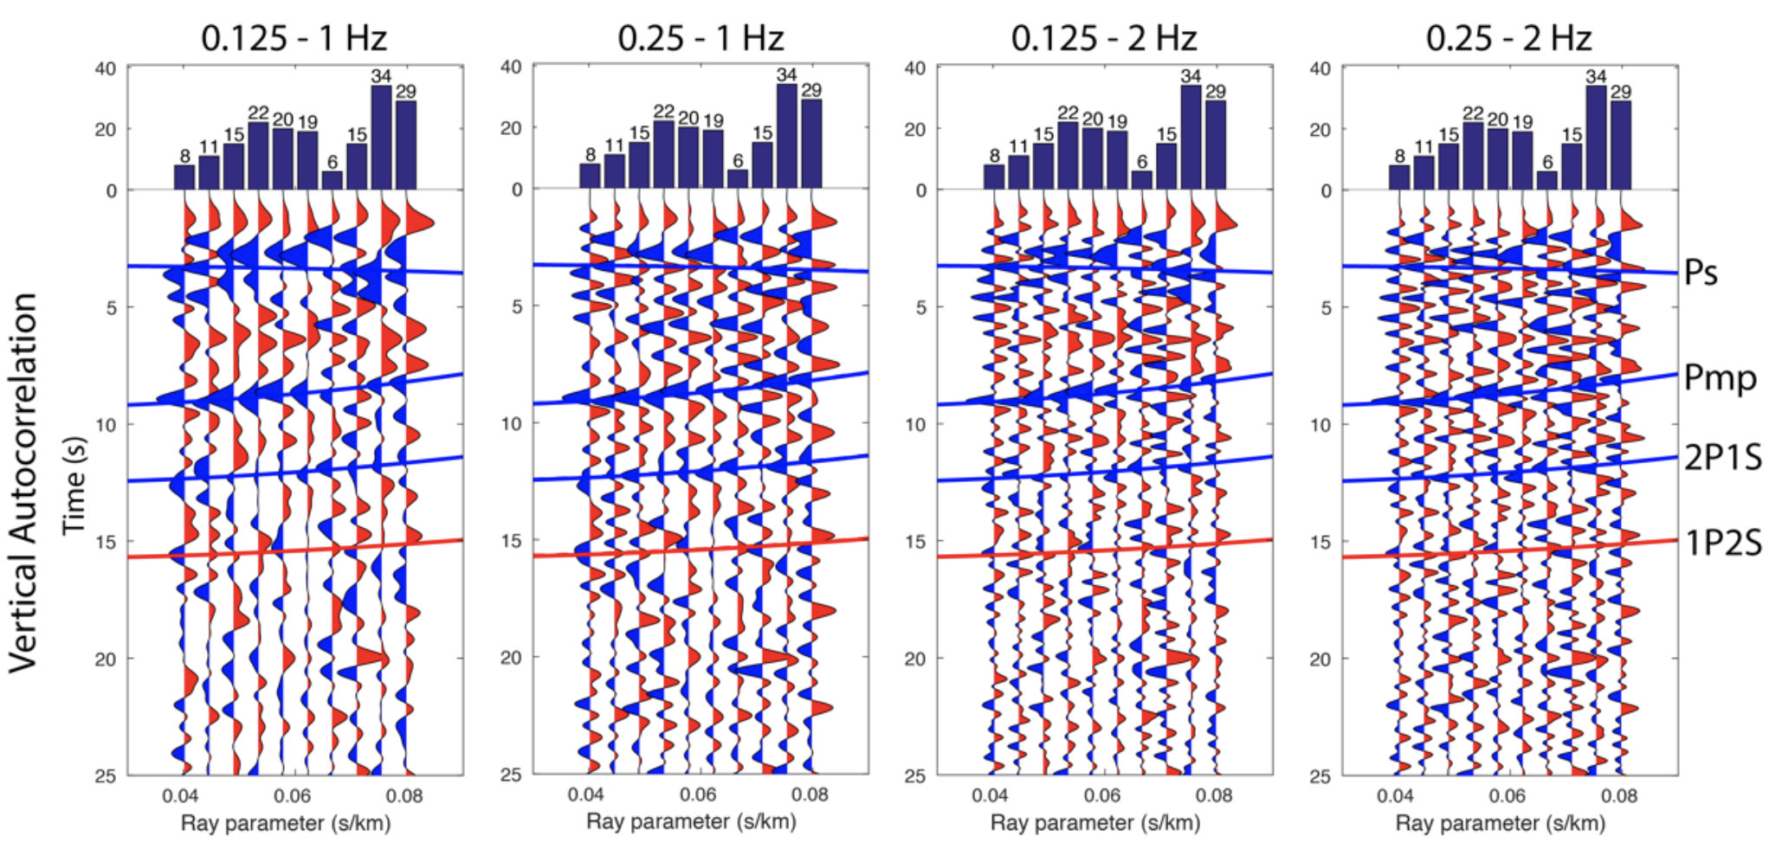
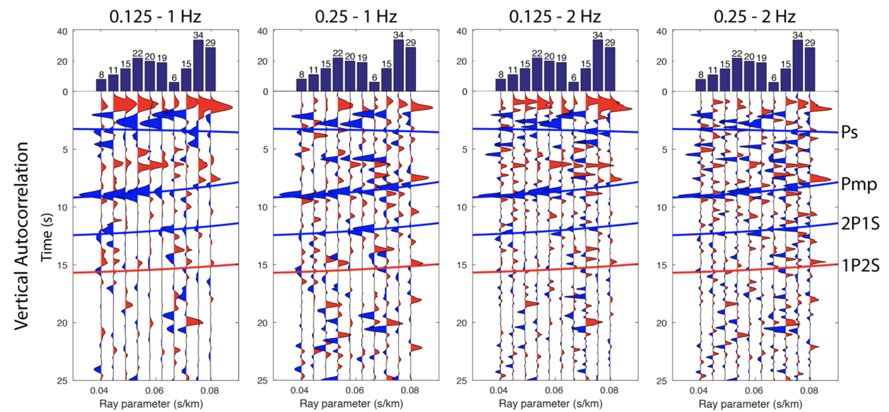
Procedure applied to reconstruct P-wave reflectivity
Observation:
Phase-weight Stacking
Linearly Stacking
Phase-Weight Stacking
Delph et al., 2019, JGR.

Slide 23
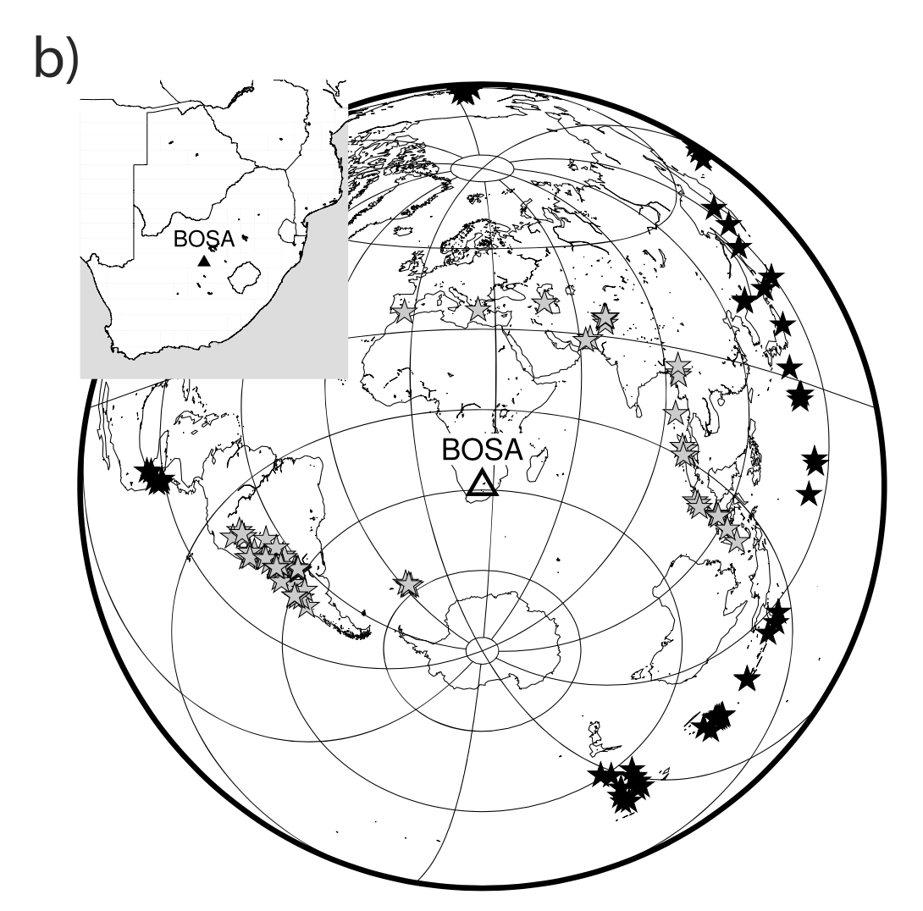
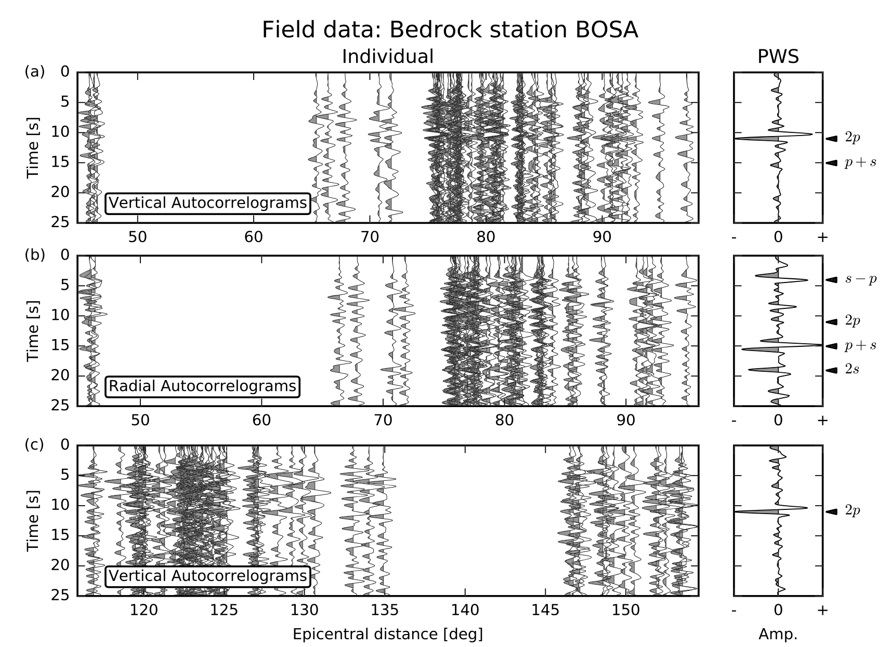
Procedure applied to reconstruct P-wave reflectivity
Observation at Craton
Phạm & Tkalčić, 2017, JGR.

Slide 24
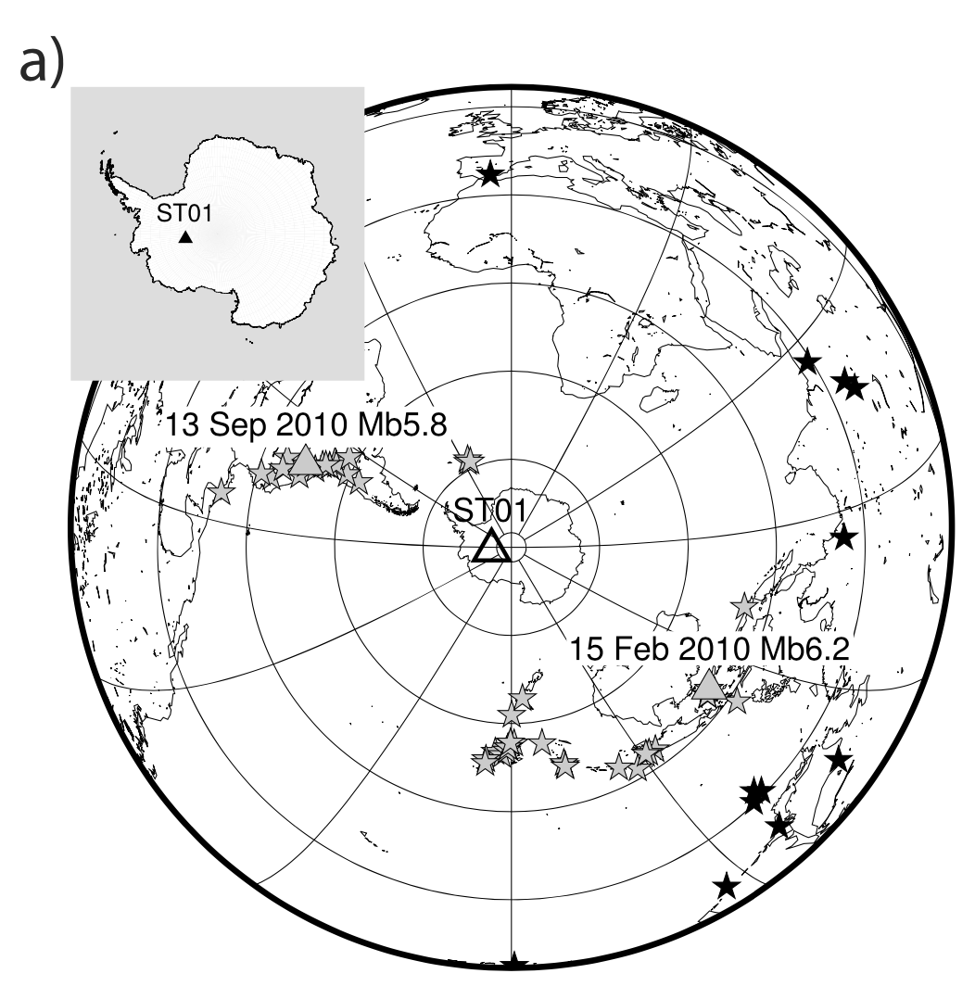
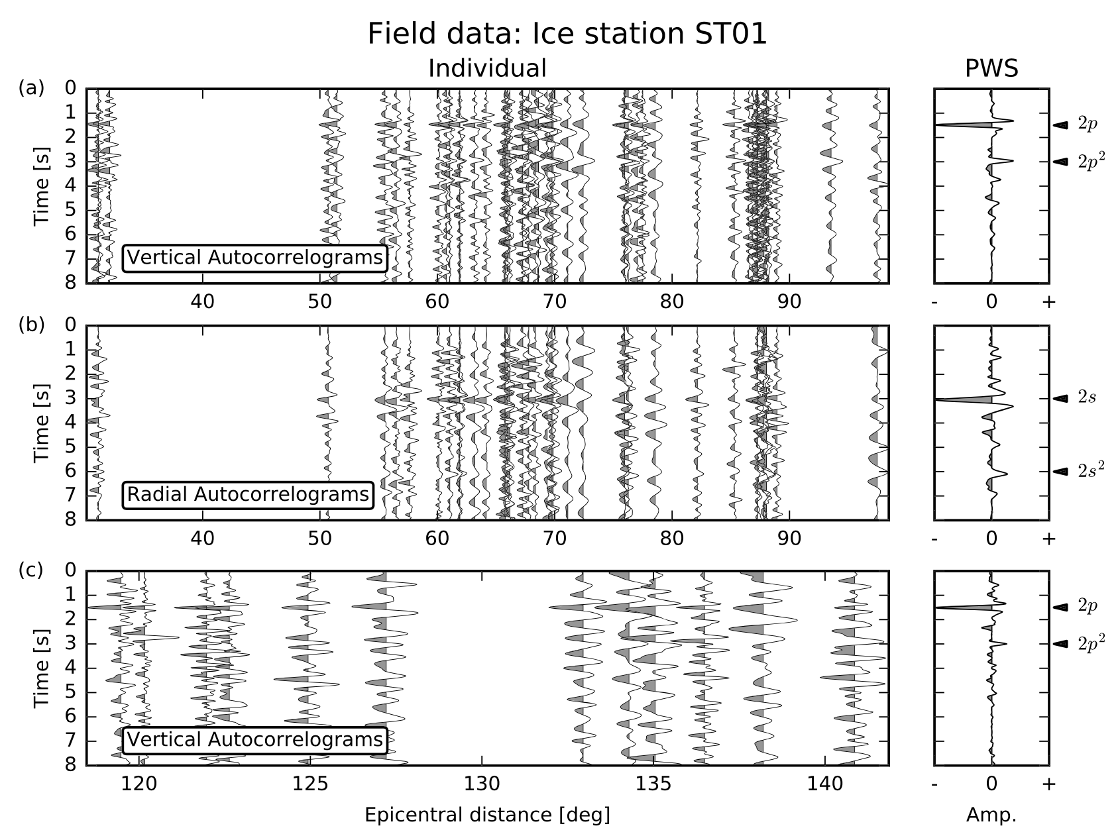
Procedure applied to reconstruct P-wave reflectivity
Observation at Ice Sheet
Phạm & Tkalčić, 2017, JGR.

Slide 25
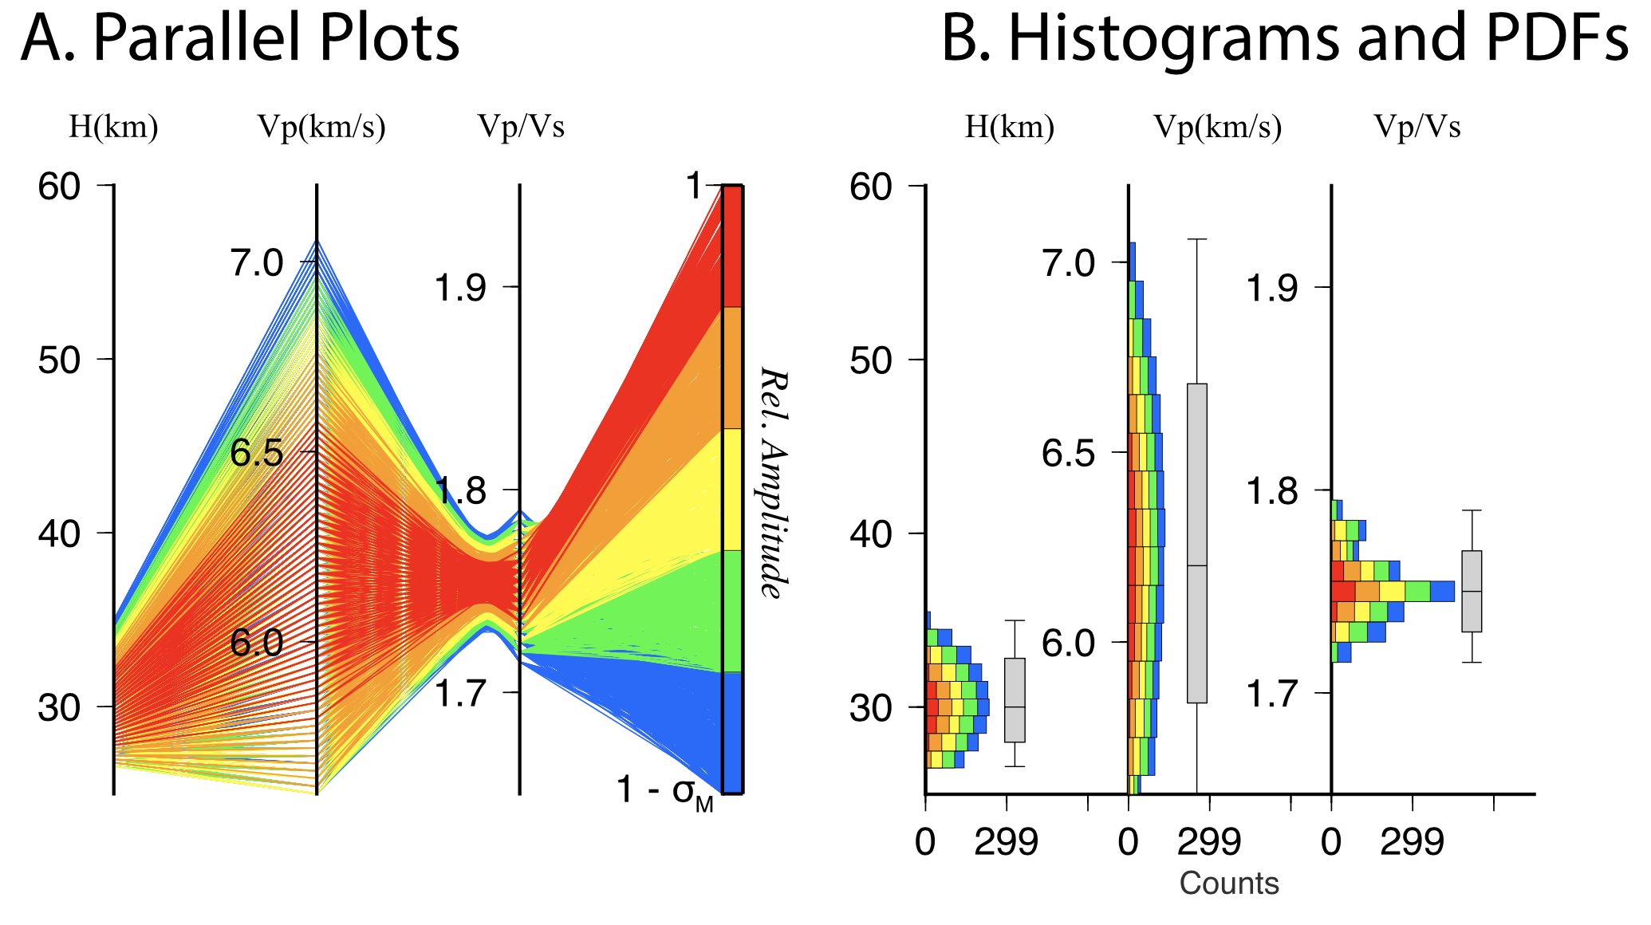
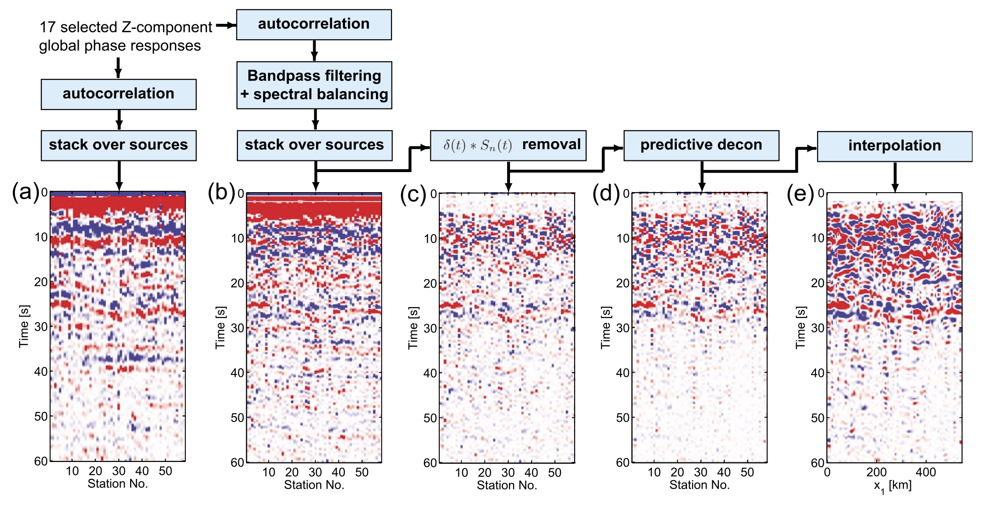
Extract crustal structure from P-wave reflectivity
H-𝜅-Vp grid search stacking
(Delph et al., 2019, JGR.)
Migration
(Ruigrok & Wapenaar, 2012, GRL.)

Slide 26
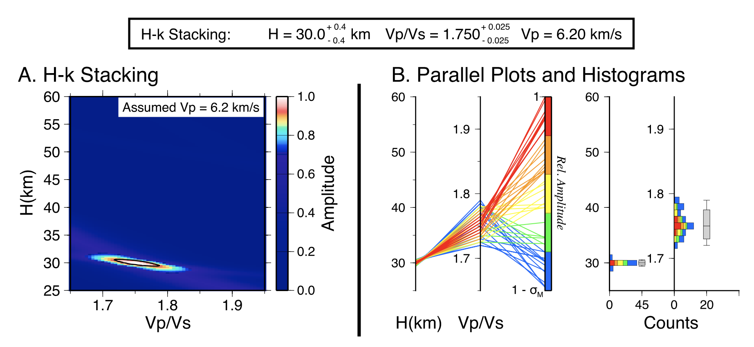
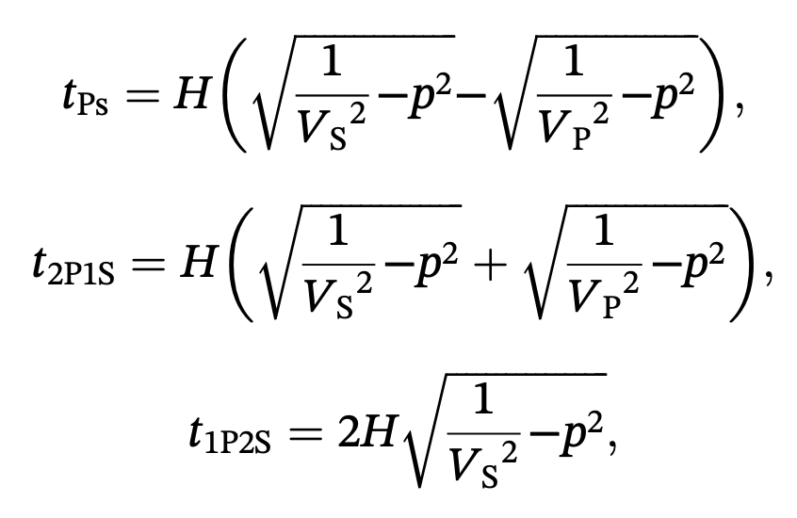
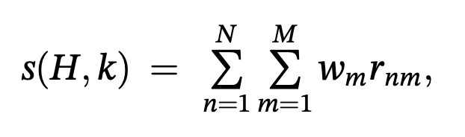
Extract crustal structure from P-wave reflectivity
H-𝜅-Vp grid search stacking
(Delph et al., 2019, JGR.)
0.7
0.2
0.1
H-𝜅
Notes:
middle 68.2% of solutions

Slide 27
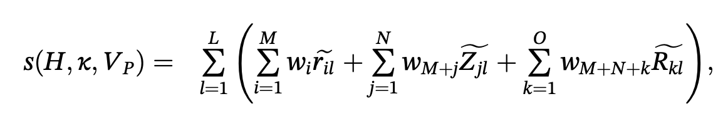
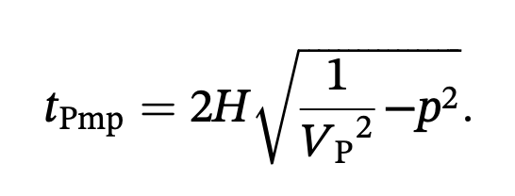
Extract crustal structure from P-wave reflectivity
H-𝜅-Vp grid search stacking
(Delph et al., 2019, JGR.)
0.4
0.2
0
H-𝜅-Vp
0.4
Notes:
middle 68.2% of solutions

Slide 28
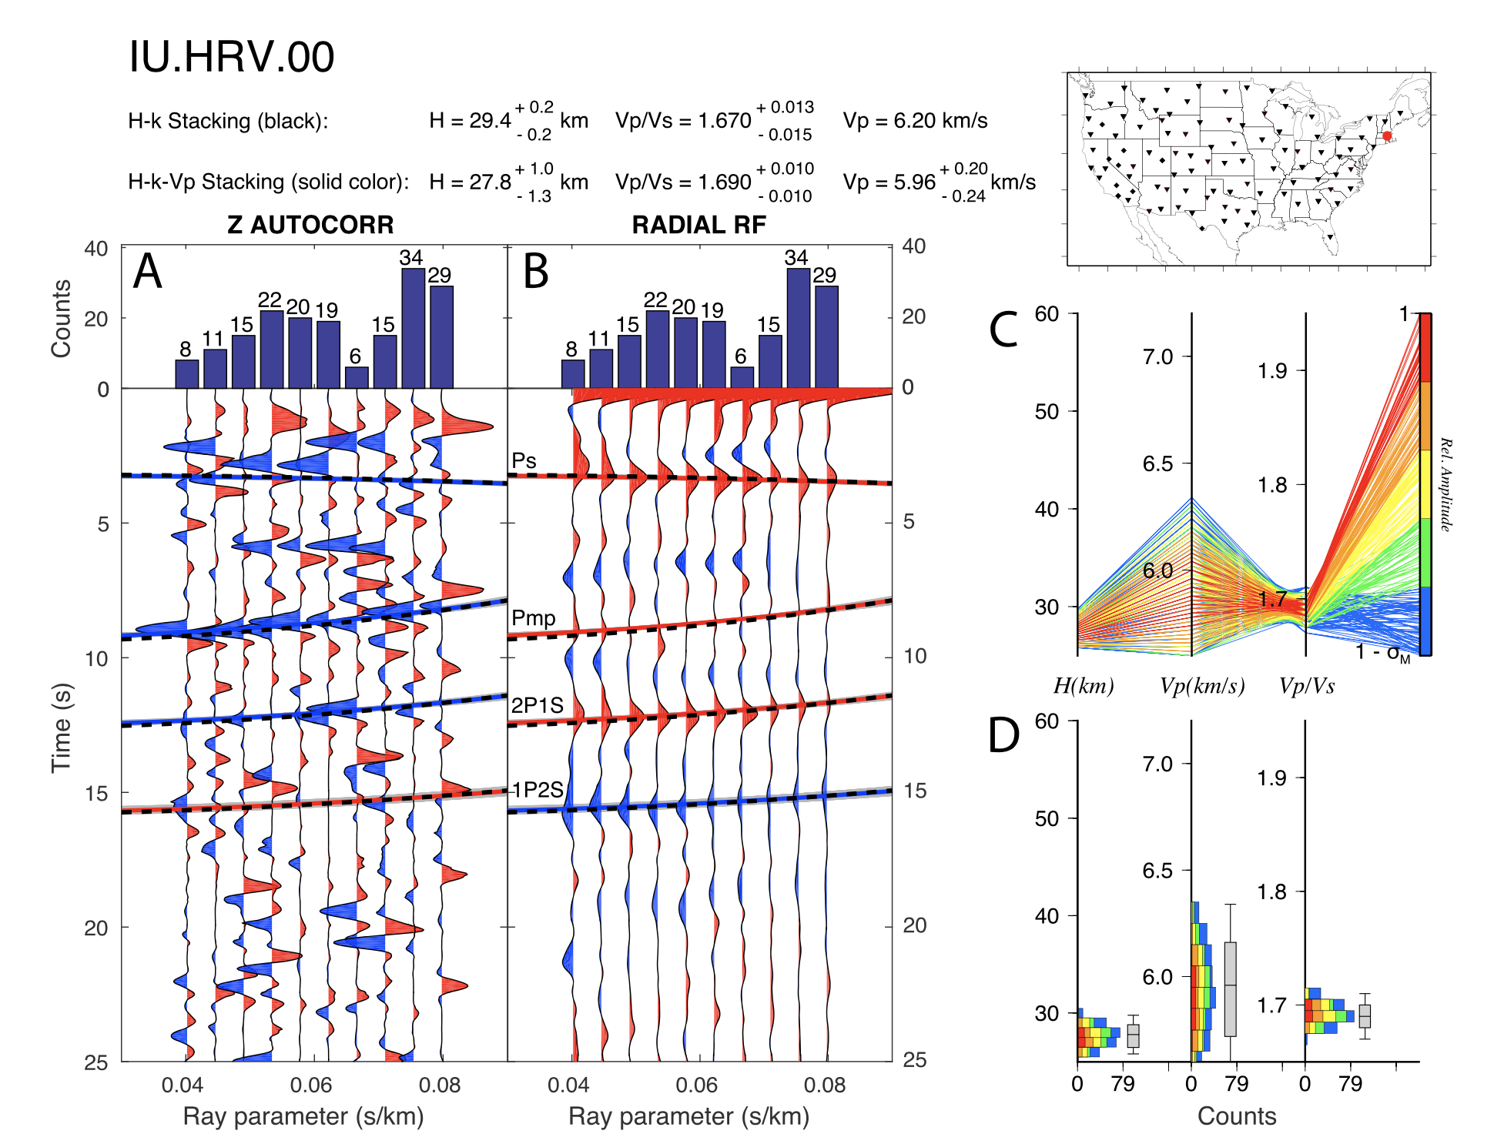
Extract crustal structure from P-wave reflectivity
H-𝜅-Vp grid search stacking
(Delph et al., 2019, JGR.)
Black dashed
Gray
Notes:
middle 68.2% of solutions

Slide 29
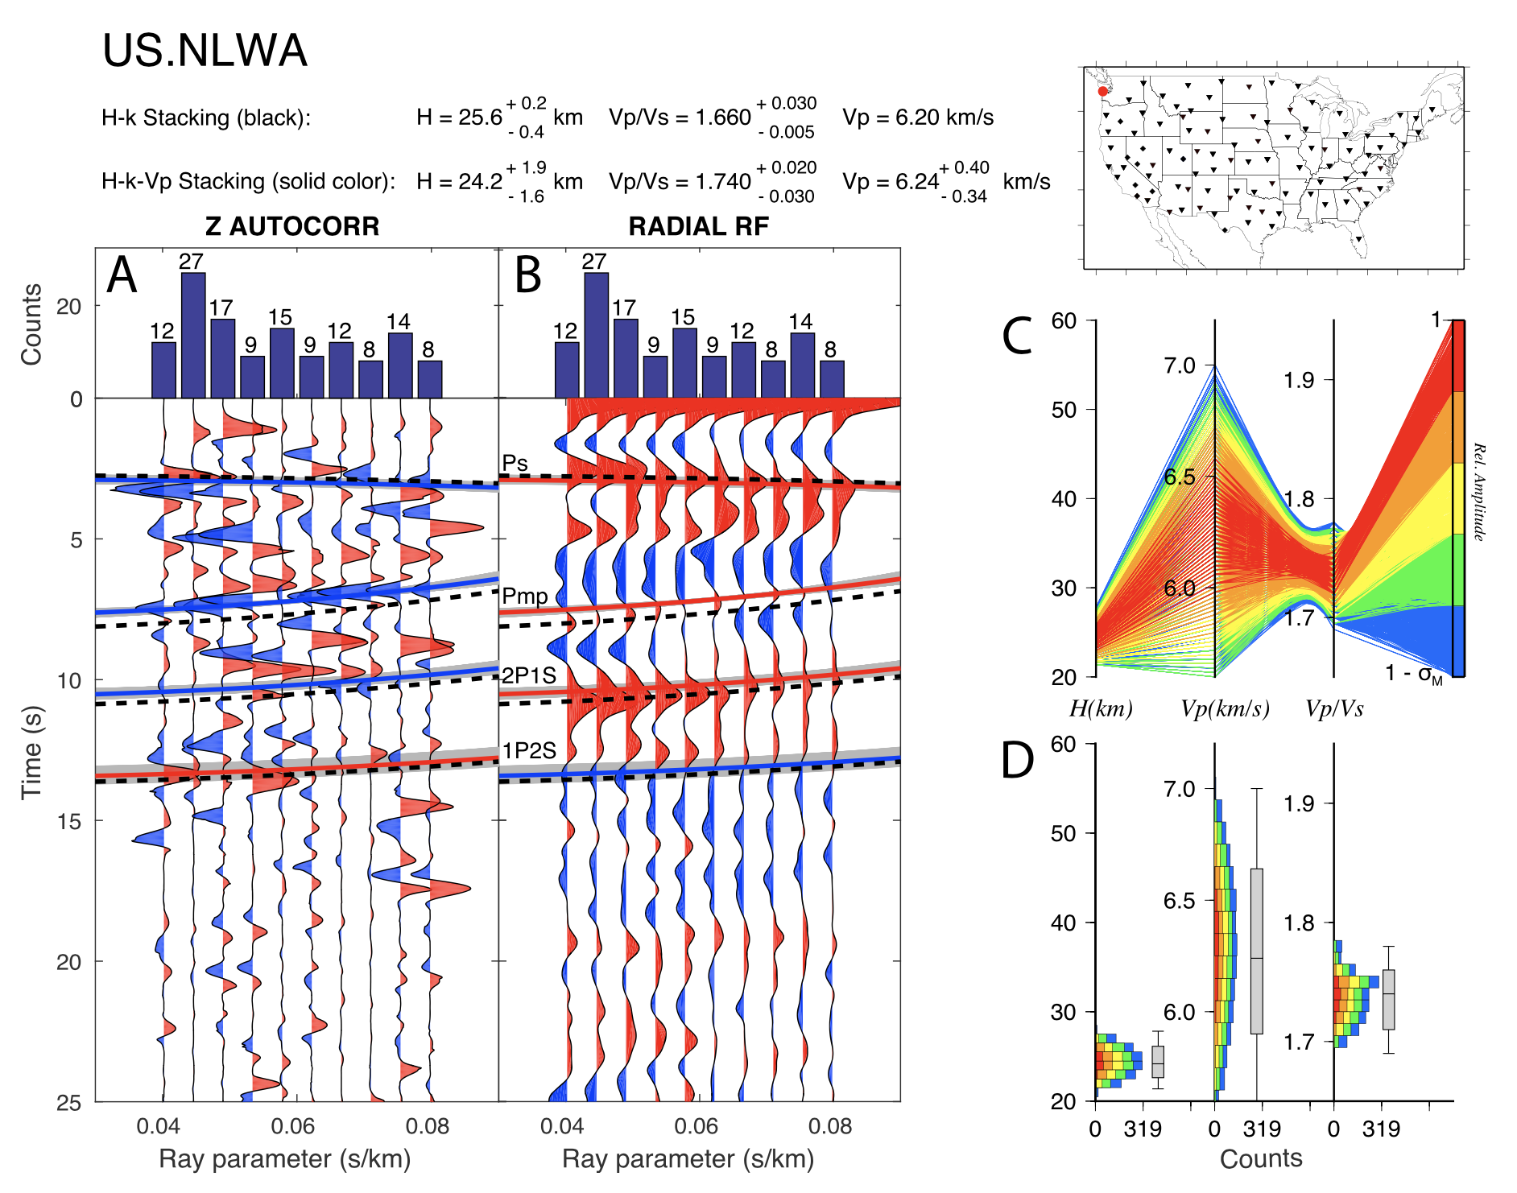
Extract crustal structure from P-wave reflectivity
H-𝜅-Vp grid search stacking
(Delph et al., 2019, JGR.)
Black dashed
Gray
Notes:
middle 68.2% of solutions

Slide 30
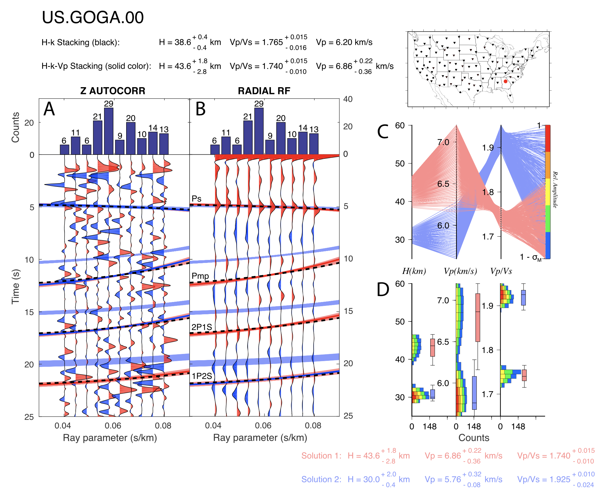
Extract crustal structure from P-wave reflectivity
H-𝜅-Vp grid search stacking
(Delph et al., 2019, JGR.)
Black dashed
Gray
Notes:
middle 68.2% of solutions

Slide 31
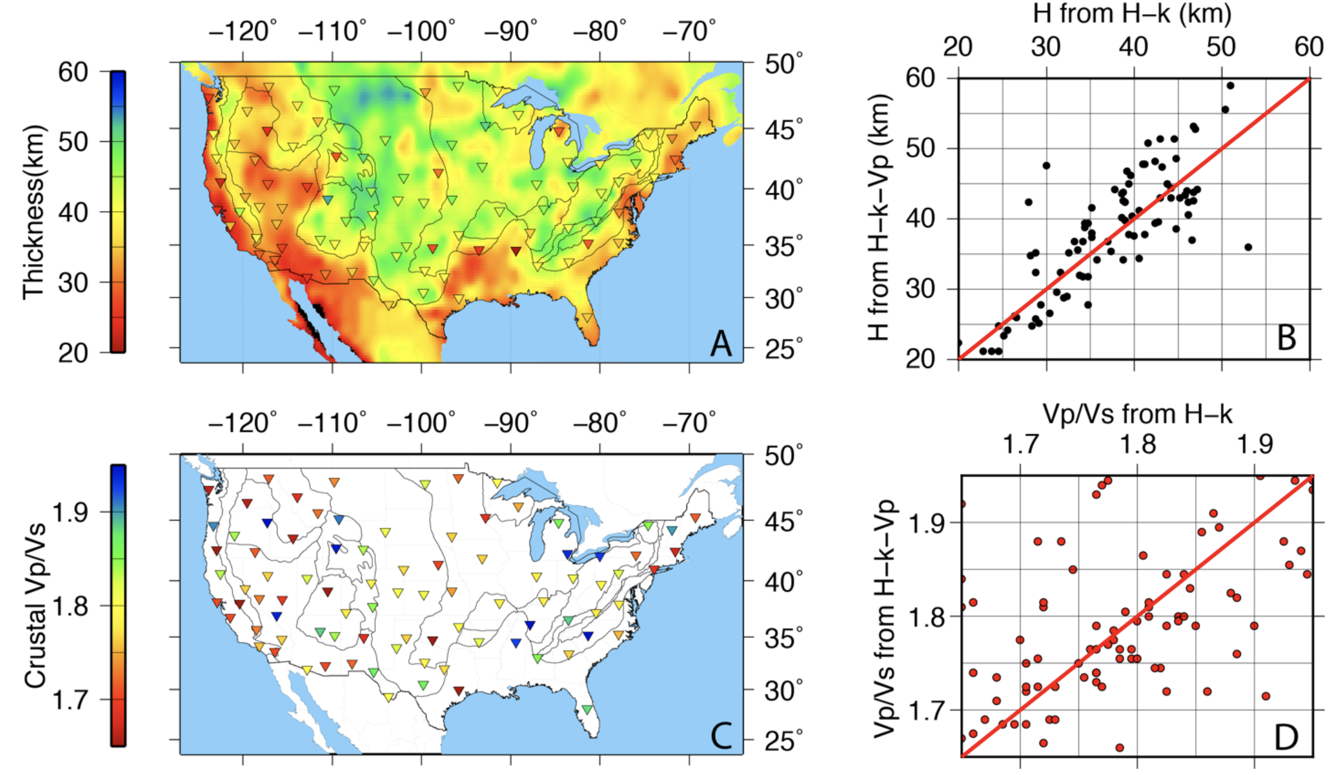

Comparison between P-reflectivity imaged discontinuity with other probes’
H-𝜅-Vp grid search stacking
(Delph et al., 2019, JGR.)
Fix Vp 6.2 km/s
Crust1.0
RMS 5.5 km
RMS 0.08

Slide 32
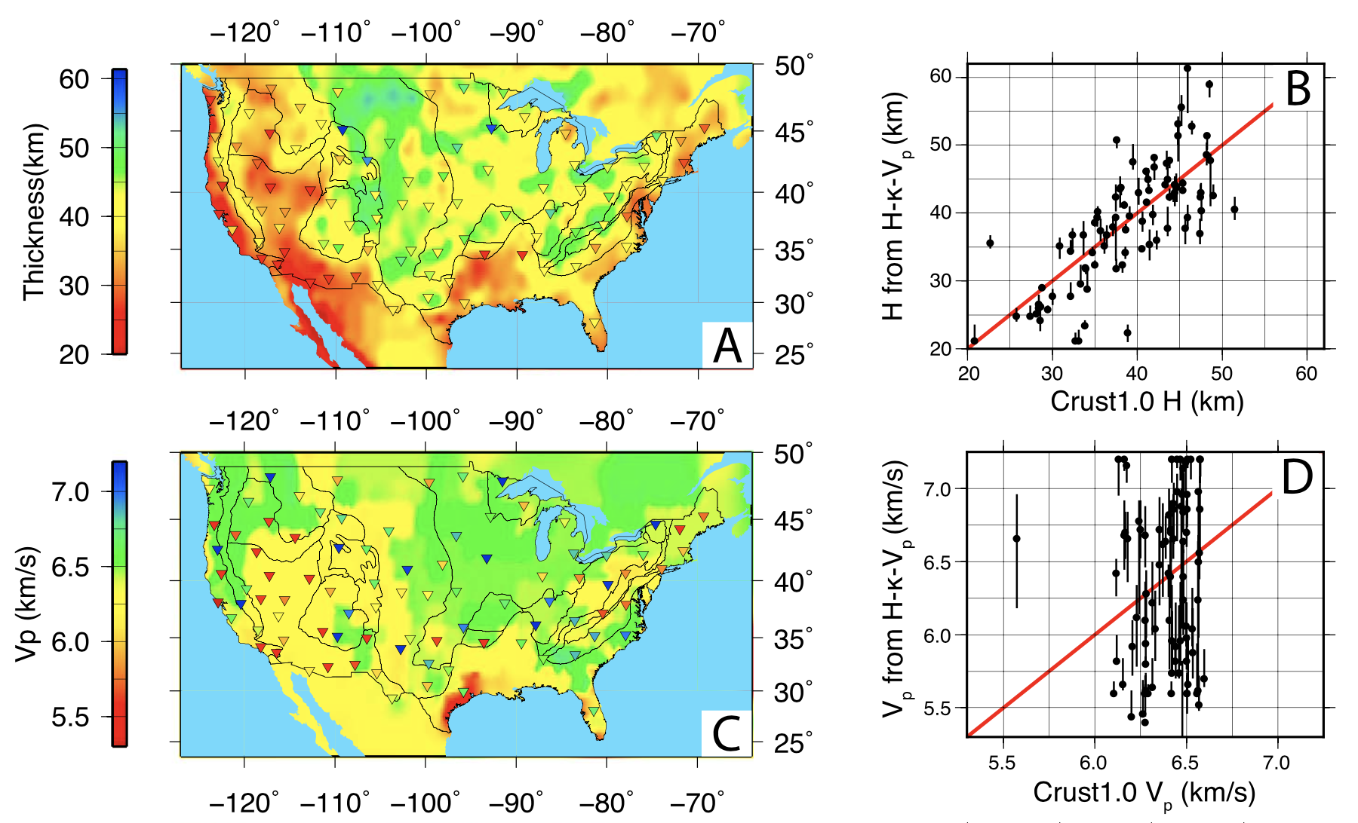
Comparison between P-reflectivity imaged discontinuity with other probes’
H-𝜅-Vp grid search stacking
(Delph et al., 2019, JGR.)
Crust1.0
RMS 5.75 km
RMS 0.59 km/s

Slide 33
Extract crustal structure from P-wave reflectivity
Migration
(Ruigrok & Wapenaar, 2012, GRL.)

Slide 34
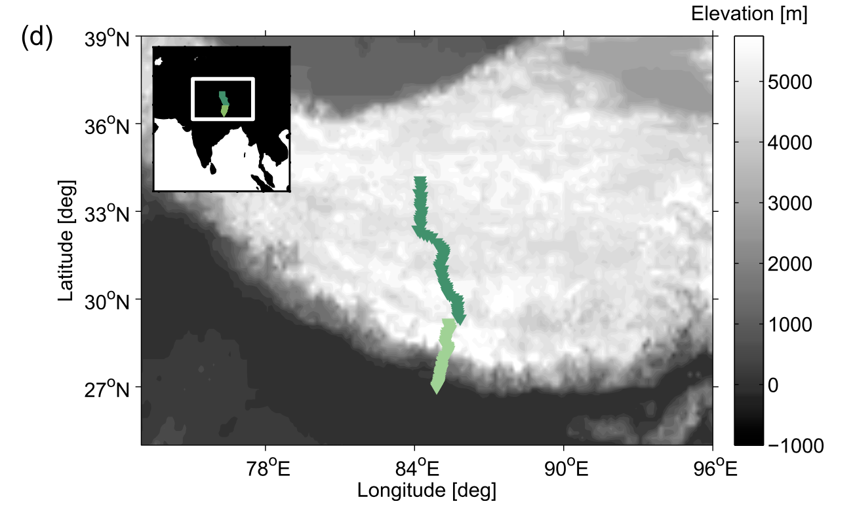
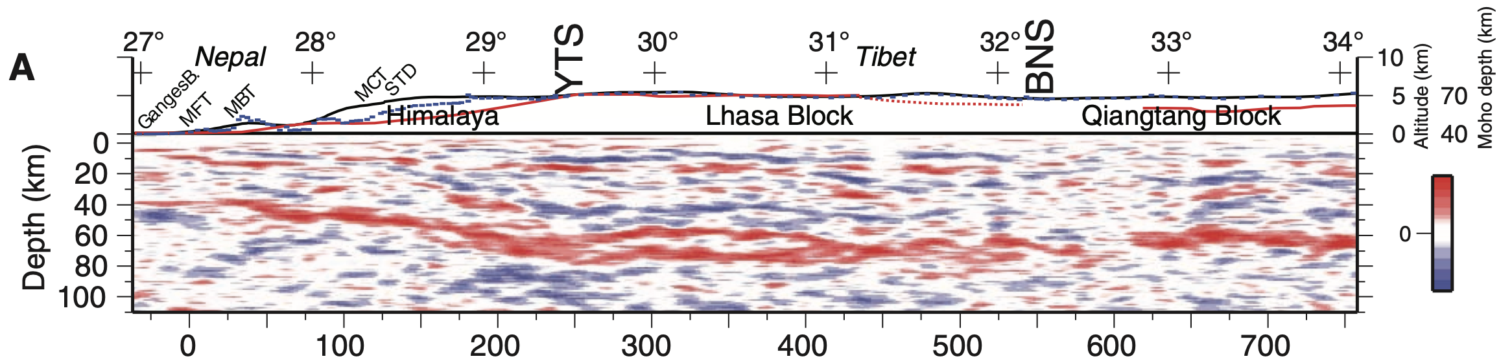
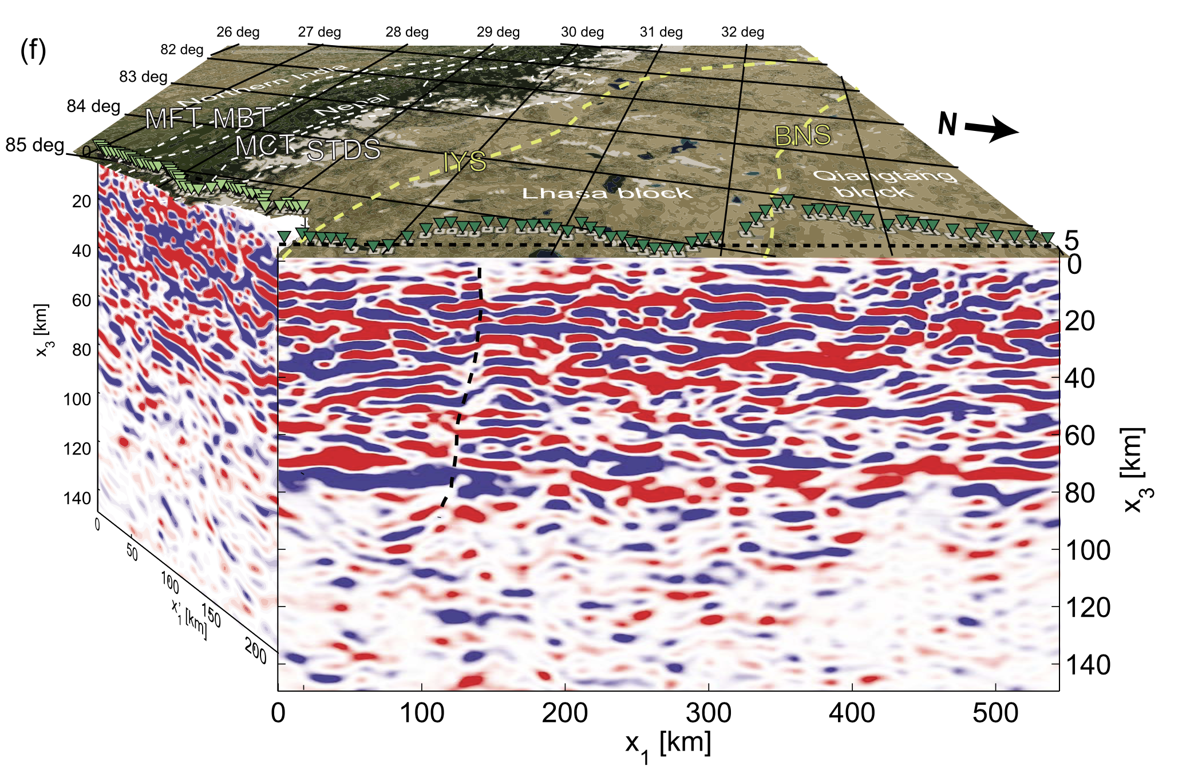
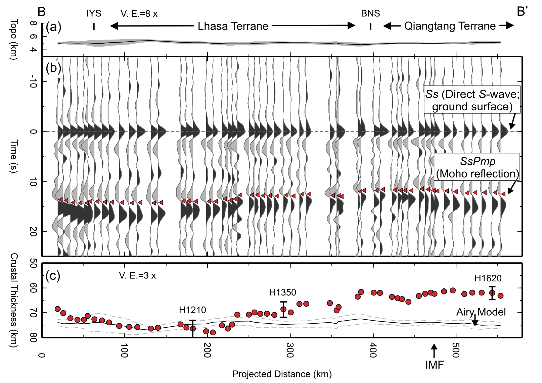
Comparison between P-reflectivity imaged discontinuity with other probes’
Pms (Nábělek et al.,2009, Science)
Migration (Ruigrok & Wapenaar, 2012, GRL.)
SsPmP (Tseng et al., 2009, GRL.)
Notes:
Hi-CLIMB experiment (2002–2005) Himalayan-Tibetan Continental Lithosphere During Moun- tain Building
Himalaya subarray (58 stations, denoted with dark- green triangles) and Tibet subarray (61 stations, denoted with light-green triangles).

Slide 35
References
Wapenaar, K. (2003), Synthesis of an inhomogeneous medium from its acoustic transmission response, Geophysics, 68, 1756–1759.
Phạm, T.‐S., & Tkalčić, H. (2017). On the feasibility and use of teleseismic P wave coda autocorrelation for mapping shallow seismic dis-continuities. Journal of Geophysical Research: Solid Earth, 122, 3776–3791.
Delph, J. R., Levander, A., & Niu, F. (2019). Constraining crustal properties using receiver functions and the autocorrelation of earthquake‐generated body waves. Journal of Geophysical Research: Solid Earth, 124.
Ruigrok, E., and K. Wapenaar (2012), Global-phase seismic interferometry unveils P-wave reflectivity below the Himalayas and Tibet, Geophys. Res. Lett., 39, L11303.
Tseng, T.-L., W.-P. Chen, and R. L. Nowack (2009), Northward thinning of Tibetan crust revealed by virtual seismic profiles, Geophys. Res. Lett., 36, L24304.
Nábělek, J., et al. (2009), Underplating in the Himalya-Tibet collision zone revealed by the Hi-CLIMB experiment, Science, 325, 1371–1374.

Slide 36
Supplementary Material
The Pmp phase in receiver functions largely cancels due to its similarity on both the vertical and radial component seismograms. -- Delph, et al., 2019. ???
Almost same ZP/RZ as ZPmP/RPmP
Synthetic
G=3.0

