Slide 1
Seismic instrument problems
Jiayuan Yao, 2020/06/25

Slide 2
Clock error
Zhu, G., Yang, H., Lin, J., Zhou, Z., Xu, M., Sun, J., & Wan, K. (2019). Along-strike variation in slab geometry at the southern Mariana subduction zone revealed by seismicity through ocean bottom seismic experiments. Geophysical Journal International, 218(3), 2122-2135.
Seismometer misorientation
Stachnik, J. C., Sheehan, A. F., Zietlow, D. W., Yang, Z., Collins, J., & Ferris, A. (2012). Determination of New Zealand ocean bottom seismometer orientation via Rayleigh-wave polarization. Seismological Research Letters, 83(4), 704-713.
Wang, X., Chen, Q. F., Li, J., & Wei, S. (2016). Seismic sensor misorientation measurement using P‐wave particle motion: An application to the NECsaids Array. Seismological Research Letters, 87(4), 901-911.
Zheng, H., Fan, J., Zhao, D., Li, C., Dong, D., Zhang, G., & Wang, X. (2020). A new method to estimate ocean-bottom-seismometer orientation using teleseismic receiver functions. Geophysical Journal International, 221(2), 893-904.
Instrument gain problem
Park, S., & Ishii, M. (2019). Detection of instrument gain problems based on body‐wave polarization: Application to the Hi‐net array. Seismological Research Letters, 90(2A), 692-698.
Waveform clipping
Yang, W., & Ben-Zion, Y. (2010). An algorithm for detecting clipped waveforms and suggested correction procedures. Seismological Research Letters, 81(1), 53-62.

Slide 3
Outline
Introduction to seismograph
Clock error
Seismometer misorientation
Instrument gain problem
Waveform clipping

Slide 4
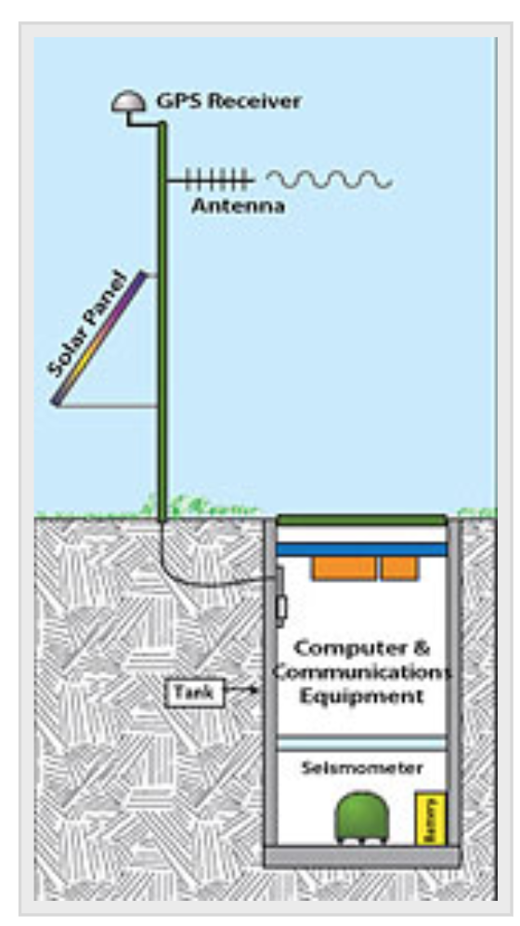
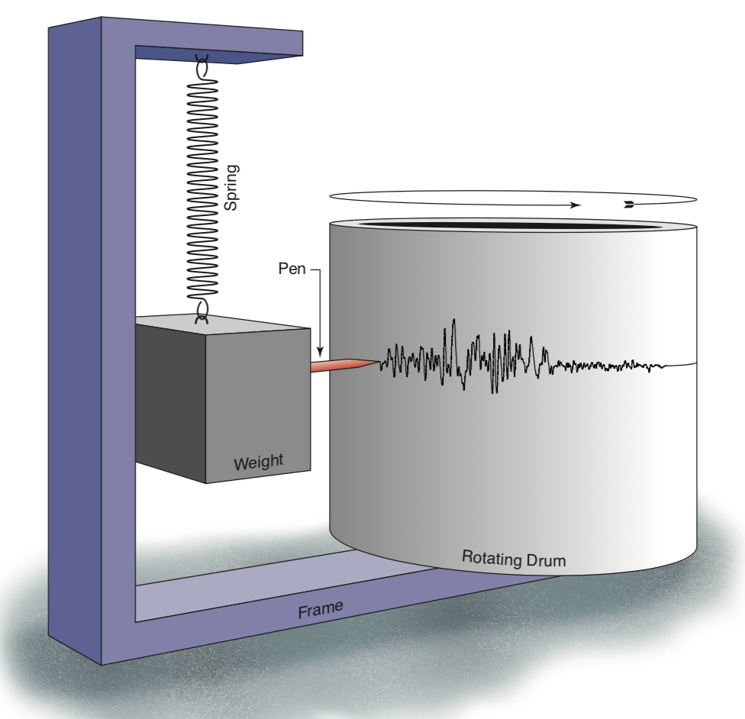
Seismograph
A seismograph is a device for measuring the movement of the earth.
It consists of a ground-motion detection sensor (called a seismometer) coupled with a recording system (called data logger).
The recorded ground motion is called seismogram.
seismometer
data logger
A cartoon shows how a seismograph works
seismogram
https://www.iris.edu/hq/inclass/fact-sheet/how_does_a_seismometer_work
http://www.usarray.org/public/about/how#anchor1

Slide 5
EOS-Myanmar network
https://www.youtube.com/watch?v=MZ0yiINuYm4

Slide 6
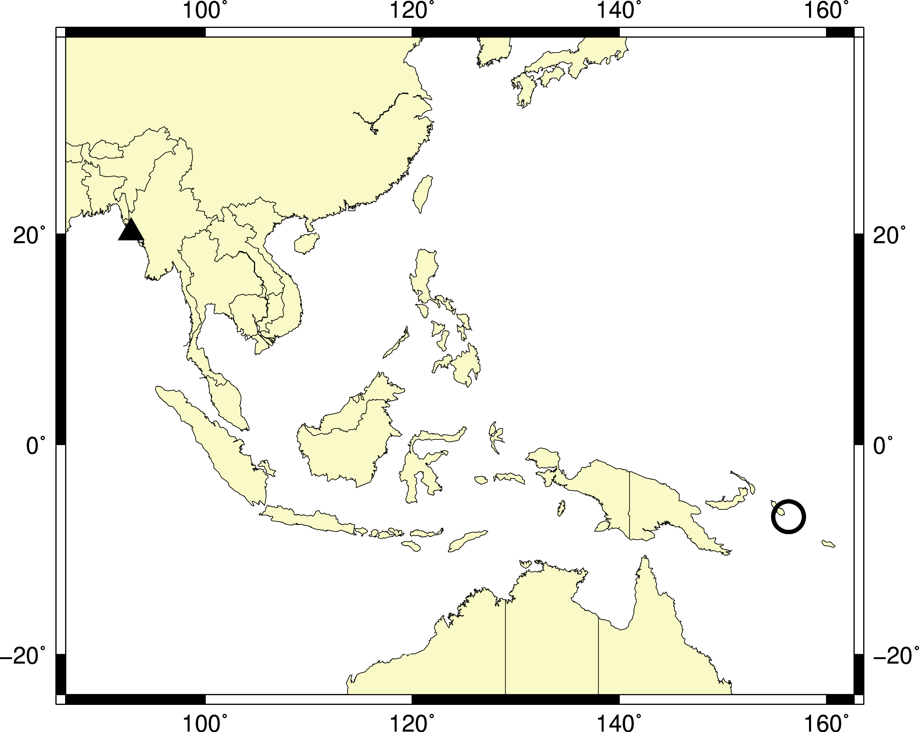
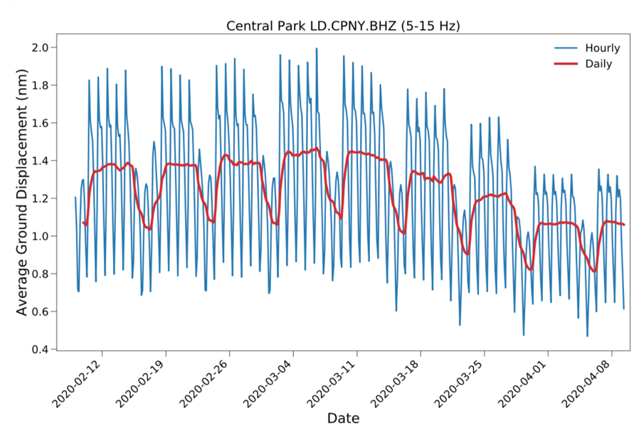
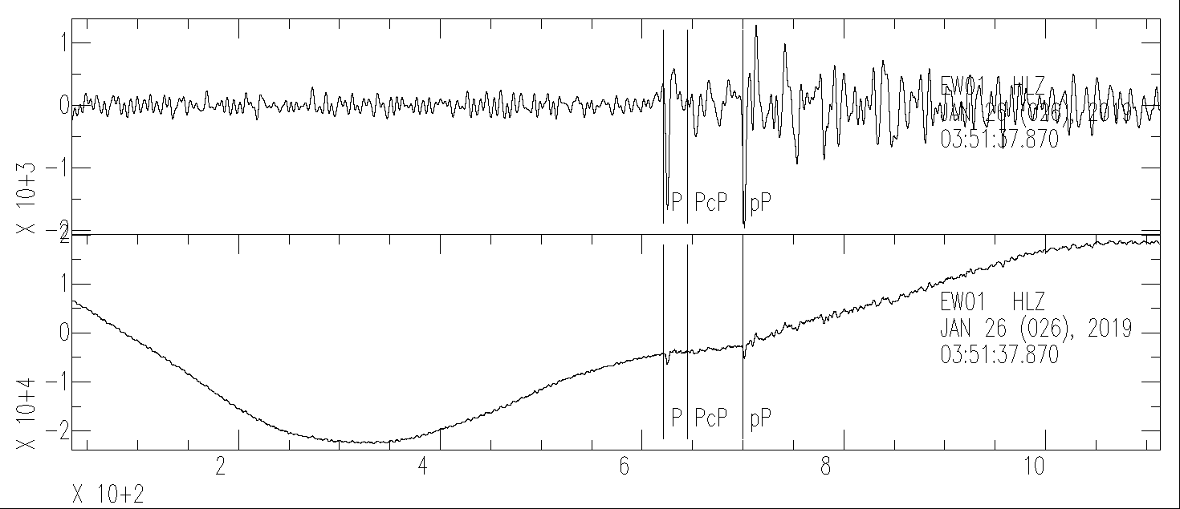
Seismograph
Sensitivity: as small as ${10}^{−9}$ meter (i.e., 1 nm)
The 2004 M9.1 Sumatra earthquake creates ground motions over the entire Earth that can be several centimeters (${10}^{7}$ nm)
Sources of ground motion
earthquake, volcano eruption, explosion, ocean waves, wind, human activity (e.g., walking & driving cars), …
EW01
20190126T03:51:37.870
Mw: 6.2
Depth: 355 km
Earthquake
bp co 0.02 0.2 p 2 n 2
Displacement (nm)
not filtered
Time (second)
Instrument response is removed
https://www.iris.edu/hq/retm/event/6450

Slide 7
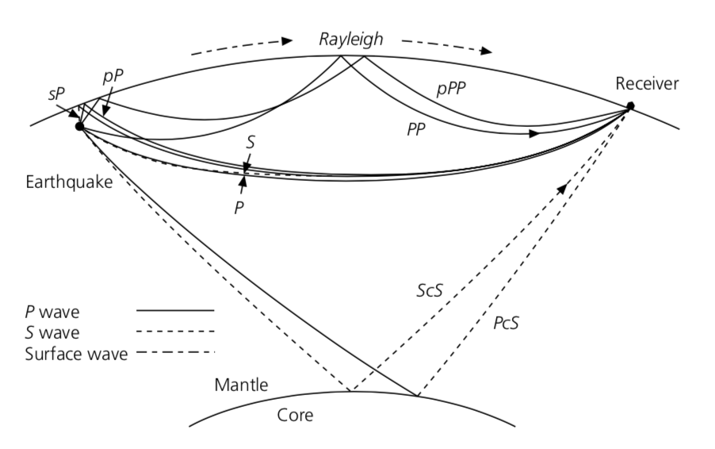
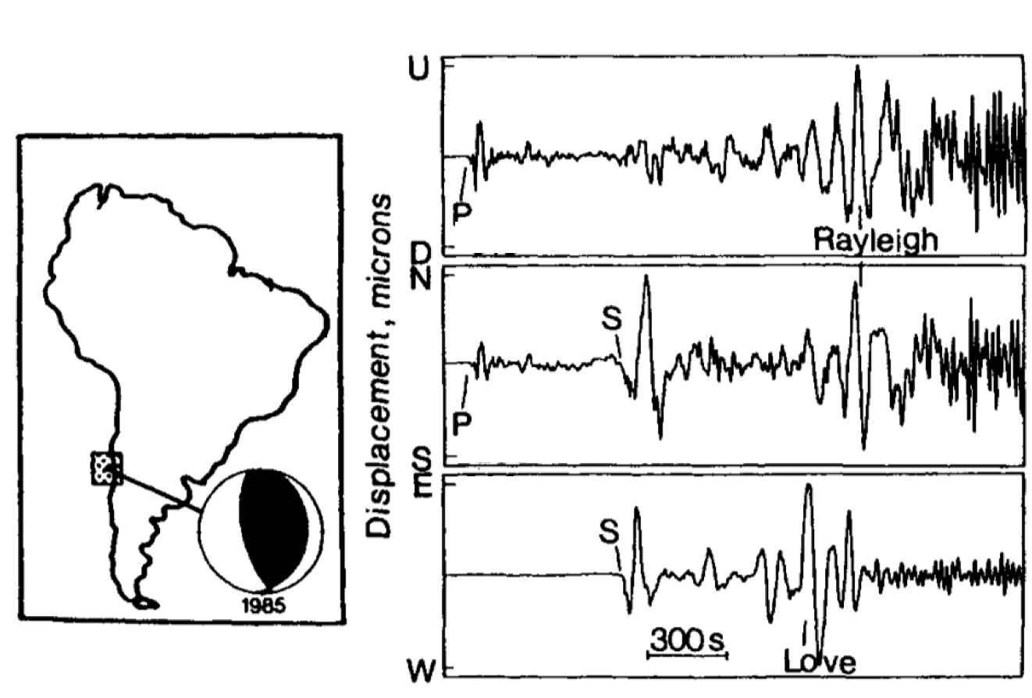
Seismogram
Love
Three-component seismograph (USA)
Stein & Wysession, 2003
South America
Key information：
Arrival time
Amplitude
Waveform
Lay & Wallace, 1995

Slide 8
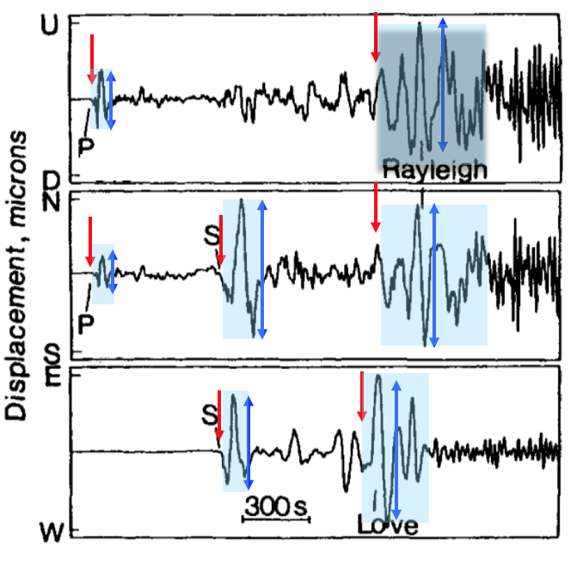
Some seismic instrument problems
Clock error
Seismometer misorientation
Instrument gain problem
Waveform clipping
https://www.iris.edu/hq/inclass/fact-sheet/how_does_a_seismometer_work
Lay & Wallace, 1995
http://www.usarray.org/public/about/how#anchor1

Slide 9
Outline
Introduction to seismograph
Clock error
Seismometer misorientation
Instrument gain problem
Waveform clipping

Slide 10
Clock error
Clock error: the internal clock of the seismograph is wrong
The synchronization with Global Positioning System (GPS) is one option for on-land station.
The timing of an Ocean Bottom Seismograph (OBS) station depends on its own internal clock, which is only synchronized with GPS before deployment and after recovery.
http://www.usarray.org/public/about/how#anchor1

Slide 11
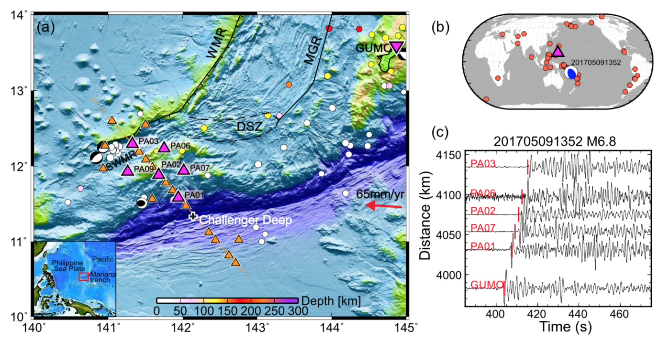
Clock error detection and correction
An OBS deployment near Mariana trench
Zhu, 2019, GJI

Slide 12
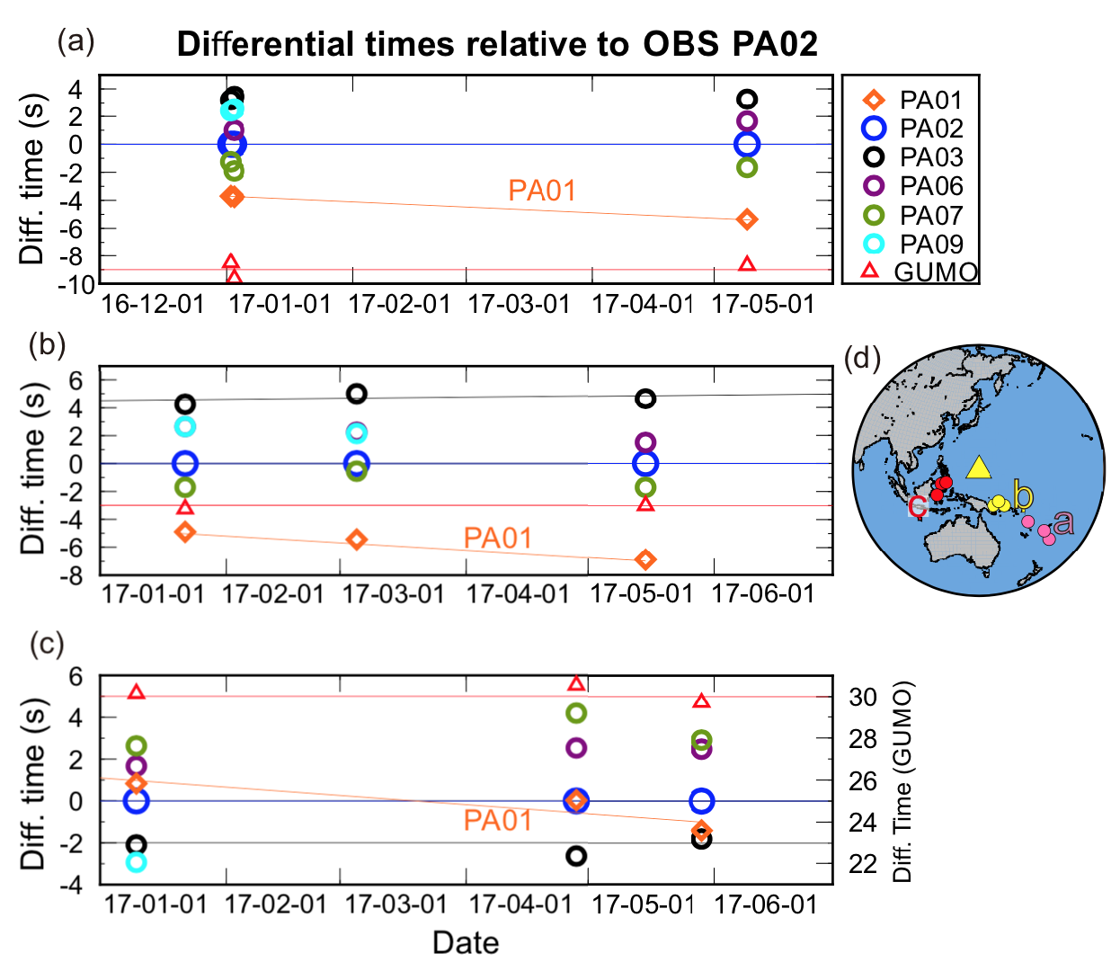
Clock error detection and correction
Teleseismic event method
For teleseismic events from nearby locations, differential travel time between two nearby station should stay stable.
Zhu, 2019, GJI

Slide 13
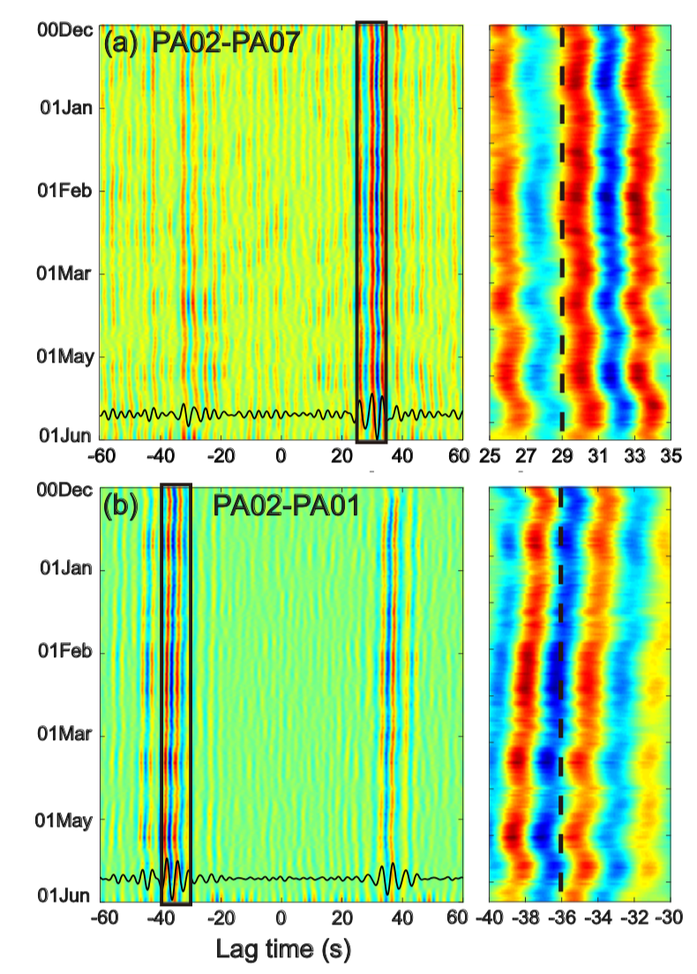
Clock error detection and correction
Ambient noise cross-correlation function
The lag time of the ambient noise cross-correlation function should stay stable.
Zhu, 2019, GJI

Slide 14
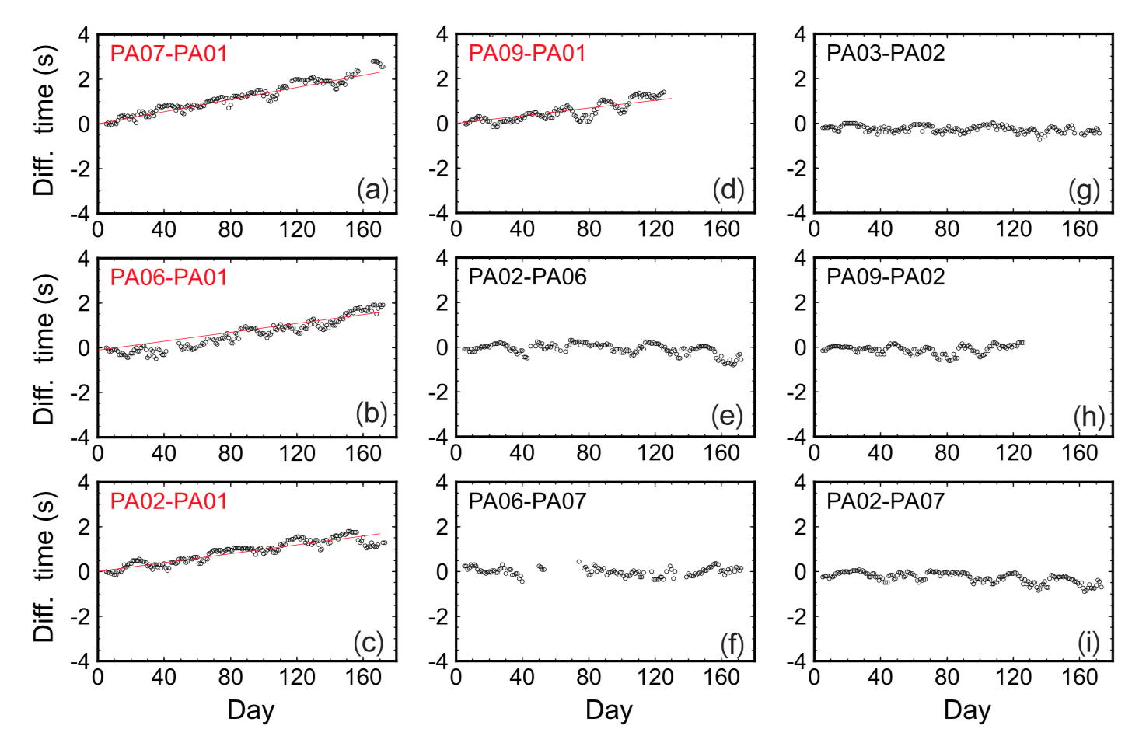
Clock error detection and correction
Ambient noise cross-correlation function
Zhu, 2019, GJI

Slide 15
Outline
Introduction to seismograph
Clock error
Seismometer misorientation
Instrument gain problem
Waveform clipping

Slide 16
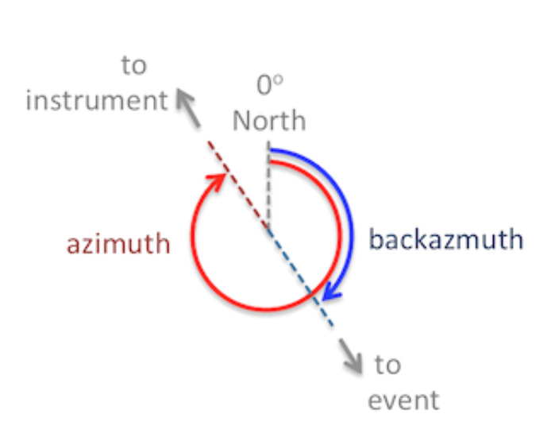
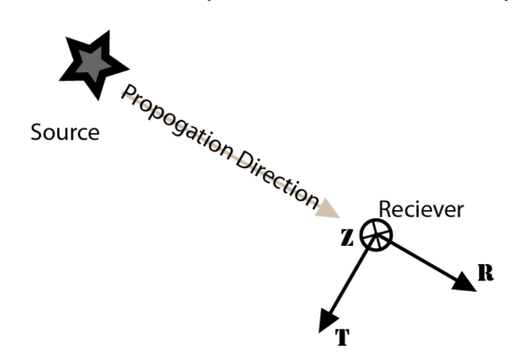
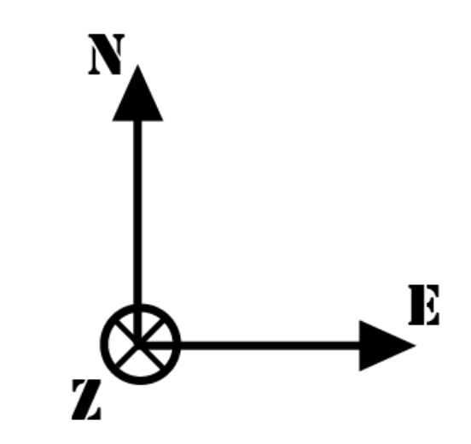
Seismometer misorientation
Typical sac file names
II.AAK.00.BHZ.SAC
II.AAK.00.BHN.SAC
II.AAK.00.BHE.SAC
Azimuth and backazimuth
channel code
band code
instrument Code
orientation Code
https://ds.iris.edu/ds/nodes/dmc/data/formats/seed-channel-naming/
ZNE components
ZRT components
http://service.iris.edu/irisws/rotation/docs/1/help/

Slide 17
Seismometer misorientation
Typical sac file names
II.AAK.00.BHZ.SAC
II.AAK.00.BHN.SAC
II.AAK.00.BHE.SAC
The true orientations of those three components could not be consistent with what their names mean.
http://service.iris.edu/irisws/rotation/docs/1/help/

Slide 18
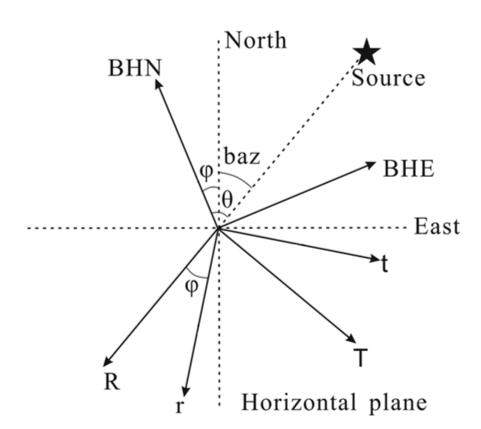
Seismometer misorientation detection methods
If there is no misorientation, we can rotate NE to RT components correctly.
If there is a misorientation ($φ$), we will have a wrong RT components without any correction.
The rotated components are along rt directions instead of the RT directions.
Zheng, 2020, GJI

Slide 19
Seismometer misorientation detection methods
We can use the properties of seismic waves to detect the misorientation. For example,
Rayleigh-wave polarization: particle motion in ZR plane
P-wave polarization: particle motion in ZR plane
Z
Station
R
Rayleigh-wave
P-wave
http://service.iris.edu/irisws/rotation/docs/1/help/
https://www.youtube.com/watch?v=6yXgfYHAS7c
https://www.youtube.com/watch?v=2rYjlVPU9U4

Slide 20
Seismometer misorientation detection methods
Rayleigh-wave polarization
Stachnik, J. C., Sheehan, A. F., Zietlow, D. W., Yang, Z., Collins, J., & Ferris, A. (2012). Determination of New Zealand ocean bottom seismometer orientation via Rayleigh-wave polarization. SRL, 83(4), 704-713.
P-wave polarization
Wang, X., Chen, Q. F., Li, J., & Wei, S. (2016). Seismic sensor misorientation measurement using P‐wave particle motion: An application to the NECsaids Array. SRL, 87(4), 901-911.
Zheng, H., Fan, J., Zhao, D., Li, C., Dong, D., Zhang, G., & Wang, X. (2020). A new method to estimate ocean-bottom-seismometer orientation using teleseismic receiver functions. GJI, 221(2), 893-904.

Slide 21
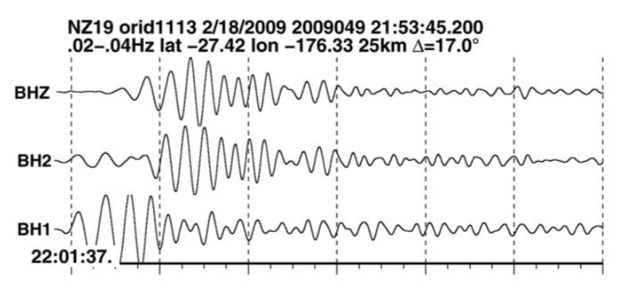
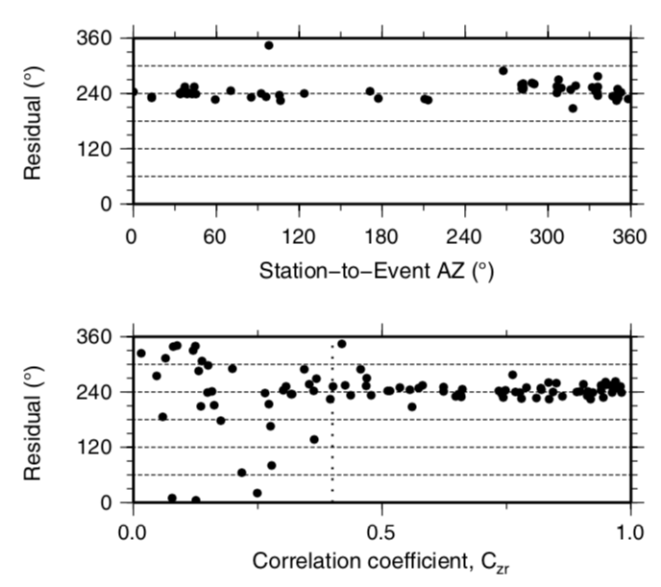
Seismometer misorientation detection methods
Rayleigh-wave polarization
Stachnik, 2012, SRL
Zheng, 2020, GJI

Slide 22
Seismometer misorientation detection methods
P-wave polarization
original P-wave waveform (Wang et al., 2016, SRL)
principal component analysis (PCA)
minimize T-component energy
We can PCA to find $θ$ directly, and then the misorientation $φ=θ−baz$.
We can also grid search$φ$ to find one which minimizes T-component energy.
Zheng, 2020, GJI

Slide 23
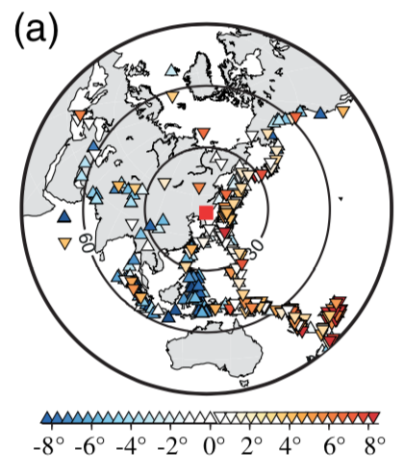
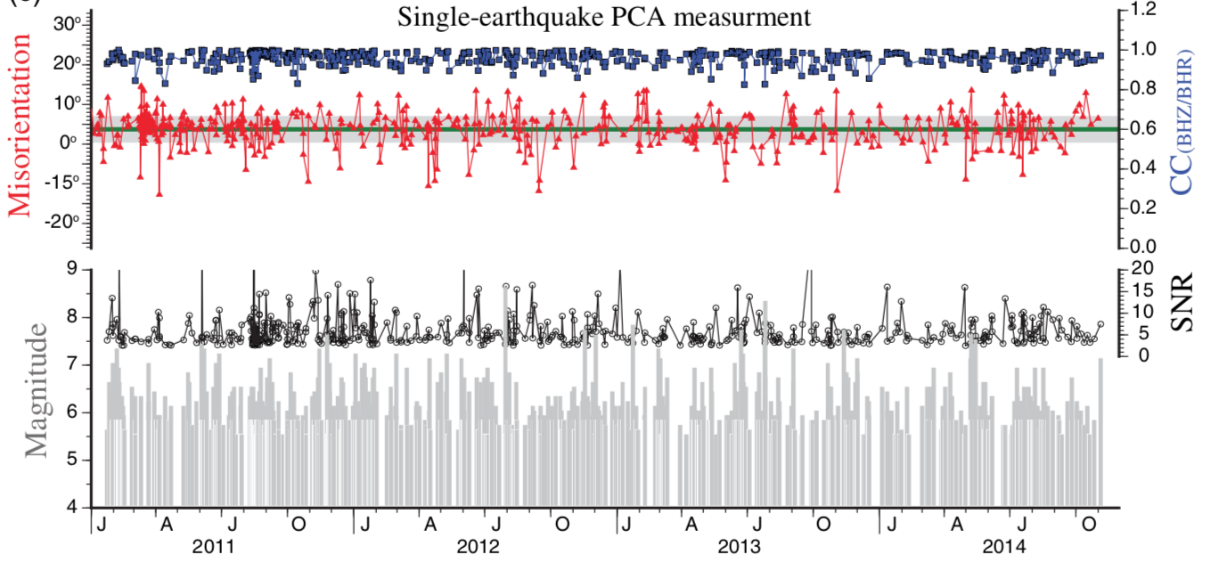
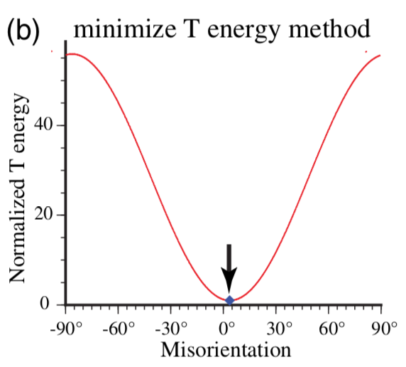
Seismometer misorientation detection methods
P-wave polarization
original P-wave waveform (Wang et al., 2016, SRL)
principal component analysis (PCA)
minimize T-component energy
Wang et al., 2016, SRL

Slide 24
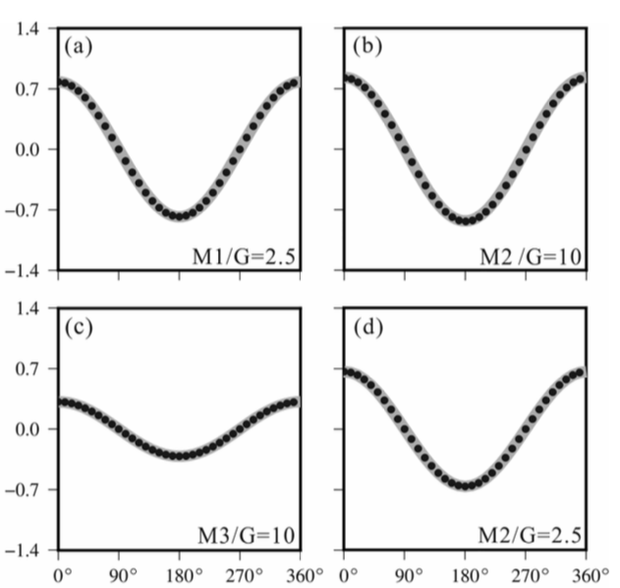
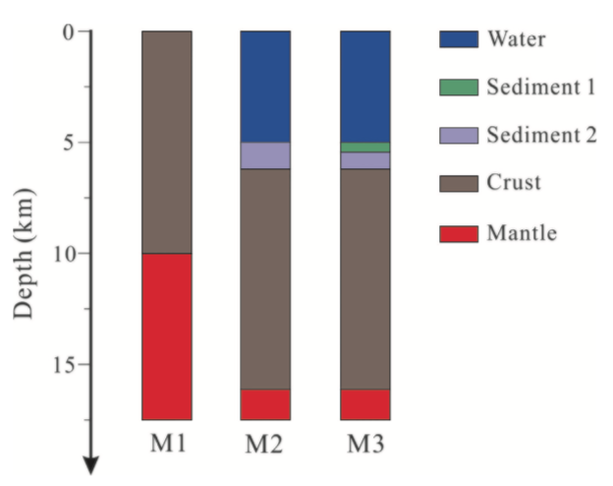
Seismometer misorientation detection methods
P-wave polarization
P-wave receiver function (p-RF) (Zheng et al., 2020, GJI)
Three velocity models
Amplitude of p-RF at t=0
$$φ$$
Zheng, 2020, GJI

Slide 25
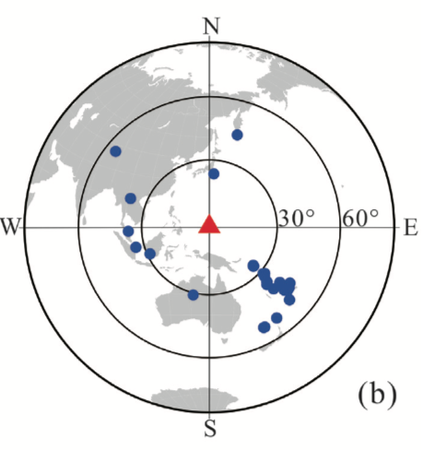
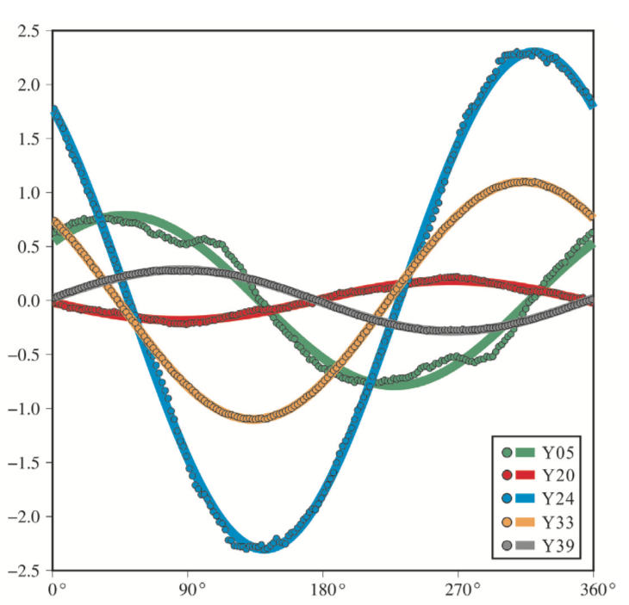
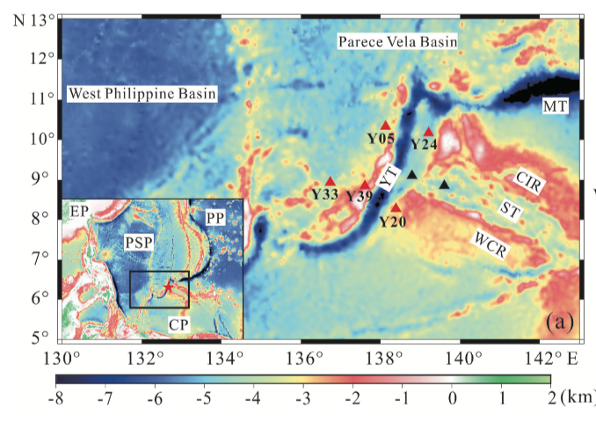
Seismometer misorientation detection methods
Y24
Y05
Y33
Y39
Y20
Amplitude of p-RF at t=0
$$φ$$
Zheng, 2020, GJI

Slide 26
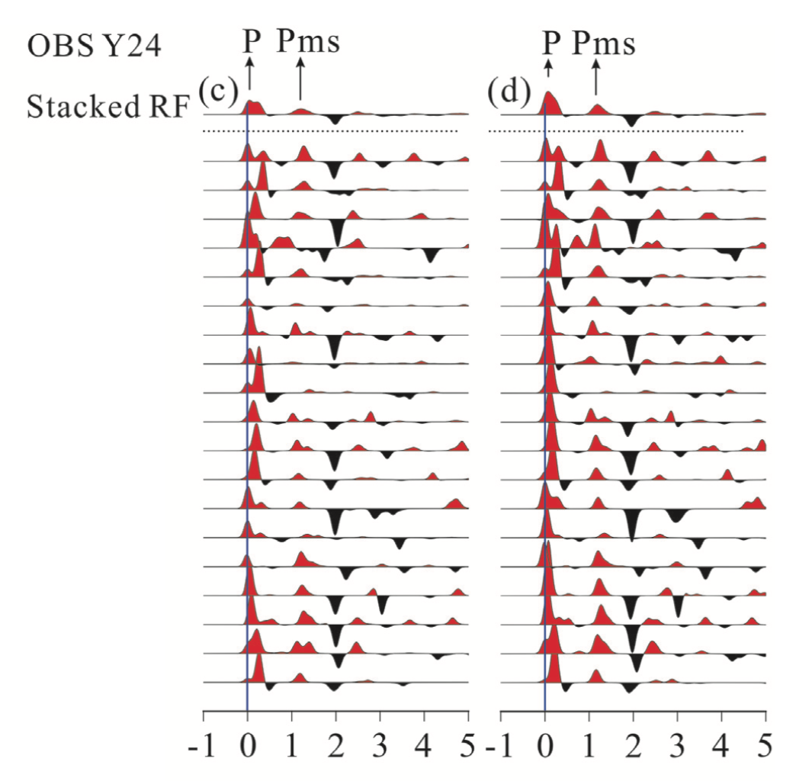
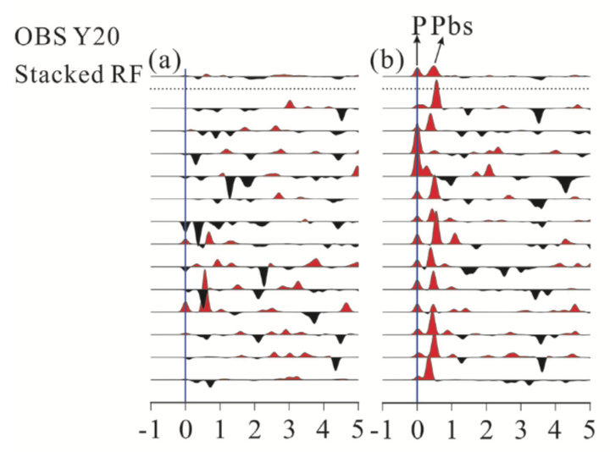
Seismometer misorientation detection methods
Before correction
After correction
Before correction
After correction
Zheng, 2020, GJI

Slide 27
Outline
Introduction to seismograph
Clock error
Seismometer misorientation
Instrument gain problem
Waveform clipping

Slide 28
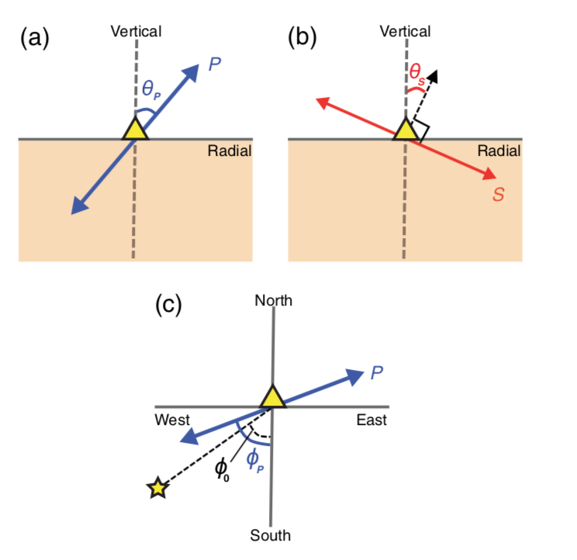
Instrument gain problem
Four criteria used to detect gain problem
Where there are three threshold angles,
Park and Ishii, 2019, SRL

Slide 29
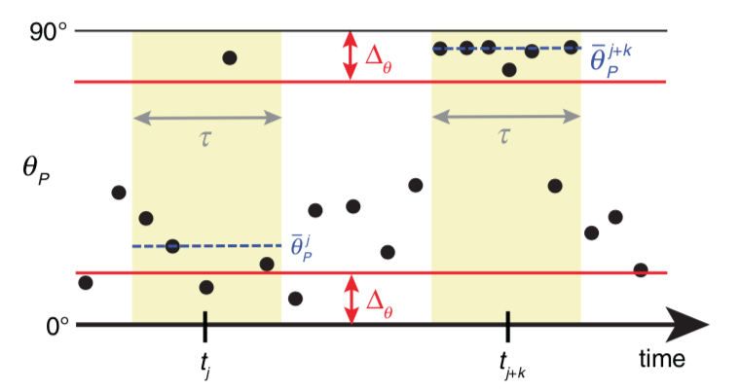
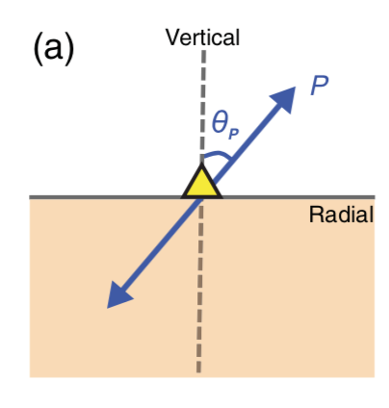
Instrument gain problem
Park and Ishii, 2019, SRL

Slide 30
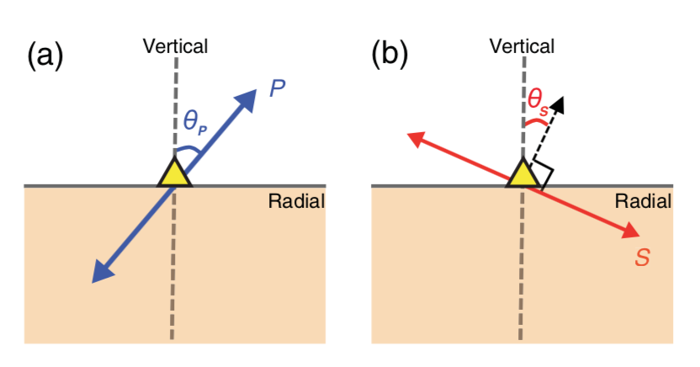
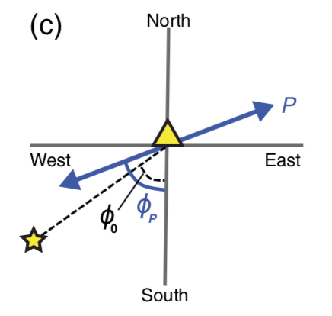
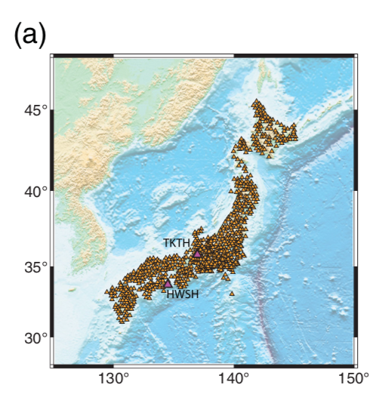
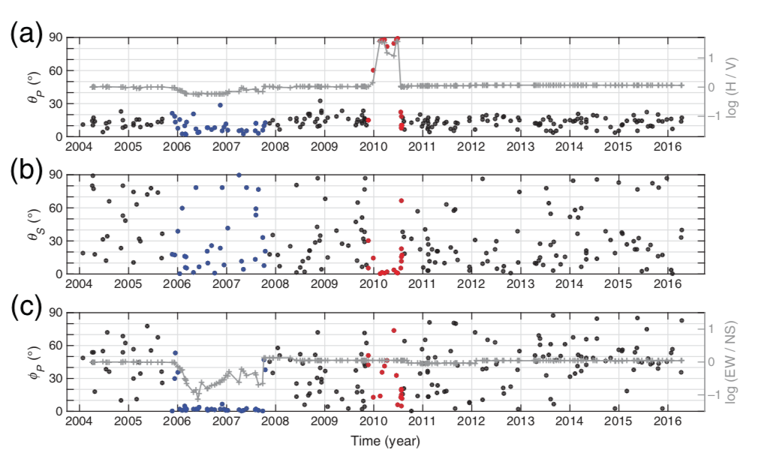
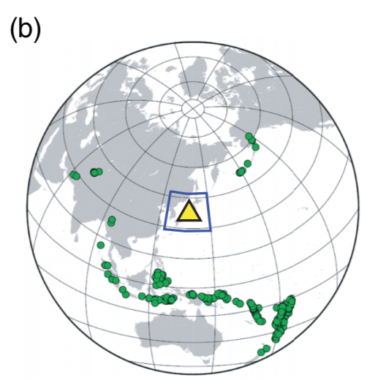
Instrument gain problem
Park and Ishii, 2019, SRL

Slide 31
Outline
Introduction to seismograph
Clock error
Seismometer misorientation
Instrument gain problem
Waveform clipping

Slide 32
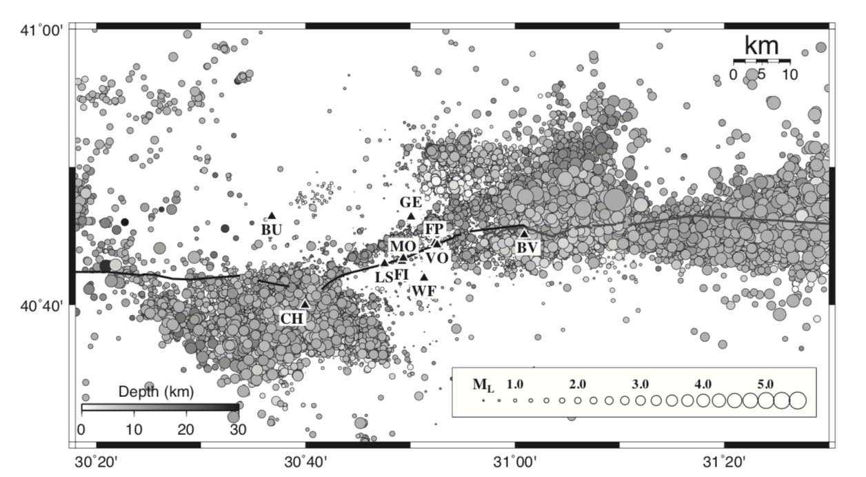
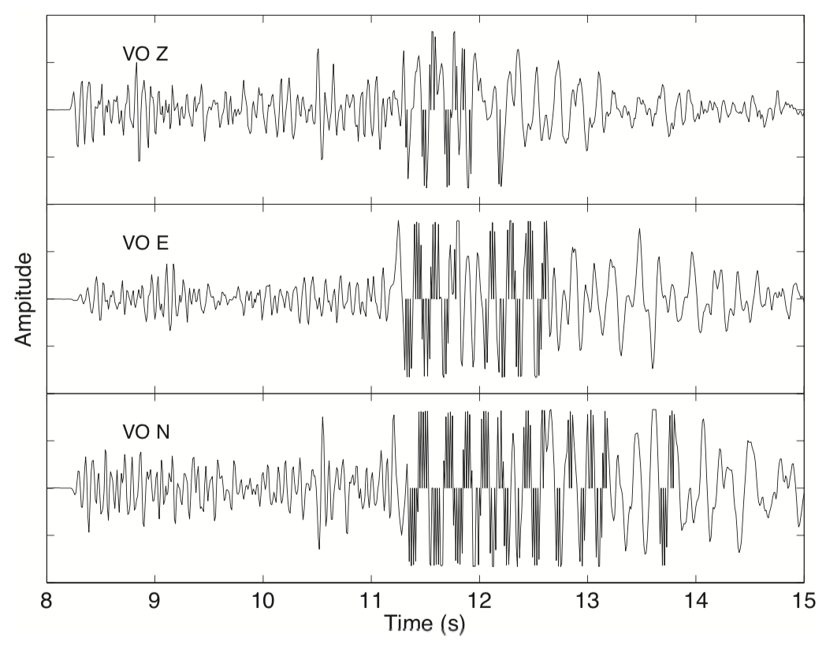
Waveform clipping
upper range
Features of clipped waveforms:
Clipped waveforms contain points with amplitude close to the upper range of the recorded data.
Clipped points are in waveform portions with amplitude close to the peak value in the seismogram.
Clipped points are located within waveform sections having large amplitude fluctuations.
Clipped points have zero amplitude values.
Data on both sides of a clipped point have the same sign or one neighboring point is also zero.
clipped points
Yang and Ben-zion, 2010, SRL

Slide 33
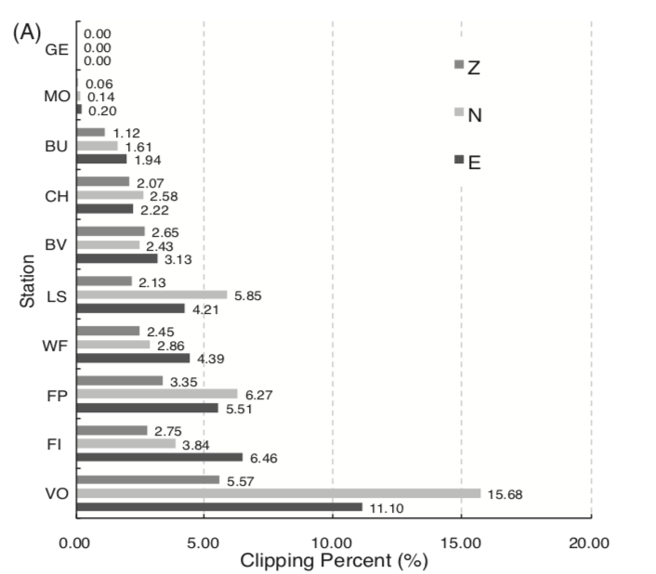
Waveform clipping
An automatic detection algorithm:
Treat waveforms with maximum amplitudes larger than a given threshold (e.g., 60% of the Observed Range) as potentially clipped waveforms.
For each potential clipped waveform, assume that points with zero amplitude, between the first and last samples with absolute values larger than 0.5 of the waveform peak amplitude, are tentatively clipped.
Require that clipped samples are bounded on both sides by points with the same sign or another zero.
Require that the maximum or minimum value of ± 10 samples on either side of the candidate clipped points is larger than 0.8 of the waveform peak amplitude.
Yang and Ben-zion, 2010, SRL

Slide 34
Conclusions
We introduce some seismological methods to detect and correct some seismic instrument problems:
clock error
seismometer misorientation
instrument gain problem
waveform clipping
We have to be very careful to do data quality analysis before using them to study the seismic source and structures.

