Slide 1
Towards Better Prediction and Content Detection through Online Social Media Mining
Chen Weiling
Supervisor : Ａ/P Lau Chiew Tong
Co-supervisor: A/P Yeo Chai Kiat
Computer Networks and Communications Graduate Lab
School of Computer Science and Engineering
20 Aug 2018

Slide 2
Outline
Background Introduction
Real-time Low-quality Content Detection Framework from the Users' Perspective
Unsupervised Rumor Detection Model based on User Behaviors
Leveraging Social Media News to Predict Stock Index Movement Using RNN-Boost
Conclusions and Future Work

Slide 3
Background Introduction
In the last decade, more and more social network sites have sprung up and attracted millions of users.
Good aspects
Social functions
Marketing and business
Data analytics
Bad aspects
Spam and phishing
Fake information
OSN: A double-edged sword
When used properly, the benefits of it can outweigh its disadvantages to some extent.
Notes:
OSN have some good aspects. For example, they encourage social connections. Also, the content generated by users on OSN is useful for marketing and business as well as other data analytics purposes. On the other hand, OSN have also caused some worrying issues like spam and phishing as well as the fake information.
To conclude, Online social network is like a double-edged sword. When used properly, the benefits of it can outweigh its disadvantages to some extent.

Slide 4
Outline
Background Introduction
Real-time Low-quality Content Detection Framework from the Users' Perspective
Unsupervised Rumor Detection Model based on User Behaviors
Leveraging Social Media News to Predict Stock Index Movement Using RNN-Boost
Conclusions and Future Work
Notes:
This thesis discusses how to break the ‘curse’ while enjoying the ‘blessing’ of OSN. The focus is on the mining of OSN to improve content detection and prediction accuracies with use cases.
The following two sections present details on how to combat the potential issues caused by OSN which address the use cases, namely, low-quality content detection and rumor detection respectively.
Section 4 gives an example of utilizing the content collected from OSN to boost the accuracy of predictive analytics using stock market index prediction as the use case. The last chapter concludes the whole thesis and provides directions for future work.
Since I only have 40 minutes, it is difficult to squeeze all the work I have done in the past 4 years. I would like to put the most focus on the rumor detection model, then the stock index prediction model, then the low-quality content detection framework.
Let’s start with the real-time low-quality content detection framework.

Slide 5
Motivation
Low-quality content detection on OSN does not receive enough attention other than spam/phishing detection.
Most of the previous research is done offline and a unified real-time solution is necessary.
Very little of the previous work is carried out from the users' perspective.
Notes:
As is indicated in the title of this section, the motivation lies in 3 aspects namely low-quality content detection, real-time and the users’ perspective. More details will be discussed later.

Slide 6
Literature Review
Definition:
Spam
Phishing
Low-quality content
Features:
Tweet based
User based (account information, posting behaviors)
Methods:
Blacklists (time lag)
Heuristics (domain knowledge)
Machine learning (classification, clustering)
Notes:
For similar work done before, I would focus on the limitations of previous work. Prevalent methods are listed here.
Blacklists are often used in phishing detection but there is always a time lag before the blacklists to include the phishing content.
Heuristics are also used in detecting phishing and spam content. The drawbacks of heuristics is that the method highly depend on domain knowledge and the features of such malicious content always evolve gradually over time.
Compared to the previous 2 methods, machine learning method has been proved to have a better performance. The mainstream machine learning methods to detect such malicious content or so-called content polluters are classification and clustering.

Slide 7
Overview of the Framework
Figure 3.1: Overview of the low-quality content Detection Framework
Notes:
Fig \ref{fig3.3.1} shows the overview of the proposed low-quality content detection system. The framework comprises two portions, the actual real-time detection of low-quality content tweets (refer to the shaded blocks in Fig \ref{fig3.3.1}) and the out-of-band training process (refer to the unshaded boxes of Fig \ref{fig3.3.1}).
The training process is conducted out-of-band to train the classifier used for real time low-quality content detection. A user survey is conducted to provide insights on the definition of low-quality content from the users' perspective. These are then used as label guides to manually label 100,000 tweets crawled via Twitter API. Significant features (both direct and indirect) of low-quality content are identified from the 100,000 labeled tweets and these features are combined with word level analysis to train the classifier.
After training the classifier, the classifier is ready to predict the labels of tweets submitted to the system. These tweets experience the same feature extraction phase as the training phase and are then forwarded to the trained classifier for low-quality content detection. The classifier will then predict whether the tweet is low-quality content or not. What is worth mentioning here is that both the feature extraction and low-quality content detection can be done in real time.

Slide 8
A study on low-quality content from users' perspective
Cluster analysis of low-quality content
Low-quality advertisements
take free bit-coin every three minute (URL omitted)
Automatically generated content
I've collected 7,715 gold coins! (URL omitted) #android, #androidgames, #gameinsight
Potential meaningless content
g7302t$u!7#52jg@i4o
Click baits
Unmatched content (e.g. shocking news, free giveaways) and URLs
Notes:
I first carried out a preliminary study to understand low-quality content. Cluster analysis is performed on a preliminary dataset containing 10,000 tweets. And the results show that the low-quality content can be roughly divided into 4 categories.
They are xx, xx, xx, and xx.

Slide 9
Identifying features characterizing low-quality content
Notes:
Table 3.5 lists the direct features proposed for low-quality content detection. These features are called direct features because they can be directly extracted once the tweet is collected.

Slide 10
Identifying features characterizing low-quality content
Notes:
Table 3.6 lists the indirect features. These features cannot be directly extracted when the tweet is collected and needs a further request to Twitter REST API to calculate.

Slide 11
Identifying features characterizing low-quality content
Like spam emails, some keywords such as “click”, “free” are more frequently seen in low-quality content than in normal tweets.
Word level analysis is frequently used in spam detection for emails while not that popular in spam detection on OSN.
Extensive use of informal abbreviations
The limited length of a tweet
Bag-of-word model （10，000 tweets） => a blacklist keyword dictionary
Notes:
Apart from the direct and indirect features. I also consider the content of the collected tweets.
xx
In this work, I build a blacklist keyword dictionary based on the frequency using the 10,000 tweets in preliminary dataset.
(The author exploits the bag-of-word model to process the original 10,000 tweet texts. There is one word bag for low-quality content and another for normal tweets. Stop words are removed in each bag. For terms in the word bag of low-quality content, the term frequency is used to represent the weight of the term but the weight will be reduced if the same word also appears in the bag of normal tweets. Then the words in the bag of low-quality content are sorted according to their weights and the top N words make up the blacklist keyword dictionary. The selection of $N$ will be discussed in the later section.)

Slide 12
Data Collection
The author collected 100,000 tweets generated by 92,720 distinct users from 16th May to 17th May 2016 via Twitter Streaming API.
Two annotators manually label the tweets (Cohen’s Kappa coefficient = 0.9)
Direct and indirect features are extracted with Twitter REST APIs.
Notes:
To carry out the experiments,
xx

Slide 13
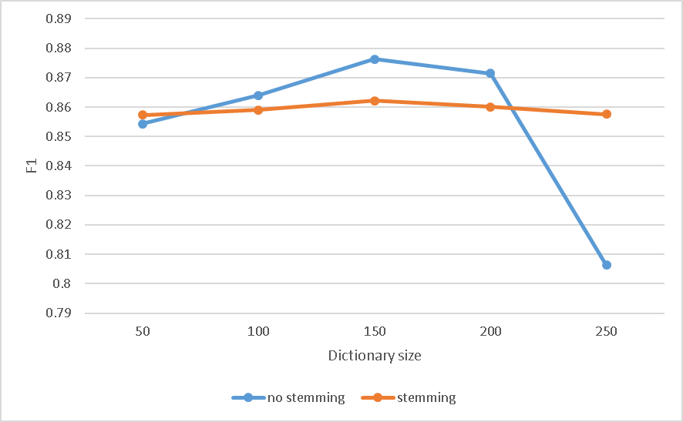
Experimental Results
Word level analysis
Figure 3. 5: F1 measure with/without stemming for different dictionary size
Notes:
Figure 3.5 shows the results related to word level analysis.
One consideration here is whether stemming should be done to process the tweets after removing the stop words as the stemming step could help reduce the number of possible terms but with the risk of losing part of the word meanings.
To achieve a better performance through word level analysis, two special factors are discussed in this subsection. One is the size of the keyword blacklist dictionary. Usually a larger dictionary will increase the detection accuracy but may fall into the overfitting trap. For each word preserved in the low-quality content corpus, its weight determines whether it can be added into the dictionary. Its weight is represented by its term frequency in low-quality content minus its term frequency in normal tweets. The dictionary size can be varied by setting different thresholds for weight.
The other controlled factor is whether to perform stemming on the tweet texts during the preprocessing phase. In this subsection, the author performs low-quality content detection with different dictionary size and evaluates the performance from the perspective of both time and detection rate. The F1 measure results are shown in Fig \ref{fig3.5}.
It is observed from Fig \ref{fig3.5} that when the size of the keyword blacklist dictionary becomes larger, the detection performance increases moderately. However, when the dictionary size is further increased, both of them fall into the trap of over-fitting. No stemming performs better than stemming when the dictionary size is not very large but experiences an early and severe drop in detection performance when the dictionary size increases. Another advantage of no stemming is that it can save the time cost which will otherwise be incurred for the extra stemming step. According to the observations, the dictionary size is set to 150 and the stemming step is skipped in the following experiments. An example of keyword blacklist dictionary can be seen in Appendix \ref{append2}.

Slide 14
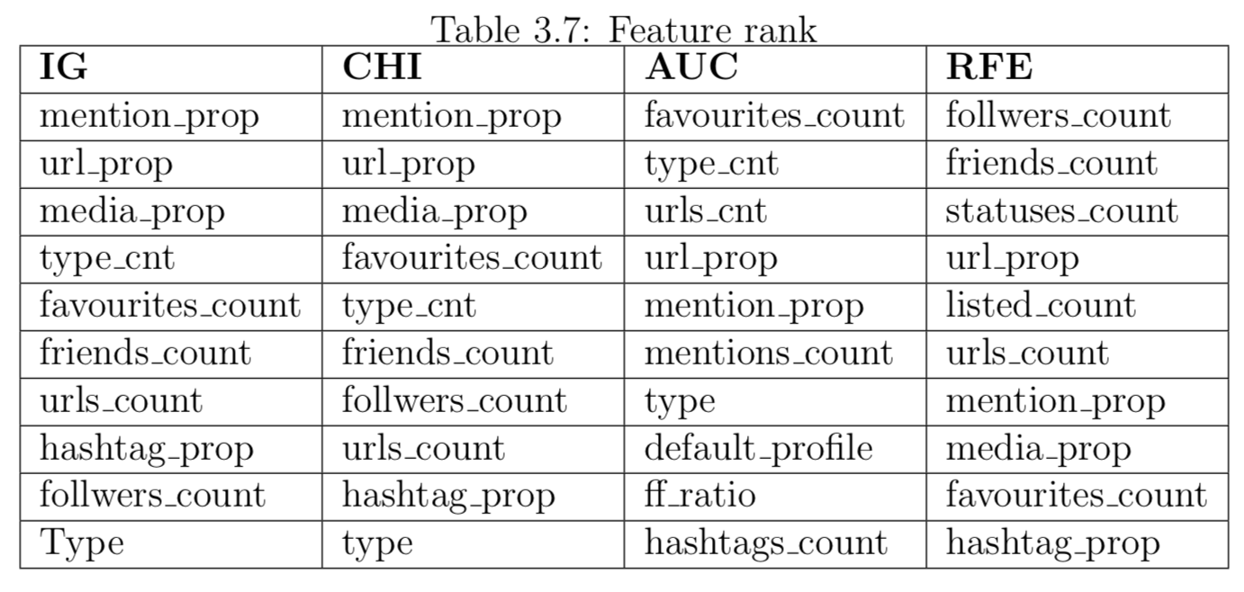
Experimental Results
Notes:
An in-depth study of the significance of different features are carried out as well.
the top 10 features selected via different evaluation methods are shown in Table \ref{table3.7}. It is to be noted that the focus is to extract the top ranking features. Hence, the relative quantitative performance is not shown.
The results show that most of the indirect features are more efficient in detecting low-quality content then direct features. This is because the indirect features also take the posting history of a user into consideration. Among all the features, mention\_prop, url\_prop and favourites\_count are selected by all four feature evaluation methods.

Slide 15
Detection Performance
Different feature subsets
Notes:
I further carry out the experiments using different feature subsets. It is observed from Table 3.8 that …
Setting
Dell Precision T3600 PC with Intel Xeon E5-1650 processor at 3.20 GHz and 16 GB of RAM
14.55Mbps download speed and 14.49Mbps upload speed
Time performance
Total time = Processing time + Response time
Direct features: 3.00 x 10⁻⁵ s + 0
Indirect features: 3.00 x 10⁻⁵ s+2.3s
The processing time for indirect features is negligible compared to the request time for indirect features

Slide 16
Detection Performance
Comparisons with other methods
Blacklists
Twitter policy
Two months later, 4.93% of low-quality content is still there
Other spam/phishing detection methods
Notes:
Comparisons with Other Methods
Blacklists
There is always a time lag between the occurrence of these content polluters and the report to the blacklists
Most of the blacklists focus on phishing or malware which are only small parts of content polluters.
Twitter
Only 77% of spam accounts detected by Twitter are suspended in one day of their first post.
The author checks the low-quality content’s status two months later, and 4.93% of them are still there.

Slide 17
Summary of Contributions
The author defines low-quality content based on preliminary studies.
The author crawls and manually labels 100,000 tweets to build a dataset.
The author provides an in-depth study of the features used for low-quality content detection.
The author provides a word level analysis and builds a keyword blacklist dictionary to facilitate low-quality content detection.
The author applies traditional classifiers (SVM and random forest) based on the proposed dominant features as well as word features for real-time low-quality content detection and it achieves a high accuracy and F1 measure as well as good time performance.

Slide 18
Outline
Background Introduction
Real-time Low-quality Content Detection Framework from the Users' Perspective
Unsupervised Rumor Detection Model based on User Behaviors
Leveraging Social Media News to Predict Stock Index Movement Using RNN-Boost
Conclusions and Future Work

Slide 19
Motivation
Rumors carrying misinformation will cause severe harm especially under some emergent situations considering the outreach and propagation speed of OSN.
Most of the previous research work treats rumor detection as a classification task while rumors only account for a small proportion.
Most of the previous research work just considers the overall differences between rumors and normal posts but not the behavioral differences among users.
Crowd wisdom is not given enough attention when detecting rumors.
Notes:
Here I list the 4 motivations but the most important one is the first one.

Slide 20
Literature Review
Definition of rumors
a piece of information which is false
a controversial and fact-checkable statement in circulation
Theories related to rumors
User behaviors
Propagation
Sentiment polarity
Prevalent detection methods
Classification
Anomaly detection
Notes:
Talking about rumors, there are actually two mainstream opinions about the definition of it. Some …, others …
In this thesis, I favor the latter definition as it is consistent with the definition in social psychological field and the explanation in major dictionaries. In other words, a rumor can be verified as genuine fact or debunked as fake news when referring to some authoritative sources later.
Rumors later proved to be misinformation definitely cause more harm than those verified as genuine facts. Thus, the focus of this work is put on the detection of misinformation or fake news. In the later sections, the term ``rumor'' shall be used to refer to actual rumors for convenience. On the other hand, for those rumors which turn out to be true, they are referred to as genuine facts or non-rumors.
Although traditional classifiers are most commonly used for rumor detection task. Considering that rumors only account for a small percentage of all posts, the dataset can be extremely imbalanced which would have a negative effect on the detection performance. Therefore the author proposes to apply anomaly detection method instead of classification.

Slide 21
Basic Concepts
Sina Weibo is one of the biggest social media platforms and can be regarded as an equivalence to Twitter in China. Weibo literally means microblog and is equivalent to a tweet.
$w$ is used to denote a Weibo (microblog) posted by a user $u_{w}$
$S_{w,k}=\{w_{1},w_{2},…,w_{k}\}$ is called a recent Weibo set regarding Weibo $w$ with the parameter $k$. Assuming the Weibo is posted at time $t$, then $S_{w,k}$ represents the recent $k$ Weibos of user $u_{w}$ before $t$. Note that ${w\text{∈}S}_{w,k}$(i.e. $w=w_{1}$)
Notes:
Before I move on the overview of the proposed model, I’d like to introduce some basic concepts first.

Slide 22
Overview of the proposed rumor detection model
Figure 4.4.1： Overview of the proposed rumor detection model
Notes:
To illustrate the procedures and performance of the proposed model, experiments are carried out on Sina Weibo. Since Sina Weibo implements many common features of OSN, the model can be applied to other OSN with little refinement needed. Fig. \ref{fig4.4.1} shows the overview of the proposed learning model for rumor detection comprising two phases, namely, feature extraction and learning model.
For a suspicious Weibo submitted to the system, the system refers to the profile of its author and crawl a set of recent Weibos posted by the author. In the feature extraction phase, each Weibo in the recent Weibo set is represented by the features extracted from itself and its corresponding comments. In the learning phase, comment based features (i.e. time dependent features) of the recent Weibo set will be first input into the RNN module to be analyzed over time as comments arrive at different time. The output of the RNN module is then combined with those Weibo based features (i.e. time independent features) and forwarded to the variant AE as an input. The variant AE then learns the normal behavior patterns of the author. Finally, the errors between the input and output of AE are calculated to perform anomaly detection and a Weibo with a larger error usually indicates a high possibility of an anomaly (i.e. rumor).

Slide 23
Data Collection
2,325 non-rumors are collected from public timeline
1,257 rumors are collected by the crawler from Weibo Community Management Centre
In total 167,731 Weibos are collected including both rumors and non-rumors with their recent Weibo sets and 1,501,472 comments.
Notes:
To carry out the experiments,
xx

Slide 24
Proposed Features
Notes:
Table 4.1 and Table 4.2 list the Weibo based features and comment based features respectively. These features are proposed inspired by previous research in social psychology field.
For example, …

Slide 25
Recurrent Neural Networks
Notes:
Recurrent neural networks are employed to process the comments of Weibos.
RNN are regarded as recurrent because they perform the same task for every element in a sequence and the current output depends on the previous computations. In RNN, connections between units form a directed cycle.
The RNN used in the model is a traditional one so I will just skip the details here.
(A recurrent neural network (RNN) \cite{lipton2015critical} is a feed-forward artificial neural network in which connections between units form a directed cycle. This builds an internal state of the network allowing it to exhibit dynamic temporal behavior. The reason that the author would like to observe the temporal behaviors is because the propagation pattern of rumors and non-rumors tend to be different. In other words, other users who read the posts respond differently over time depending on whether the original post is a rumor or not.
the proposed one-hidden-layer RNN module is formalized as follows (see Fig. \ref{fig4.4.2}(a)): given an input sequence $\{\bx_{1},\ldots,\bx_{T}\}$, the hidden states $\{\bh_{1},\ldots,\bh_{T}\}$ are updated at every time step so as to generate the outputs $(\bo_{1},\ldots,\bo_{T})$.
$\bh_{t}$ is the hidden state in the $t$th time slot and can be regarded as the ``memory'' of the network. $\bh_{t}$ is calculated based on the previous hidden state and the input at the current step. Similarly, $\bo_{t}$ is the output vector. $\bh_{t}$ and $\bo_{t}$ are calculated using Formula \ref{formula2} in which $U_R,W_R,V_R$ are the input-to-hidden, hidden-to-hidden, hidden-to-output parameters respectively. When training the parameters the errors between $\bo_t$ and $\bx_{t+1}$ are calculated since it is expected that the output at step $t$ would learn the influence of the comments in the previous time slots and predict the result in the next slot. )

Slide 26
Group Comment Features
The time range between the first and last comment of the Weibo is first calculated, then the time period is divided into T time slots equally.
Each w has T sets of comments $\{C_{t}, t=1,2,…,T\}$
In the RNN module, the input value of the tth time slot $x_{t}=(x_{t,1},$ $x_{t,2},…,x_{t,m})$ is a m-vector. $x_{t,i}$ denotes ith comment based feature calculated at time slot t, by applying function g(·) on the comments in $C_{t}$ using
Notes:
Then I would like to introduce about how to feed the comment features into RNN?
The function g(·) describes the general characteristics of all the comments falling into the same time slot. Functions like sum and mean are tested and they perform similarly. In the proposed model, the mean function is selected for the following experiments.

Slide 27
Autoencoder
Notes:
The output of RNN is combined with Weibo based features so as to input into an AutoEncoder. One of the most important features of AE is that the target values are set to be equal to the inputs. However, in the proposed model, when combining RNN and AE, some changes are made.
(An AutoEncoder (AE) \cite{rumelhart1993learning} is an artificial neural network used for unsupervised learning of efficient codings, i.e. setting the target values to be equal to the inputs. Considering the characteristics of AE, it can be used for anomaly detection \cite{sakurada2014anomaly}. Data experience a dimension reduction process in the hidden layer of AE and in this subspace, normal data and anomalies appear significantly different \cite{chandola2009anomaly}.
The details of the proposed one-hidden-layer AE module can be seen in Fig \ref{fig4.4.3}. An Autoencoder takes an input $\bX$ and first maps it (with an encoder) to a hidden representation $\bH$ through a deterministic mapping. The hidden value $\bH$ is then mapped back (with a decoder) into a reconstruction $\bO$ of the same shape as $\bX$. The mapping happens through a similar transformation. The input data $\bX$ is a matrix in the experiments, where the rows of $\bX$ denote different Weibos and the columns of $\bX$ represent different features. The following formula concludes the calculation process in which $W_{A},b$ and $V_{A},c$ are the input-to-hidden and hidden-to-output parameters respectively.)

Slide 28
Combination Model of RNN and AE
Target value:
Notes:
Figure 4.4 shows the details of the combination model of RNN and AE.
The input of AE is the combination of the output of RNN and the Weibo based features. And I use the input of RNN instead of the output to combine with the weibo based features as the target value. This is because during the RNN process, there are already accumulated errors. It is more meaningful to set the target value as the observed values instead of the predicted ones. The improvement of a variant AE from a standard one is demonstrated in experiments which will be discussed later.
Note that if all the recent Weibos have too few comments (less than 2), the model cannot learn the crowd wisdom from so few comments. To speed up the model, the whole RNN module is pruned and $\bX=\bY=\bX^w$. In other words, under the situation of too few comments, the model only takes into consideration of Weibo based features

Slide 29
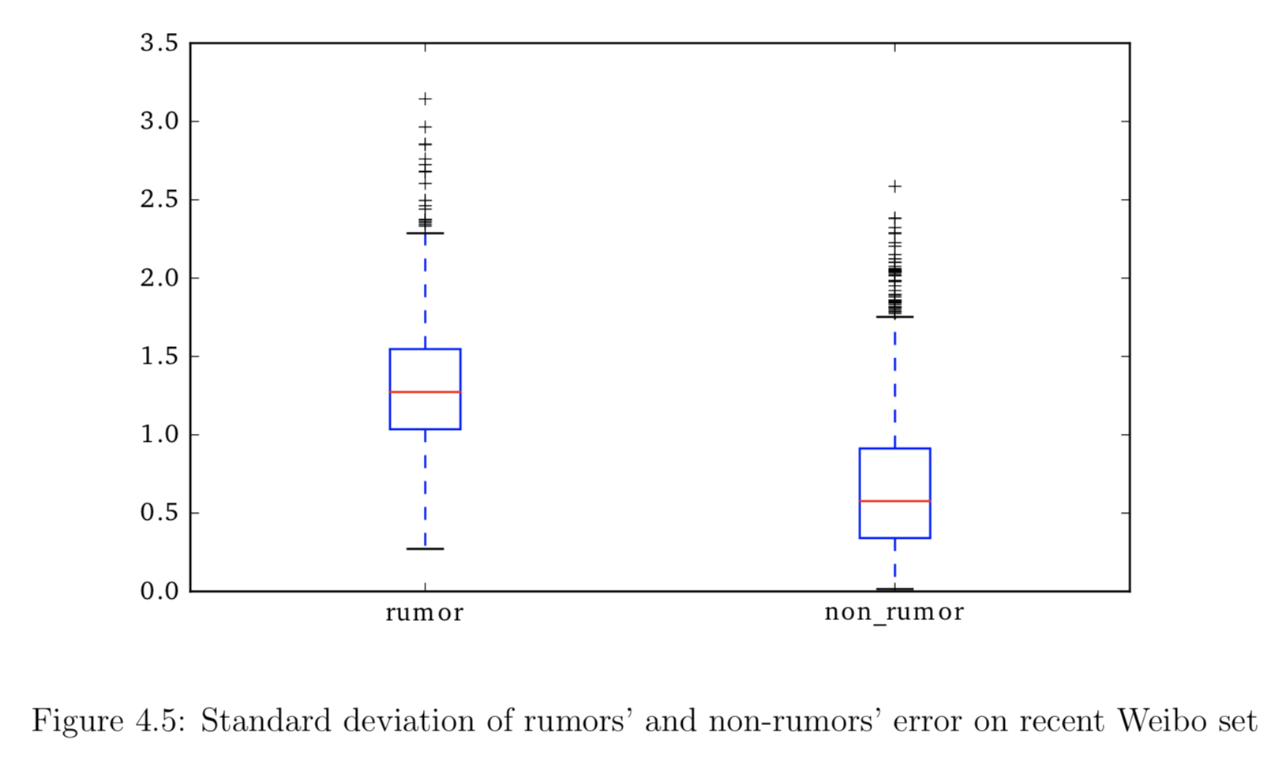
Rumor Detection
Using the Euclidean norm, the reconstruction error for the $j$th Weibo in a recent Weibo set can be calculated by:
${Err}_{i,j}=||O_{i,j}−Y_{i,j}||$₂.
Self adaptive threshold:
$${threshiold}_{i}={md}_{i}+max⁡(1,{sd}_{i})$$
Then the label of the original Weibo is predicted as follows:
$$\text{isRumor}\text{=}\left\{\begin{aligned}1, {Err}_{i,1}>{threshold}_{i} \\ 0,{Err}_{i,1}\text{≤}{threshold}_{i}\end{aligned}\right.$$
Notes:
To perform rumor detection, construction errors are calculated using Euclidean norms and a self-adaptive threshold is defined. If …
The author further draws the box plot of all the standard deviations of the errors based on rumors and non-rumors in Fig \ref{fig4.5}. It turns out that for non-rumors and their recent Weibo sets, the standard deviations of the errors are smaller and most of them are less than 1. Therefore, by substituting $sd_i$ with $\max(1,sd_i)$ the false positives of the model are reduced.

Slide 30
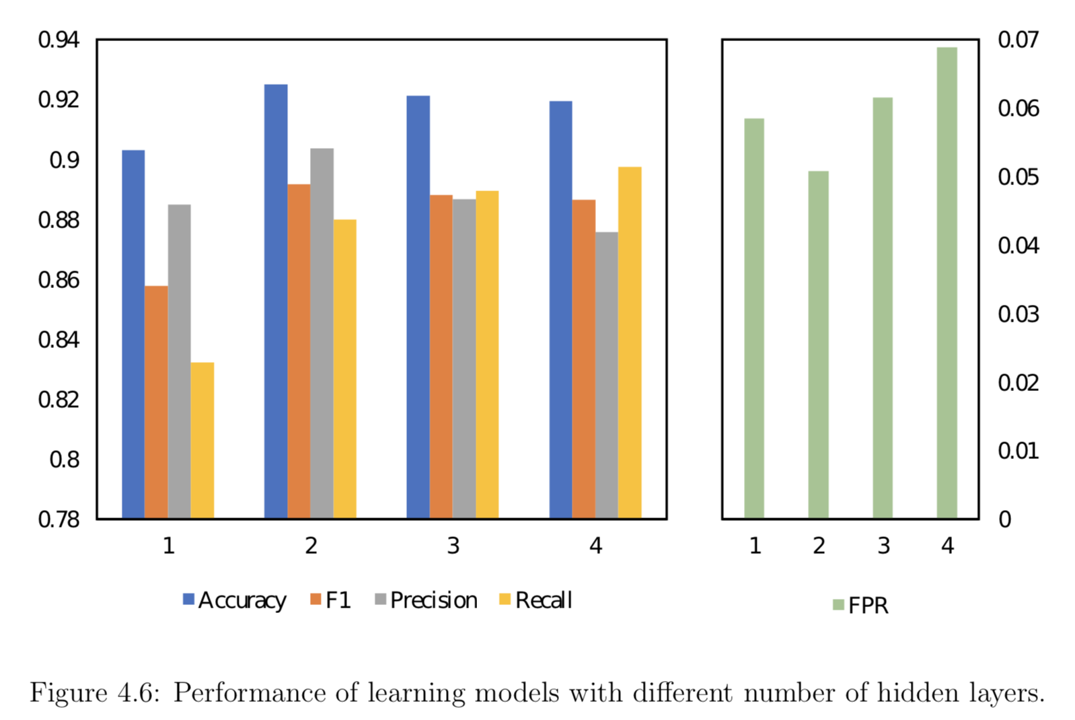
Results and Comparisons
Notes:
both one- and multiple-hidden- layer learning models are implemented to compare their detection performance. The detection results with different number of hidden layers are shown in Fig 4.6. It is observed that a 2-hidden-layer learning model achieves a best result.

Slide 31
Results and Comparisons
Notes:
Comparisons with other methods are also provided. The first 4 rows are methods from previous work. The last 3 rows show the results of the variant of our methods. our-ind indicates the proposed model in this chapter. Our-sae adopts a standard AE instead of a variant in the proposed model. Our-agg builds an aggregated model for all users instead of building individual models for individual users.

Slide 32
Summary of Contributions
The author exploits crowd wisdom based on proposed comment features to perform rumor detection on OSN.
The author further uses RNN to study the comment based features over time.
The author treats rumor detection as an anomaly detection task and for the first time adopts Autoencoder to detect rumors on OSN.
The proposed model is unsupervised and thus does not need labeled data which makes it especially useful when rumor data are difficult to obtain for training.

Slide 33
Outline
Background Introduction
Real-time Low-quality Content Detection Framework from the Users' Perspective
Unsupervised Rumor Detection Model based on User Behaviors
Leveraging Social Media News to Predict Stock Index Movement Using RNN-Boost
Conclusions and Future Work
Notes:
Next I am going to introduce the third piece of my work which is xx

Slide 34
Motivation
Most of the previous work have used text content from Twitter to predict the U.S. stock market while not so much attention is paid to the Chinese stock market for similar research purpose.
In addition, many of the previous work either focuses on the news only or public moods based on tweets crawled from public timelines without any preprocessing.
Lastly, popular sentiment analysis dictionary is not feasible to measure the sentiment of the stock investors.
Notes:
Another important motivation which is not listed here is that Nassirtoussi et al. and Garcke et al. report that a prediction accuracy above 55% can already be considered as a report-worthy result, which the author believes, is still far from satisfactory.

Slide 35
Literature Review
Feature engineering in financial prediction
Technical analysis
Experts analyze charts which reflect the values of technical indicators land there exist visual patterns in the market charts.
Technical indicators include closing price, highest price, lowest price, volume, etc. Technical rules include moving average rules, filter rules, relative strength rules, etc.
Fundamental analysis
3 levels： economic analysis, industry analysis and company analysis
bottom-up analysis and top-down analysis
main sources of traditional fundamental data
Algorithms and Models
Binary classifier: Logistic, Support Vector Machine, ANN, etc.
Regression: Linear Regression, Support Vector Regression, etc.
Notes:
Talking about financial market prediction technical analysis and fundamental analysis are frequently used for prediction purposes. Binary classifiers like xx are used to predict the movement direction while regression models like xx are used to predict the real values of the financial markets.

Slide 36
Overview of the Model
Figure 5.1: Overview of the proposed model.
Notes:
According to previous work, public moods have a significant influence on stock market. To quantify public moods, the author proposes to analyze the news content posted on social media by official accounts. These official accounts usually have a large number of followers which means the content they post can have a huge outreach. In this work, the author carefully selects official accounts from the Chinese largest online social website - Sina Weibo and collects their posts.
Thereafter, LDA features are computed and sentiment analysis is performed. LDA features and sentiment features are together called content features. These content features are combined with other technical features calculated based on historic stock data and then input into the RNN with Gated Recurrent Units (GRU) to predict the stock price. The errors between the predictions and the real values are calculated so as to adjust the weights of the different training samples and then input into the next RNN for the next round of training. The boosting process is adaptive in the sense that subsequent RNN models are tweaked in favor of those samples wrongly predicted by the previous RNN models. In the end, the final prediction is combined using the weighted median to represent the final output of the boosted RNN, that is, the prediction for the stock index price of the next day. With this predicted output, the model is also able to predict the movement direction of the stock (i.e. whether the stock price goes up and down) of the next day.
The overview of the proposed hybrid model can be seen in Fig \ref{fig5.1}. This model can be easily adapted to predict the stock index of other financial markets as long as the news content posted on social media can be obtained. The equivalence of Sina Weibo in this work is Twitter.

Slide 37
Data Collection
History data of stock market index (CSI)
1 Jan 2015 to 14 Feb 2017 (513 trading days)
News content from OSN
95 famous blue verified accounts （e.g. national newspapers, provincial newspapers or magazines, famous TV news programs shown in CCTV and popular financial newspapers or magazines）
808,283 Weibos posted by these accounts are collected
Preprocessing to filter irrelevant greetings, jokes, etc
Notes:
As is stated in the motivation section, the purpose of this work is to predict the Chinese stock market. Therefore, to carry out the experiments, the Chinese Stock Index (CSI) from 1 Jan 2015 to 14 Feb 2017 are collected from Yahoo Finance. CSI is used to reflect the price fluctuation and performance of 300 stocks traded in the Shanghai and Shenzhen stock exchanges.
To utilize the content features which facilitate CSI prediction, Sina Weibo is chosen as the source of the needed news content. Sina Weibo is one of the most popular OSN in China which has about 351 million active users by September 2017 \cite{LeadingSNS2017}. Sina Weibo is often regarded as an equivalence of Twitter in China because they both have many common OSN features with respect to users and posts. This makes it possible for the application of the proposed hybrid model to be migrated from one platform to another.
Before introducing the data collection process, the author would introduce more details about the account system of Sina Weibo. All users are able to register a normal account with Sina Weibo. With the normal accounts, the users are able to view, share and write posts. To increase the influence of posts or attract more followers, it is possible for the normal users to request verification of their accounts from Sina Weibo. There are different types of verified accounts and what should be emphasized here is the blue type verified accounts. Entities behind blue type accounts are usually verified organizations including companies, institutes, media, etc. Once the organization clears the verification process, a blue ``V'' will be added behind their user names.
In this work, the author collects news content from the Weibos posted by the blue verified accounts. In total, 95 famous blue verified accounts under media categories are selected. These accounts usually have a large number of followers (i.e. more than 90k), ranging from National newspapers, provincial newspapers and magazines to famous TV news programs shown at national TV channels. Most of these accounts post general news and only a small portion focuses on financial related news. The reason the author does not only choose financial news agencies is because the impact of news on the stock market is usually latent. As such, political news and sometimes even the rumors of celebrities would affect the stock market. In total, 808,283 Weibos posted by these accounts are collected during the time period mentioned before.
To avoid losing followers, these verified accounts sometimes also post jokes, greetings, etc. apart from pure news. To filter these non-news content, a filter is implemented to sieve out those Weibos using particular keywords and symbols (e.g. good morning, humor of the day and so on). Some news content might be mistakenly deleted in the preprocessing step. However if the news is significant enough, it is highly possible that it would be posted by other accounts without all being filtered out.

Slide 38
Feature Engineering – Technical Features
Notes:
Table 5.1 list the technical features used in the proposed model.

Slide 39
Feature Engineering – Content Features
Sentiment features
Suppose there are $n_{i}$ pieces of news content collected in day i, the sentiment feature of each Weibo is denoted as${ v}_{j},j=1,2,…,n_{i}$, the overall sentiment feature of the day can be calculated as follows
$$V_{i}=\frac{1}{n}\sum_{j=1}^{n_{i}}{v_{j}}$$
Notes:
Apart from the technical features, features extracted based on content are also considered. Let’s talk about sentiment features first.
xx

Slide 40
Feature Engineering – Content Features
Calculate the priori probability of every keyword $w_{i}$ for each class as follows.
$$P\left(w_{i} | c\right)=\frac{1}{{total}_{c}}\sum_{j=1}^{n_{c}}{count(w_{i},m_{j})}$$
Calculate the likelihood of the Weibo falling into each class
$P\left(m∈c\right)=P(c)\prod_{i=1}^{n_{m}}{P(w_{i}|c}$)
$p(c)$is the prior probability of class $c$ and in our case
$$p\left(c_{1}\right)=\frac{{total}_{c_{1}}}{{total}_{c_{1}}+{total}_{c_{2}}}$$
The sentiment score of Weibo m is
$$v_{m}=\frac{p(m∈c_{1})}{p\left(m∈c_{1}\right)+p(m∈c_{2})}$$

Slide 41
Feature Engineering – Content Features
LDA features
The Latent Dirichlet Allocation (LDA) is an implementation of the topic model. Suppose there are m topics in all news content which is denoted as ${topic}_{l},l=1,2,…,m$. The overall probability of news content in day i for ${topic}_{l}$ is calculated as follows:
In this work, Python Library scikit-learn is used to calculate the LDA features with online variational Bayes algorithm. Each row of the output matrix represents a topic vector of a Weibo. Each element in the vector represents the probability of the Weibo belonging to the specific topic, from which $p(i,{topic}_{l})$is then calculated.
Notes:
Then let’s move on to LDA features.

Slide 42
Recurrent Neural Networks (RNN)
It is difficult for traditional RNN to learn long-term dependencies.
Notes:
RNN are frequently used in time series forecasting tasks. The structure of the one-hidden-layer RNN is shown in Fig \ref{fig5.2}.
Theoretically, RNN are able to learn information in arbitrarily long sequences. However, they are only able to look back a few steps in actual practice due to the vanishing gradient problem which makes it difficult to learn long-term dependencies. Grated Recurrent Unit (GRU) is then proposed to tackle the issue by employing a gating mechanism. Fig \ref{fig5.3} shows the simple structure of a GRU unit.

Slide 43
Grated Recurrent Unit (GRU)
Notes:
This is a typical GRU unit. So I wouldn’t go into details about it.
($r_t, z_t$ are respectively the reset and update gates in GRUs. The reset gate determines how to combine the new input $x_t$ with the previous memory $h_{t-1}$ in computing $s_t$. $s_t$ can be regarded as a ``candidate'' hidden state. The calculation of $h_t$ uses the update gate $z_t$ to define how much of the previous memory to keep. The following equations are used for calculating a GRU hidden unit:
in which $\sigma(x)$ is a hard sigmoid function and $\odot$ denotes component-wise multiplication.
In the experiments, the author applies a two-hidden-layer GRU module to capture the higher-level feature interactions between the different time steps. The units in the second hidden layer are calculated similarly as in the first hidden layer. )

Slide 44
Training the model
Training data of RNN: $x_{i},i=1,2,…,n$, $x_{i}$ is a feature vector of day $i$
Target values of RNN: $y_{i},i=1,2,…,n$,$y_{i}=\frac{C_{i}}{C_{0}}−1$, $C_{i}$ is the closing price of day $i$
The model uses the data in $t_{0}\sim t_{m−1}$to train the GRU parameters and predicts the dependent data in $t_{m}\sim t_{n}$. In the second phase, the GRU parameters are updated after a new prediction is made.
The historic data of previous $s$ days are used to predict the stock price of the next trading day. the prediction $y_{i+1}$ is computed based on the updated parameters after $x_{i}$and $y_{i},i=t−s,…,t−1$are input into the GRU module for training.
Notes:
What is worth mentioning here is that the closing price is not directly used as the target value because it fluctuates dramatically making it more difficult to predict. Instead, the dependent variable is computed as $y_i = C_i/C_0-1,i=1,\ldots,n$, where $C_0,\ldots,C_n$ are the closing prices of CSI.

Slide 45
AdaBoost
(weighted median)
Notes:
Adaboost is the abbreviation for ``adaptive boosting''. It is often combined with other learning methods to improve the accuracy. The earlier version of Adaboost is conjuncted with a decision tree and works as an ensemble classifier. Later, Drucker proposed an Adaboost regressor which is known as Adaboost.R2 so that it can deal with regression problem \cite{drucker1997improving}.
In boosting process, estimators (i.e. learning methods) are trained sequentially. Generally, training data are input into the first estimator and those data samples whose predicted values differ most from the observed values will be noted. The weight of these data samples are then increased when they are input into the second estimator. The weight (i.e. coefficient) of the estimator is also calculated based on its overall errors. In the end, the output of the final model is combined using the weighted median, whereby predictors with more ``confidence'' are weighted more heavily. An overview of the Adaboost.R2 algorithm can be seen in Fig \ref{fig5.4}.

Slide 46
RNN-Boost

Slide 47
RNN-Boost

Slide 48
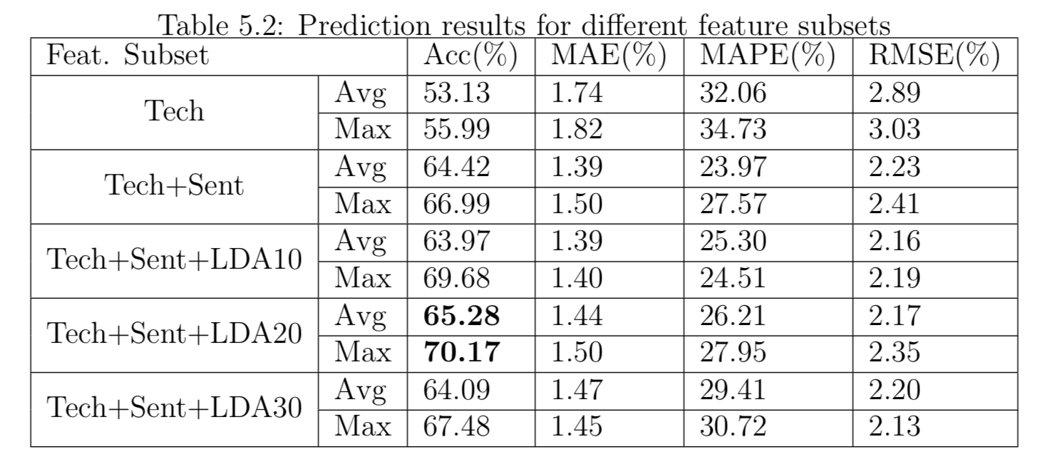
Results and Comparisons
Notes:
Table 5.2 shows xx
It is observed when only using the technical indicators, the average accuracy is only about 53%. However, when sentiment features are incorporated, the average accuracy increases significantly to 66.99%.
I also test the performance of adding LDA features. Different number of topics are considered and some representative results are shown here in Table 5.2 It is observed that when setting number of topics as 20, the model achieves the best results.

Slide 49
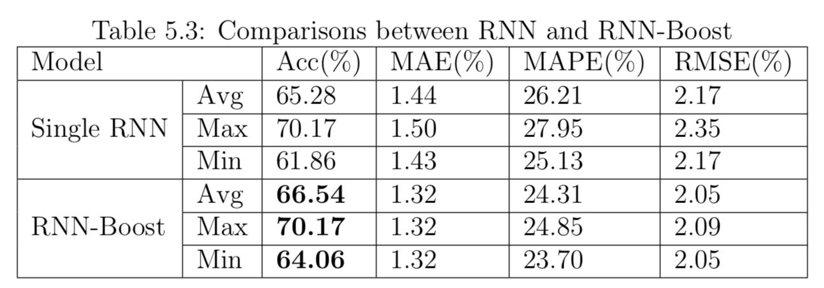
Results and Comparisons
Notes:
Table 5.3 shows xx

Slide 50
Results and Comparisons

Slide 51
Summary of Contributions
The author exploits news content from online social media instead of traditional news media for sentiment analysis to facilitate the prediction of stock index.
The author further proposes LDA features to improve the performance of the prediction model and combines them with sentiment features and other technical indicators.
The author, for the first time, proposes a hybrid model incorporating RNN and Adaboost to predict stock index and experiments show that the proposed model can achieve a good prediction performance.
Notes:
Contributions of this work are listed as follows:

Slide 52
Outline
Background Introduction
Real-time Low-quality Content Detection Framework from the Users' Perspective
Unsupervised Rumor Detection Model based on User Behaviors
Leveraging Social Media News to Predict Stock Index Movement Using RNN-Boost
Conclusions and Future Work
Notes:
This thesis discusses the good and bad aspects of OSN and how to break the 'curse' while enjoying the 'blessing'. The focus is on the mining of OSN to improve anomaly detection and prediction accuracies with use cases.
The following two chapters present details on how to combat the potential issues caused by OSN which address the use cases, namely, low-quality content detection and rumor detection respectively.
Chapter 5 gives an example of utilizing the content collected from OSN to boost the accuracy of predictive analytics using stock market index prediction as the use case. The last chapter concludes the whole thesis and provides directions for future work.

Slide 53
Conclusions
Content Detection
Real-time Low-quality Content Detection Framework from the Users' Perspective
Unsupervised Rumor Detection Model based on User Behaviors
Prediction
Leveraging Social Media News to Predict Stock Index Movement Using RNN-Boost
Notes:
This thesis discusses the good and bad aspects of OSN and how to break the `curse‘ while enjoying the `blessing’. The focus is on the mining of OSN to improve anomaly detection and prediction accuracies with use cases. I first present details on how to combat the potential issues caused by OSN which address the use cases, namely, low-quality content detection and rumor detection respectively. Then I give an example of utilizing the content collected from OSN to boost the accuracy of predictive analytics using stock market index prediction as the use case.

Slide 54
Future Work
Low-quality content detection
A more customized content filter for disinterested content on OSN
Malicious users/communities detection as well as their campaigns
Rumor detection
Predict the influence of rumors
Dampen the impact of rumors
Stock movement prediction
Feature engineering on more advanced technical indicators
Incorporate syntax analysis and other advanced NLP techniques
Focus on single stock prediction
Notes:
For future work, I would like to introduce them separately according to the 3 pieces of work introduced today.

Slide 55
Future Work - Other Research Directions
Astroturf campaign detection
Astroturfing is a tactic to simulate grassroots support for a message or organization (e.g. political, advertising, religious or public relations) with the purpose of shaping public opinions.
Terrorism/crime anticipation
Help improve public security and reducing potential loss caused by crimes or terrorism attacks
Exploit the geospatial and demographic information of tweets
Mental disorder pre-diagnosis
Early diagnosis of severe mental disorder help the families and doctors to take actions immediately to prevent potential tragedies.
Sentiment and semantic analysis
Notes:
Some other research directions are also listed here. For example, xx
These topics further extend the research presented in this thesis with an intention of maximize the benefits brought about by OSN and minimize the negative effects they may cause.
(\item \textbf{Astroturf campaign detection.} Astroturfing is a tactic to simulate grassroots support for a message or organization (e.g. political, advertising, religious or public relations) with the purpose of shaping public opinions. This research topic can be regarded as an extension to content polluter and rumor detection. Astroturfing cannot be classified as either a content polluter or a rumor. The astroturfing messages may carry true information which makes it even more difficult to detect. One possible research direction is to study the spread pattern of astroturf campaigns and propose relevant features to distinguish them from the normal posts. With a model which is able to detect astroturf campaign automatically, it alleviates the possibility of regular users being deceived by plausible content which is delicately designed for astroturf campaigns and makes it possible for these users to keep neutral about particular topics instead of being manipulated by some stakeholders.
\item \textbf{Terrorism/crime anticipation.} It plays a significant role in improving public security and reducing potential loss caused by crimes or terrorism attacks. A more specific use case would be finding street gang members on Twitter. Many street gang members intimidate others through Twitter and sometimes even share recent illegal activities \cite{balasuriya2016finding}. Therefore, tweets posted by these gang members are useful for predicting potential crimes and to prevent them in advance. In addition, the geospatial and demographic information of tweets can help trace the criminal route and even locate the criminals in the end.
\item \textbf{Mental disorder pre-diagnosis.} Recently, with the fast development of the society, more and more people suffer from mental disorders. Some patients with severe depression may even commit suicide which cause much pain and loss to their friends and families. Instead of talking to others, some of the patients are more willing to post their feelings on OSN. It is very meaningful to propose a framework which is able to detect suicide tendency using sentiment and semantic analysis based on the tweet posts. Early diagnosis of severe mental disorder help the families and doctors to take actions immediately to prevent potential tragedies. )

Slide 56
Author’s Publications - Journals
Weiling Chen ,Yan Zhang, Chai Kiat Yeo, Chiew Tong Lau, and Bu Sung Lee, “Leveraging social media news to predict stock index movement using RNN- Boost.”, Data & Knowledge Engineering (currently under revision).
Weiling Chen ,Yan Zhang, Chai Kiat Yeo, Chiew Tong Lau, and Bu Sung Lee, “Unsupervised rumor detection based on users behaviors using neural networks.”, Pattern Recognition Letters (2017).
Weiling Chen ,Chai Kiat Yeo, Chiew Tong Lau, and Bu Sung Lee, “A study on real-time low-quality content detection on Twitter from the users perspective.”, PloS One, no. 8 (2017): e0182487.

Slide 57
Author’s Publications - Conference
Julien Leblay, Weiling Chen ,Steven Lynden, “Exploring the veracity of online claims with BackDrop.”, in Conference on Information and Knowledge Manage- ment (CIKM), 26th ACM International, ACM, 2017.
Weiling Chen ,Yan Zhang, Chai Kiat Yeo, Chiew Tong Lau, and Bu Sung Lee, “Stock market prediction using neural network through news on online social networks.”, in Smart Cities Conference (ISC2), 2017 International, pp. 1-6. IEEE, 2017.
Yan Zhang, Weiling Chen ,Chai Kiat Yeo, Chiew Tong Lau, and Bu Sung Lee, “Detecting rumors on Online Social Networks using multi-layer autoencoder.”, in Technology & Engineering Management Conference (TEMSCON), 2017 IEEE, pp. 437-441. IEEE, 2017.
Yan Zhang, Weiling Chen ,Chai Kiat Yeo, Chiew Tong Lau, and Bu Sung Lee, “A distance-based outlier detection method for rumor detection exploiting user behaviorial differences.”, in Data and Software Engineering (ICoDSE), 2016 International Conference on, pp. 1-6. IEEE, 2016.
Weiling Chen ,Chai Kiat Yeo, Chiew Tong Lau, and Bu Sung Lee, “Behav- ior deviation: An anomaly detection view of rumor preemption.”, in Informa- tion Technology, Electronics and Mobile Communication Conference (IEMCON), 2016 IEEE 7th Annual, (pp. 1-7). IEEE. Las Vegas, Nevada, pp. 233-238, Jan 2015.
Weiling Chen ,Chai Kiat Yeo, Chiew Tong Lau, and Bu Sung Lee, “Real-Time Twitter Content Polluter Detection Based on Direct Features.”, in Information Science and Security (ICISS), 2015 2nd International Conference on, pp. 1-4. IEEE, 2015.

Slide 58
Thank you!
Q&A

